Slide 1
North Region
Milestones of growth of Shadow Parli, SMPs, SMLAs

Slide 2
Continuation of ENHF Vision in 2020
In the month of January 2019 Lord gave a Revelation called “Rise up & Build” (RUB)
RUB was a time bound plan which had to be completed in 2 months, February & March 2019

Slide 3
Rub meetings Held on @
?21st and 22nd March 2019
ZONE : South
State : Tamilnadu
Meeting level : Sapphire camp
Participants : 12

Slide 4
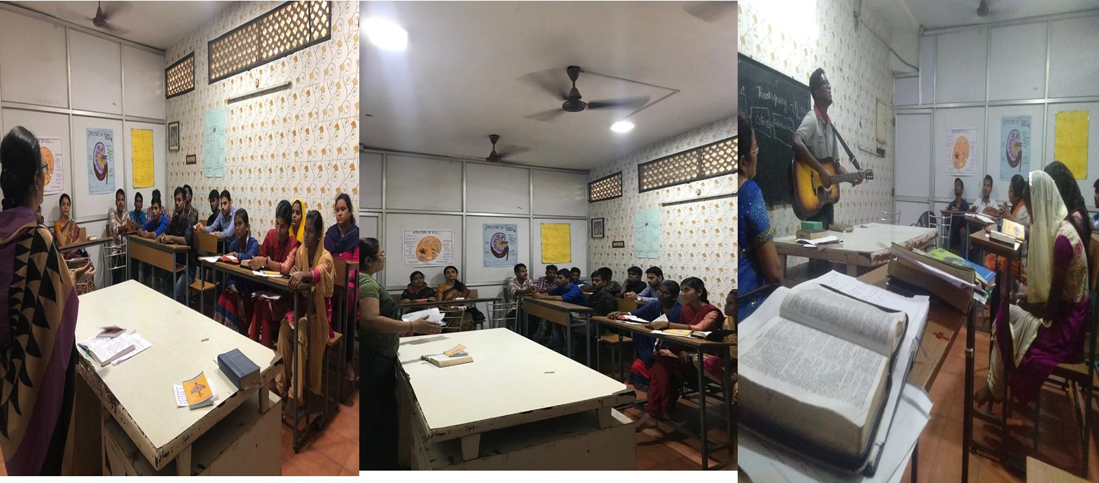
Rub meeting @
?29th and 3th March 2019
ZONE : South
State : Tamilnadu
Meeting level : Sapphire camp
Participants : 23

Slide 5
The AOJ Soldiers went to all the States to inherit the land as per Numbers 33:51-56.
Num 33:51-56 Speak to the sons of Israel and say to them, When you have passed over Jordan into the land of Canaan,
then you shall drive out all those who live in the land from before you, and destroy all their carved images, and destroy all their moulded images and pluck down all their high places.
And you shall possess the land, and live in it. For I have given you the land to possess it. And you shall divide the land by lot by your families. And you shall give the more inheritance to the many; to the few you shall give the less inheritance. Wherever the lot falls out to him; according to the tribes of your fathers you shall inherit. But if you will not drive out the people of the land from before you, then it will be, those of them whom you let remain shall be goads in your eyes and thorns in your sides, and they shall trouble you in the land in which you live. And it shall be, as I thought to do to them, so I shall do to you.

Slide 6
“Rise up & Build”
Inheriting the land - 5 steps
1. Curse breaking
2. Sanctifying & inheriting
3. Prophesying
4. Blowing the trumpets
5. Writing Laws

Slide 7
Rise up & Build
Family Get Together (RFGT)
25% districts of India were covered by RUB programme in 2 months time.
Lord asked us to come together for a thanksgiving RUB Family Get Together (RFGT) on April 6-7, 2019.
On that day Lord gave the Vision of Shadow Parli & SMPs. (highlight this point)

Slide 8
Shadow Parliament and selecting SMPs,
All AOJ soldiers were informed about this.
2Co 5:20 “Therefore, we are ambassadors for Christ, God making his appeal through us. We implore you on behalf of Christ, be reconciled to God”.
The Lord has given us a new strategy, unprecedented unheard and unimagined.

Slide 9
As per Revelations received by the Lord on 6.4.2019
AOJ members should be trained in Administration as well as Spiritual Guidance.
Administration refers to
Member of Parliament - M.P.,
Member of Legislative Assembly - M.L.A.,
Indian Administrative Service I.A.S.,
Indian Police Service I.P.S.,
Indian Foreign Service I.F.S.
Indian Revenue Service etc.
Spiritual guidance is Prophecy.

Slide 10
2. In all Administrative systems, there should be a PROPHET side by side to help them know the divine ways. They will exhort, edify, comfort, correct, admonish, warn and thus see the heavenly decisions implemented and that the administrators give primary importance to the guidance of the Holy Spirit.
Prophets should be able to get direct messages from God regarding administration.
In all the Constituences & State Legislative Assemblies, Prophets should be appointed.

Slide 11
"Even though Army of Jesus soldiers are not contesting the forthcoming elections, we shall select a member of the Army of Jesus for each Constituency of the Parliament, as per guidance of the Holy Spirit. He or She should act as shadow M.P. and work for transformed India 2020-2021”

Slide 12
Appointment of SMPs
Those who adopted the M.P. Constituencies were called SMPs (Shadow Member of Parliament.)
All the M.P. Constituencies were distributed by lots to those who came forward to adopt them.

Slide 13
Let us thank God for the opportunity He has given us
SMPs are Ambassador for Christ for that Constituency in heaven.
Each SMP is appointed for a period of 6 months. They Perform following duties:
a. Appealing & imploring on behalf of Christ to the people of constituency “Be reconciled to God”
b. Prophesy over this Constituency. Make decrees and declarations to this effect!
(few pictures of the Shadow Parli held in various States)

Slide 14
First batch SMPs appointed

Slide 15
(Add More Pics)

Slide 16
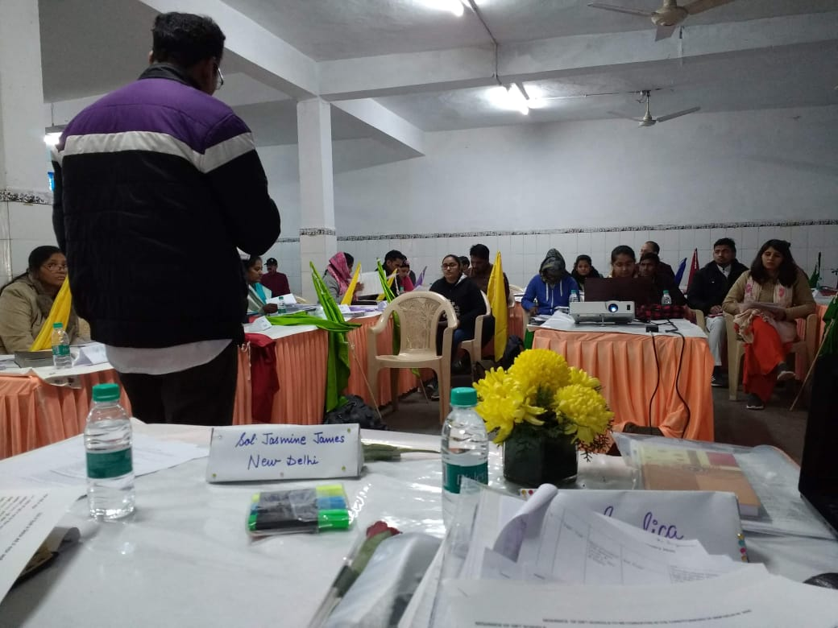
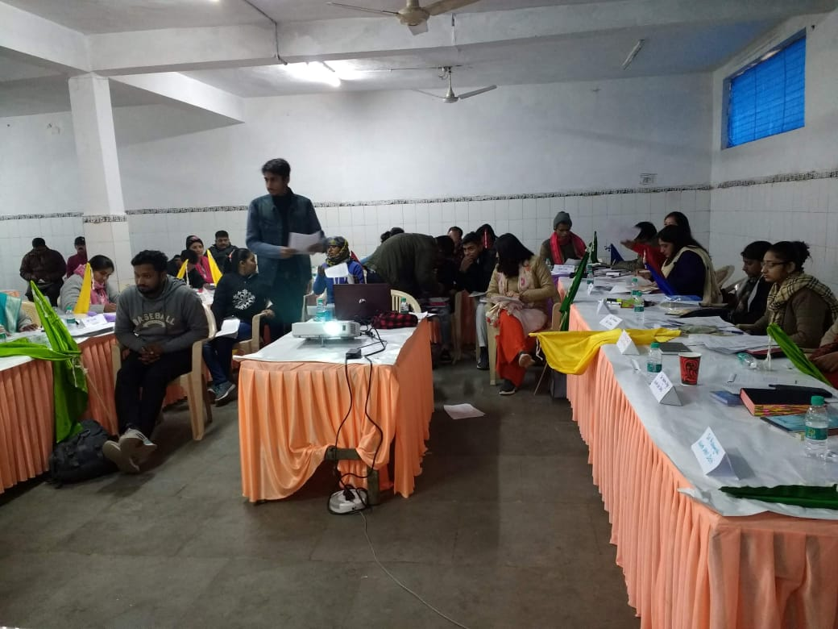
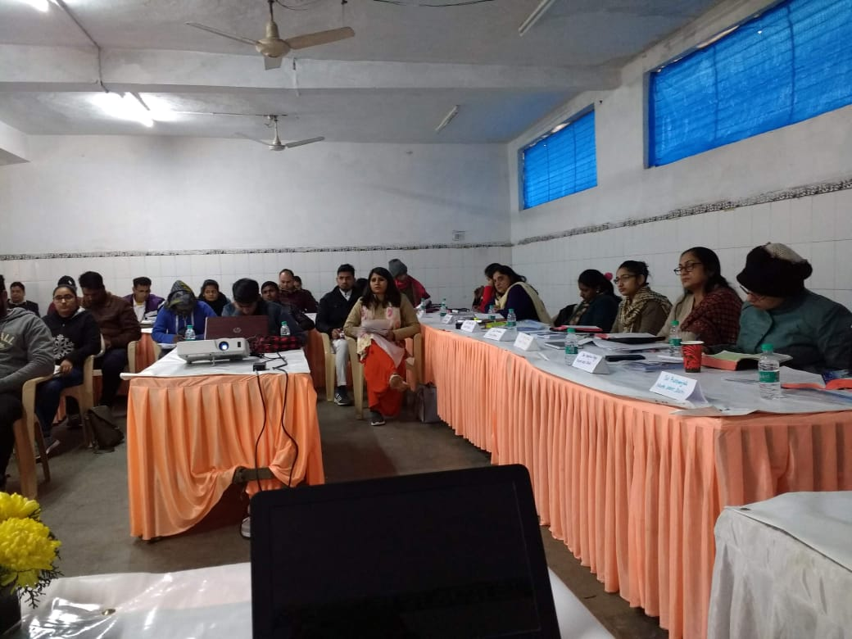
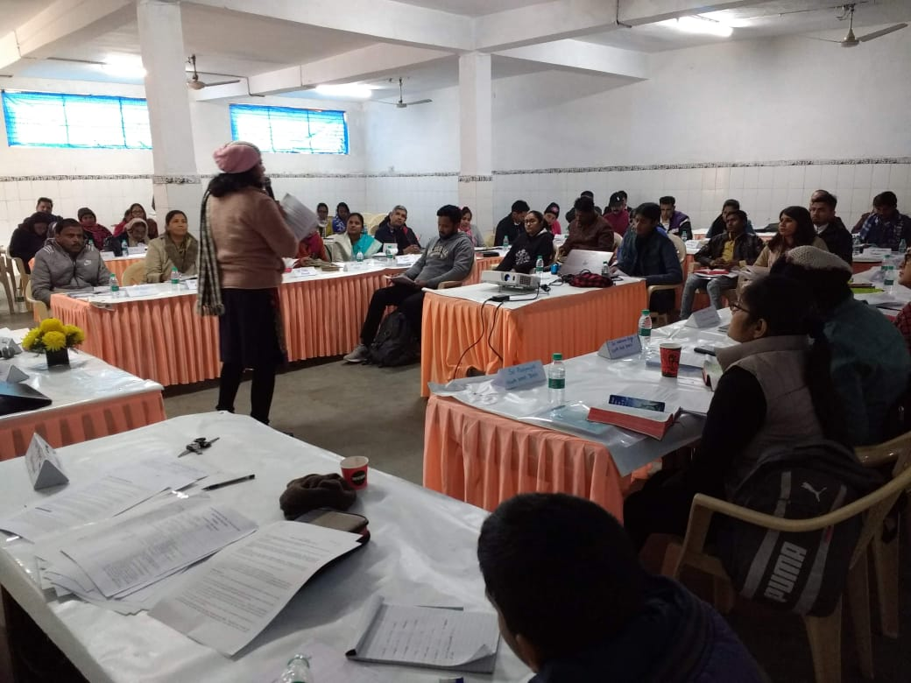
Shadow Parli North Region Jan 2020

Slide 17
Smps – Duties & Responsibilities 30.06.2019
The following are the duties of SMPs
1. Open a file in the name of the Constituency.
2. Take a survey of your Constituency.
a. Total Population( gender, language spoken, Religion etc),
b. Important places,
c. Taluks, villages,
d. Places of historical importance,
e. Flora & fauna of the area,
f. Places of religious, social, educational & geographical attraction,
g. languages spoken,
h. Religions followed by people,

Slide 18
i. Per capita income of the people,
j. Developments,
k. Opportunities of employment,
l. Main source of income for the people,
m. Infra structure,
n. Unpleasant things, (to be eradicated)
3. Conduct a monthly night prayer in your constituency. (Follow the format given). Invite reps from all taluks
4. Fill your constituency with Troop Churches
5. Conduct as many gift schools as possible
Shadow MPs will take an Oath

Slide 19
6. Select 30 people for prayer with fasting, from the constituency. Give 1 prayer point daily to pray. The points can come in rotation. Every day one person will be praying for the constituency. (From the centre, 30 prayer points should be sent every month.)
7. Visit their constituencies once a month (Can be during night prayer) – Ask all the Troop Church soldiers to be present there.
8. Attend all the meetings of Shadow Parli

Slide 20
Constituencies & SMPs- Haryana
Name of Name of Constituencies | Smp Appointed | Appointed on | Contact no
1.Ambala (SC) | Sol.Sonia | 10.07.2019
2 .Kurukshetra | Sol.Gracy John | 10.7.2019
3.Karnal | Sol.Usha | 10.7.2019
4 .Sonepat | Sol.Anjali | 10.7.2019
5 .Rohtak | Sol.Nirmala | 10.7.2019
6.Faridabad | Sol.Vinitha | 10.7.2019
7 .Mahendragarh | Sol Ajaypal | 10.07.2019
8.Bhiwani | Sol.Daisy David | 10.07.2019
9 .Hissar | Sol. Babita | 10.7.2019
10.Sirsa (SC) | Sol.Sonia D’ Souza | 10.7.2019

Slide 21
Constituencies & SMPs- (Add for every State)
Name of Name of Constituencies | Smp Appointed | Appointed on | Contact no
1
2
3
4
5
6
7
8

Slide 22
Heavenly Court- a breakthrough in the growth of Constituencies
Nov- Dec 2020 - Revelation about Heavenly Court was given
SMPs were taught how to take the appeals regarding Constituencies to the Heavenly court & win a favourable verdict &
How to represent their Constituencies in the heavenly Court

Slide 23
Speakers appointed for each State
(This was First prepared on 7.8.2020 & updated on 27.9.2020)
States were divided into zones and zones were named.
(Give names of Zones prepared on 7.8.2020, updated on 27.9.2020)

Slide 24
North Regions: States - Zones – Names of zones
Sl no | Region | State | No of Consti-tuencies | Name of Zone | Smp name & no
1
2
3
4
5
6
7
8
9
10
11
12

Slide 25
India - Regions – States - Zones – Names of zones
Sl no | Region | State | No of Consti-tuencies | Name of Zone | Smp name & no
32
33 | North Region | Himachal Pradesh, Chandigarh |  | Abraham
34 | North Region | Uttrakhand |  | Glory
35 | North Region | Delhi, Haryana | 17 | Isaac
36 | North Region | Punjab | 14 | Moses

Slide 26
India - Regions – States - Zones – Names of zones
Sl no | Region | State | No of Consti-tuencies | Name of Zone | Smp name & no
37 | North Region | Jammu & Kashmir, Ladakh |  | Jacob
38 | North Region | West U.P. |  | Cana
39 | North Region | West U.P. |  | Moriah
40 | North Region | West U.P. |  | Sinai
41 | North Region | West U.P. |  | Tiberias

Slide 27
2020- Year of Inheriting
Method of Inheriting
In 2020, January the Lord’s command came.
“Go & inherit the land. Let the SMPs visit their Constituencies, step in and place their foot in their given places. I will give the land to them”.
Time given was January 31, 2020 - deadline
Eze 47:14 And you shall inherit it, each man like his brother, that I lifted up My hand to give to your fathers; even this land shall fall to you for an inheritance.

Slide 28
Modus Operandi
Take your 10 Co- soldiers and the Troop church soldiers (if you have any) to visit your Constituency on that day of DOI. (Day of inheriting)
Write down, specifying the borders of your Constituency. See below how the Lord taught the Israelites to take measurement. (You should have prepared it early enough). Take the copy with you.
Eze 47:15,17-18 And this is the border of the land to the north side, from the ……., the way of …., to the entrance of Zedad; And the border shall be from the sea to Hazar-enan, at the border of Damascus and the north northward, even the border of Hamath. And this is the north side. And you shall measure the east side from between ….And this is the east side.
Find a secluded place, in your Constituency (a house, a park, a hotel, a room) which will accommodate all of you. These are the steps you have to follow.

Slide 29
1. Praise and worship the Lord for one hour. (Follow the four steps – Thanking Him, Praising Him, asking forgiveness for all the sins done in the territory of your land, (start from the soil, water, plants,…) stand in the gap on behalf of all those who did it and who are living there at present. Enter the throne room of God like Esther and plead mercy for them during the worship time.
2. You may share the Word of God. Read out any the following verses
Deu 32:8, Acts 17:26, Joshua 1:3, Lev 20:24, Num 26:55, 33:54, 1 Sam 2:8, Ps 25:13, 37:9,11,29, Ps 69:36, Is 54:3, Is 60:21. Holy Spirit will explain.

Slide 30
3. In the hearing of everybody there, make a declaration. (In vernacular)
(format is to be given to the smps)
I….((Your name) in the mighty name of Jesus Christ, Lord of lords, and King of kings, declare and decree that this land of the Constituency (Name) in which we have set our foot on, which has the borders of (specify the borders) has been created by our Father Almighty , Jehovah in heaven and redeemed by Jesus Christ by His precious blood. As per Gal 3:26 and Rom 8:17, we are sons of the same God, heirs and Co heirs with Jesus Christ . Today we cancel and nullify all other ownership, dominions, powers authorities, claims, which anybody legally hold on this land. (date). I (Name) acquire it for Jesus Christ and write it in my name. Hereafter the land of the above said borders, with all its territory, the forest, agricultural area, rivers, hills or mountains, buildings, ocean, marshland, with all the people who are living in and occupying this land belong to Jesus Christ.

Slide 31
Nobody else have any claim over this land. I seal this decree in the precious Name of Jesus Christ. Amen.
Signature
Witnesses (the names of all who are present)
4. Blow the trumpet (2 Chr. 13:14) Make a war cry (Shout Halleluiah 3 times together as loud & as long as you can.) Now The land becomes the Lord’s.
5. Hoist a flag. (if it is a room, it can be tied up in a high place) (Ps 60:4)

Slide 32
6. Mapping your Constituency . Spread out the map of your Constituency on the floor. (Should bring a map or drawing of it when you come)
Mark out the places for Troop Churches and Gift Schools. In faith select any number above 20. Put a small round mark in the map with (colour) pen in the areas you have marked.
Troop Churches (TC) and Gift Schools (GS) can be distinguished by colours.
Lay your hands on the map and bless the Lord.
7. Conclude with a prayer.
You may plan the execution of this whenever an SMLA takes charge.

Slide 33
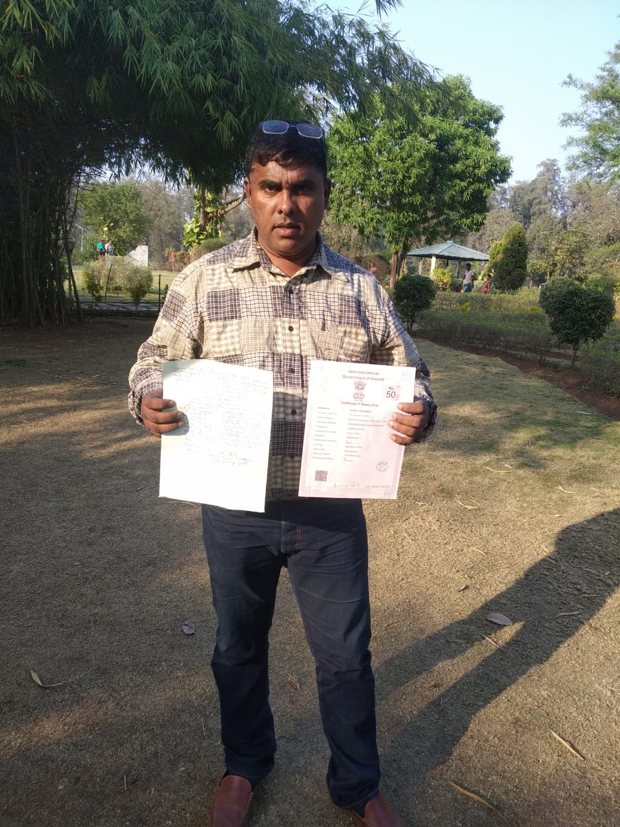
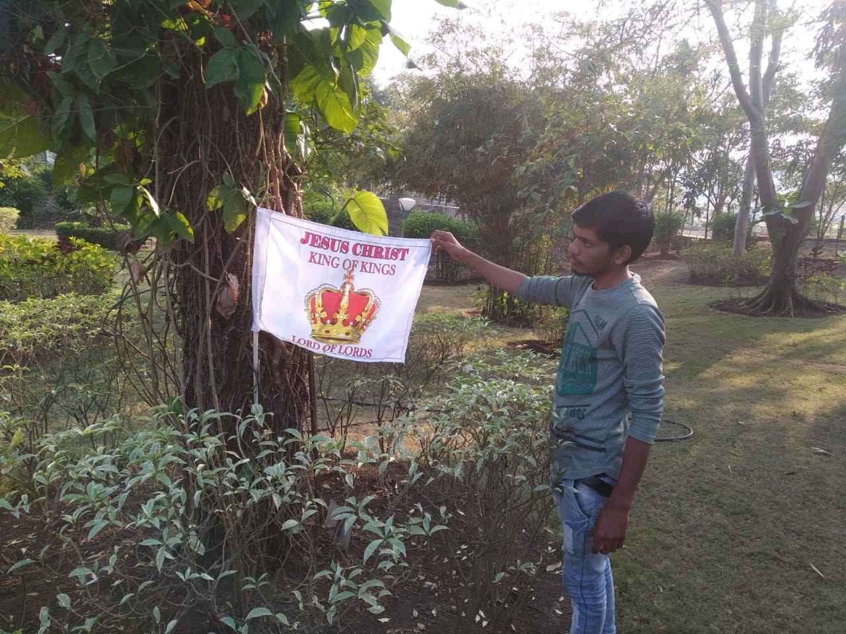
2020 January – inheriting the land
(Add your Pics)
Photos

Slide 34
From 11.1.2020 Conference Prayer for Speakers started on Saturdays 6.00-7.30 am
For Inheriting the land“
Jos 18:1 After this, the entire assembly of the Israelis gathered together at Shiloh and set up a Tent of Meeting there, where the land lay conquered before them.
This Conference of the Speakers of States i

Slide 35
2020 Jan 31 Inheriting over
From 11.1.2020, during Covid 19 period, through zoom meetings, the SMPs, Speakers, conducted monthly Shadow Parli. Night prayers, offline 24 hours worship, Troop Churches, Gift Schools etc.
Within 10 months the Lord united the whole Nation into one body.
Towards the end of 2020 October the command came from the Lord to divide the nation still into SMLA Constituencies and to appoint SMLAs.

Slide 36
SMLAS Appointed
In 2020 SMLAs were appointed in all the Constituencies of the 7 Regions from Oct 30-Nov 4, 2020
2021 CBS (Children Bible School) started for the growth of the children – to raise children soldiers in all SMP & SMLA Constituencies.
April 7-July 5- 90 Days Daniel Academy was conducted to give intense training to budding Daniels in all SMP & SMLA Constituencies. 90 AOJ soldiers shared their testimonies & why they joined AOJ.
All these helped the spiritual growth of SMPS & SMLAs & kindled their passion to win the land for Jesus.

Slide 37
North India divided into 6 Zones
Isacc Zone etc
Regional Meetings were arranged for all regions on Saturdays & Sundays Morning 6.00-7.30 am

Slide 38
INDIA
South
West
North
Central
Goa
Gujarat
Maharashtra
Rajasthan
Dadra and Nagar Haveli
Daman and Diu
Andhra Pradesh
Karnataka
Kerala
TamilNadu
Telangana
Lakshadweep
Puducherry
Andaman and
Nicobar
North - East
East
Uttar Pradesh,
Madhya Pradesh,
Bihar
Chandigarh
Delhi
Haryana
Himachal Pradesh
Jammu and Kashmir
Ladakh
Punjab
Uttarakhand
Uttar Pradesh
Arunachal Pradesh
Assam
Manipur
Meghalaya
Mizoram
Nagaland
Sikkim
Tripura
Jharkhand
Chhattisgarh
Odisha
West Bengal

Slide 39
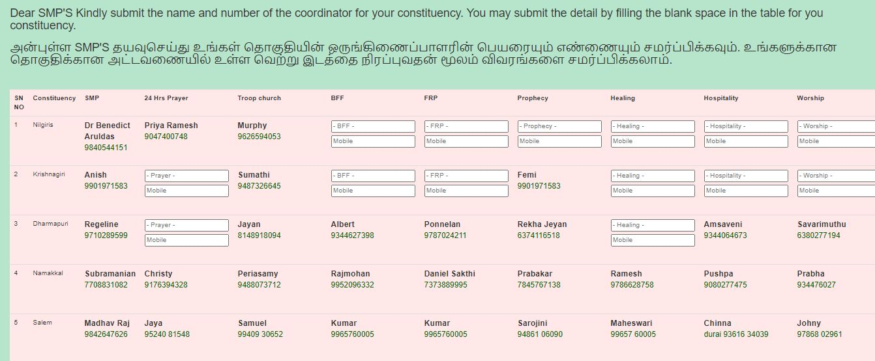
Smps – Weblink Inaugurated on 23.07.2020

Slide 40
Constituencies started growing
Gift Schools, Night prayers, Troop Churches & Morning Worships are conducted Constituency wise
First time Morning Worship started on 20, July 2020. It started spreading to various places. Now being done in 12 Constituencies.

Slide 41
From 2021 Jan
A Core team was created at the National level, regional, State and Zonal level e consisting of 4 members
1. Speaker | in charge of looking into the civil administration of the Constituency
2. Deputy Speaker
3. Coordinator | In charge of the spiritual matters (26 sections & Operations)
3. Secretary | In charge of documents, registers, ppts , videos, audios, etc. especially they should be kept in the archives for the use of future generations.
They pray daily for 15 minutes and keep up unity among them. They prepare a successor in 6 months to be appointed in their place and get ready for their next calling from the Lord. They come together monthly for their fellowship, share their experiences and learn from each other how to do their duties in a better way. They present a praise report, thank the Lord for His blessings, submit their plan for the next month.

Slide 42
Outcome in North Region
2 years of implementation of the God given project Shadow Parli & SMPs, SMLAs
2021- Promise from God for a decent, honest government.
“My cities shall again overflow with prosperity” Zec 1:17.
It is proved that
1. Authority is given to the SMPs & SMLAs to control the Government & administration of the State
2. Even without entering into politics, we can bring Jesus government in the nation.
(Add points as applicable)

Slide 43
1
2
3
4
5
6
7
8
9

Slide 44
India is getting liberated – State by State – overthrowing worldly traditions, superstitions, meaningless religious rituals etc…
First the Lord entrusted the responsibility of transforming India to the Chief Pastors & reputed Evangelists (2006-2010)
Then it was given to the believers (2010 -2020)

Slide 45
Now the Lord is using ordinary people in politics, Chief Ministers, political party workers etc to bring changes in the nation.
AOJ Soldiers,
Let’s make use of the time and opportunity given to us!
We are given a great responsibility!
Standing with the M.P.s, M.L.As as shadows.

Slide 46
Luk 3:8 Bear fruits in keeping with repentance. …………For I tell you, God is able from these stones to raise up children for Abraham.
All the plans of God are time bound!
Let’s fulfill our works diligently and meticulously!

