Slide 1
NORTH REGION MONTHLY REPORT, DECEMBER, 2021

Slide 2
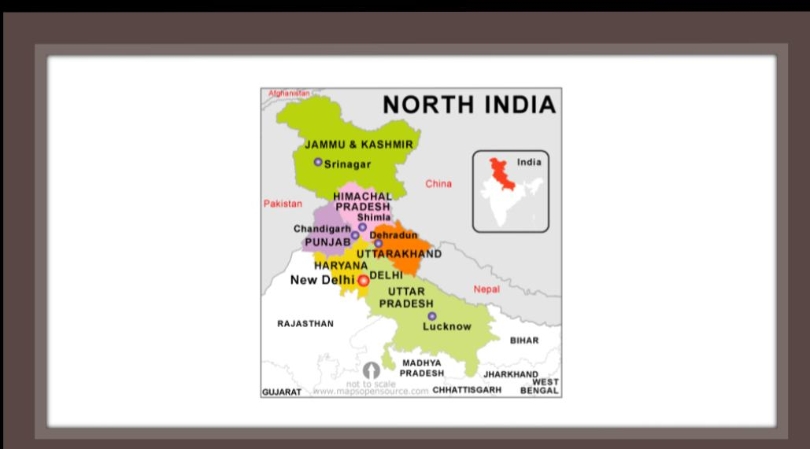

Slide 3
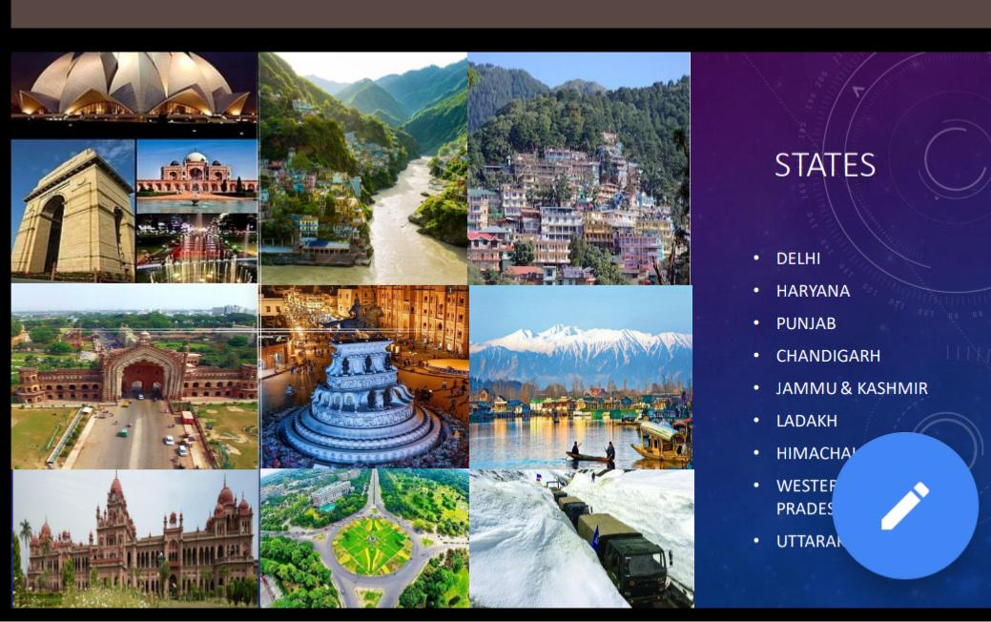

Slide 4
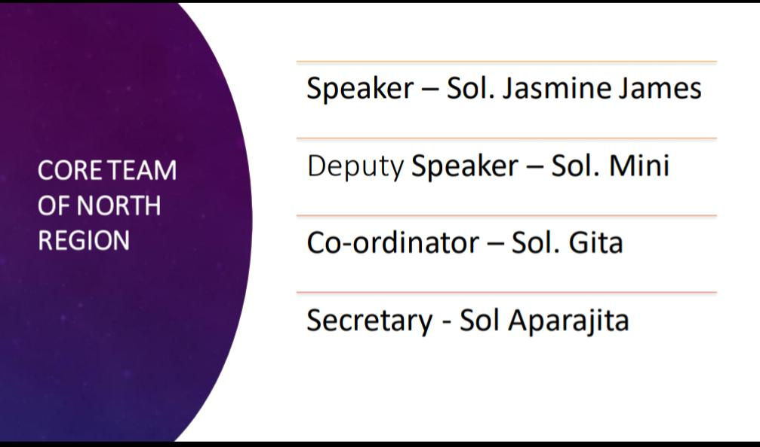

Slide 5
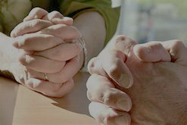
PRAISE REPORT
OF
DELHI
DECEMBER 2021

Slide 6
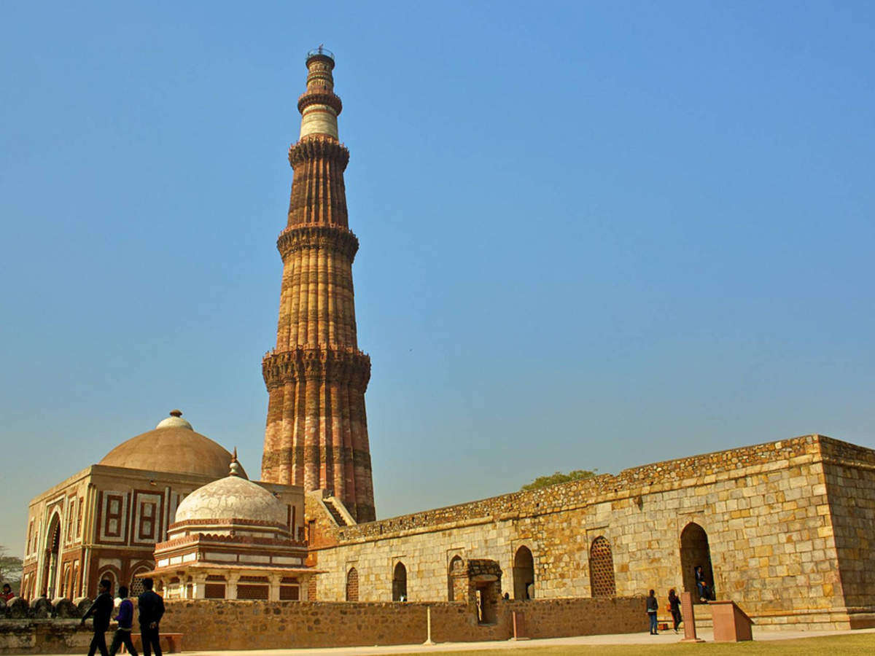
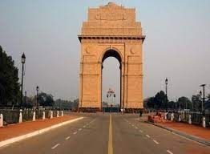
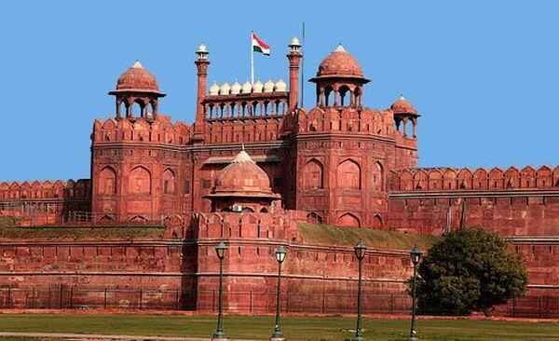
Constituencies
1. New Delhi
2. South Delhi
3. East Delhi
4. Chandni Chowk
5. North East Delhi
6. North West Delhi
7. West Delhi

Slide 7
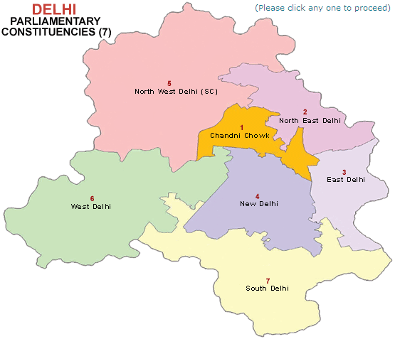

Slide 8
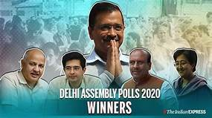
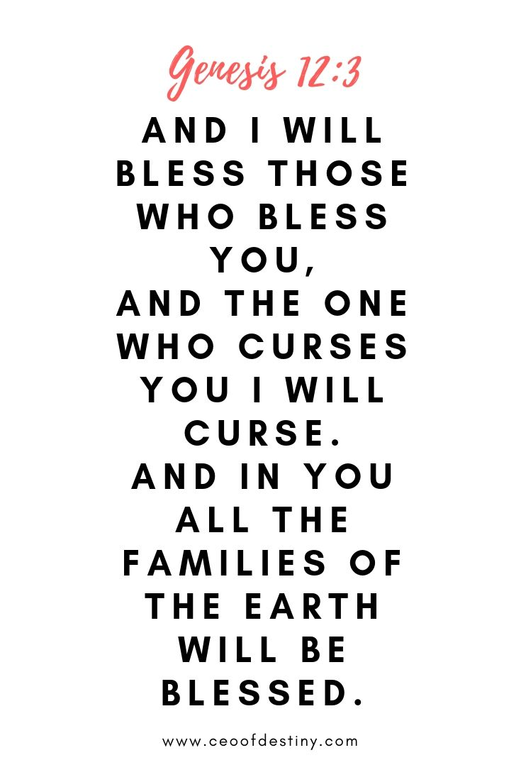

Slide 9

NEW CORE TEAM OF DELHI
Speaker – Sol. Lissy
Dy Speaker – Sol. Neha
Co-ordinator – Sol. Mohini
Secretary - Sol Kusumlata

Slide 14
TROOP CHURCHES

Slide 15
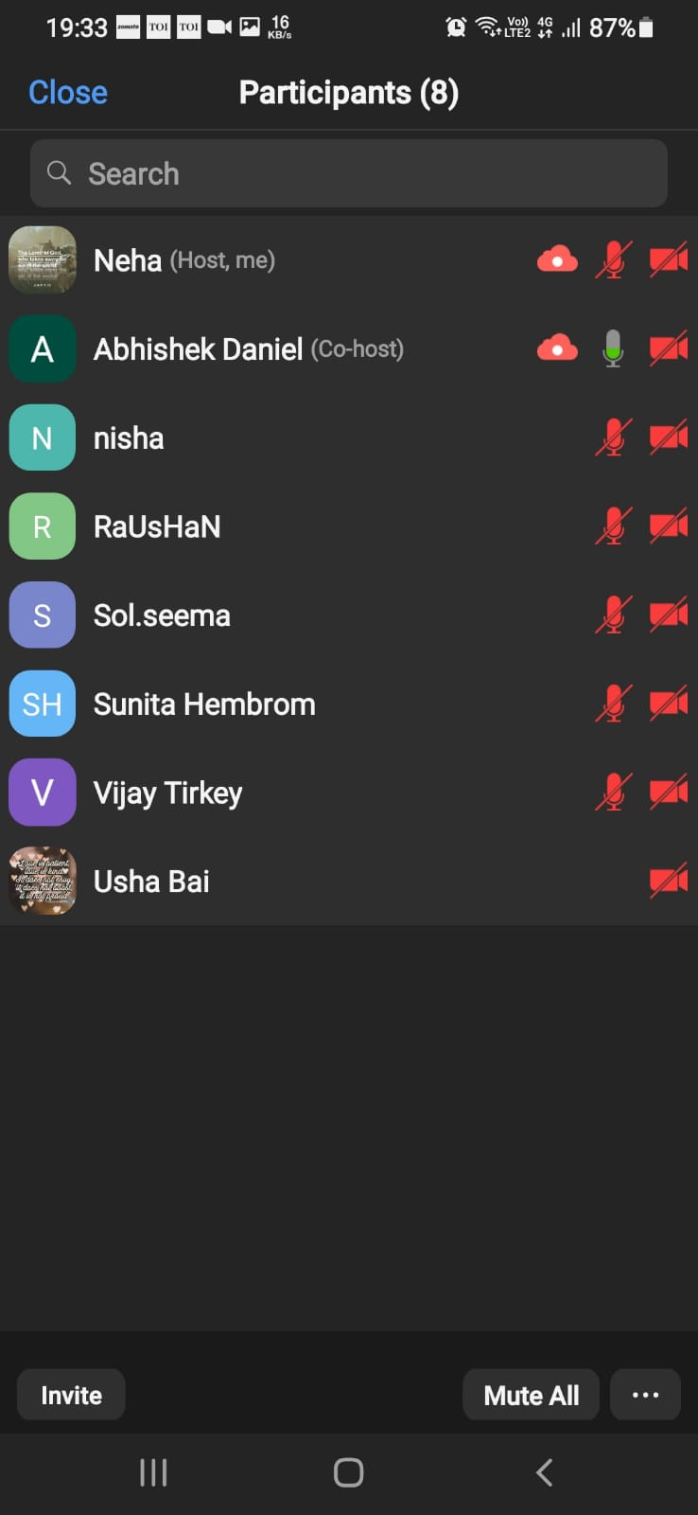
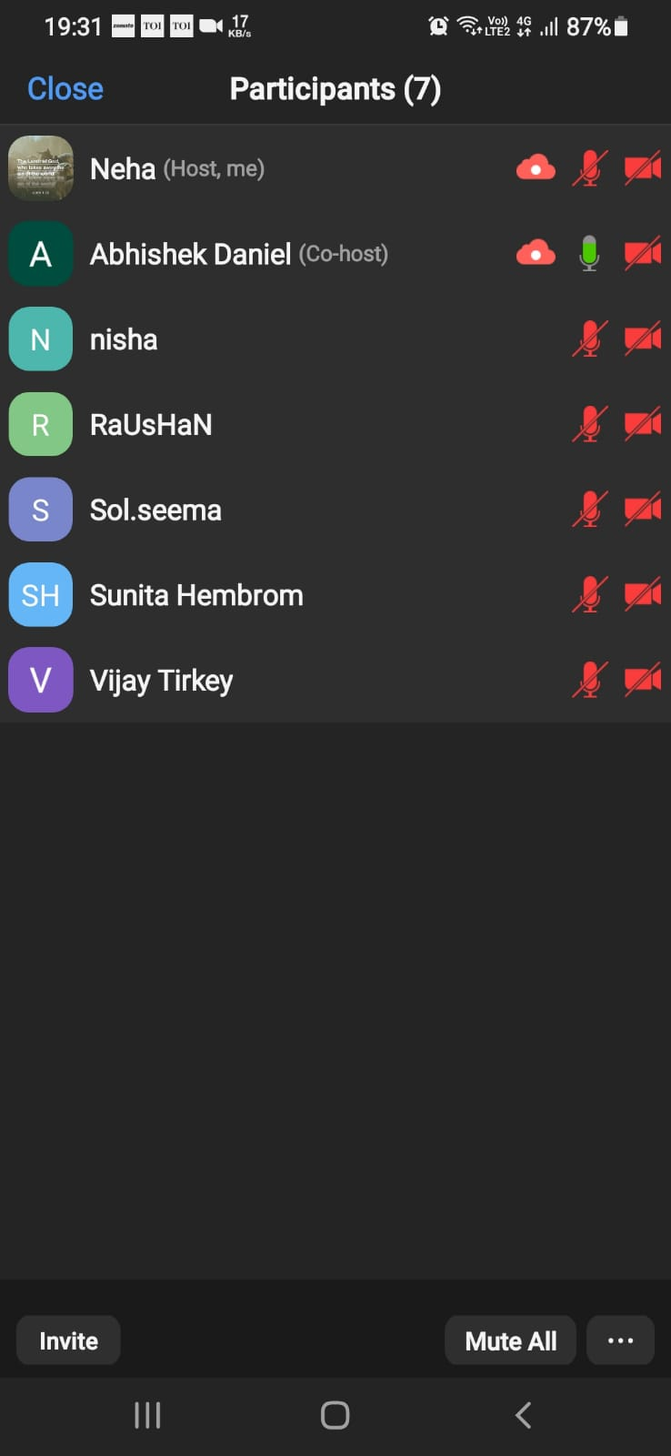
JOSEPH TROOP CHURCH
Co-ordinator- Sol. Jasmine & Sol. Mahesh
No. of Members: 18, Average Attendance: 10
Status- Runs on every Sunday Morning
ADONAI TROOP CHURCH
Co-ordinator- Sol. Neha
No. of Members: 8
Status- Started on 11th December, Runs weekly
Started as a part of Trade Troop Church in Evangelism through Business Programme
with two Pastors in this troop. Praise God!

Slide 16
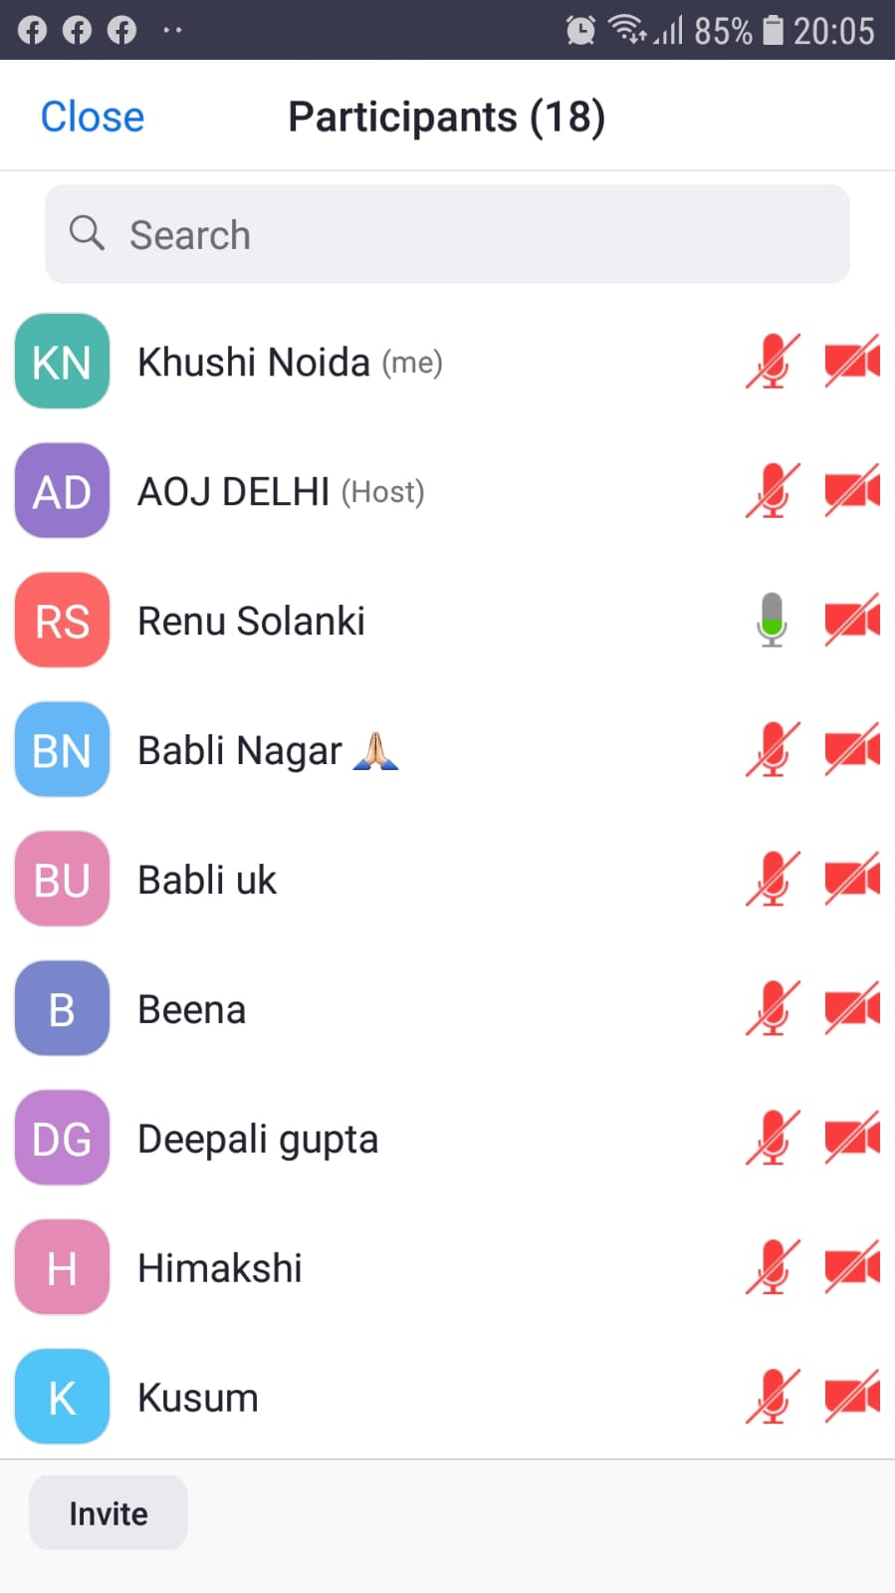
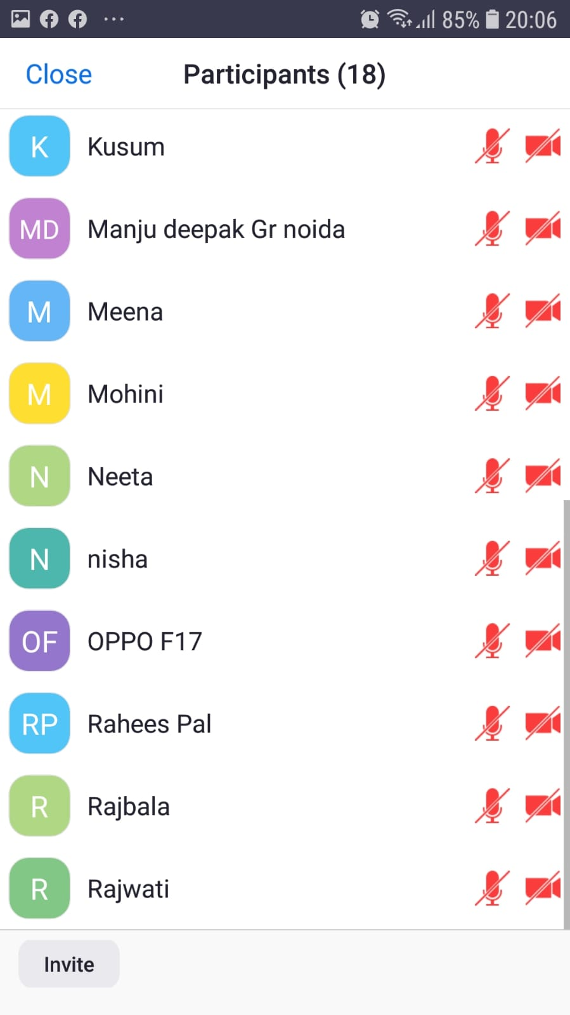
SAMARTHEYA TROOP CHURCH
Co-ordinator- Sol. Kusumlata
No. of Members: 12
Status- 21st December,- 29th December, 2021
Anointing Day Attendance

Slide 17
HOSPITALITY
Organizer: Sol. Neelam Sharma
Co-ordinator- Sol. Sanjeeta & Sol. Priyanka
Date and Time: December 1, 2021- December 8, 2021
2 pm to 4 pm
Language: Hindi

Slide 18
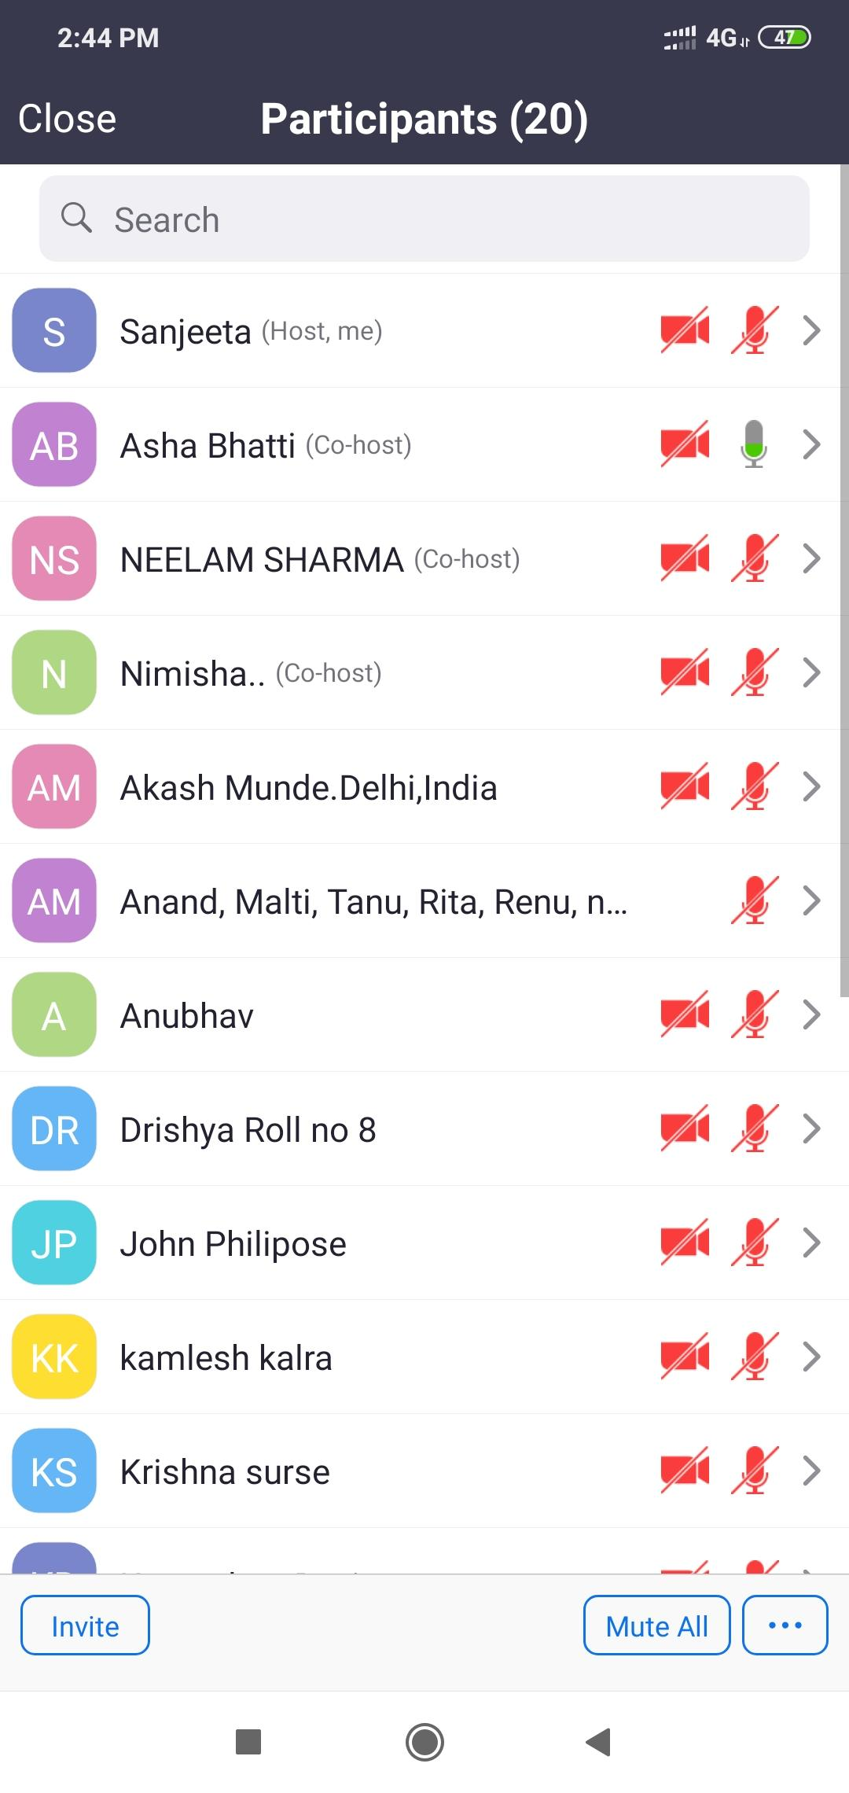
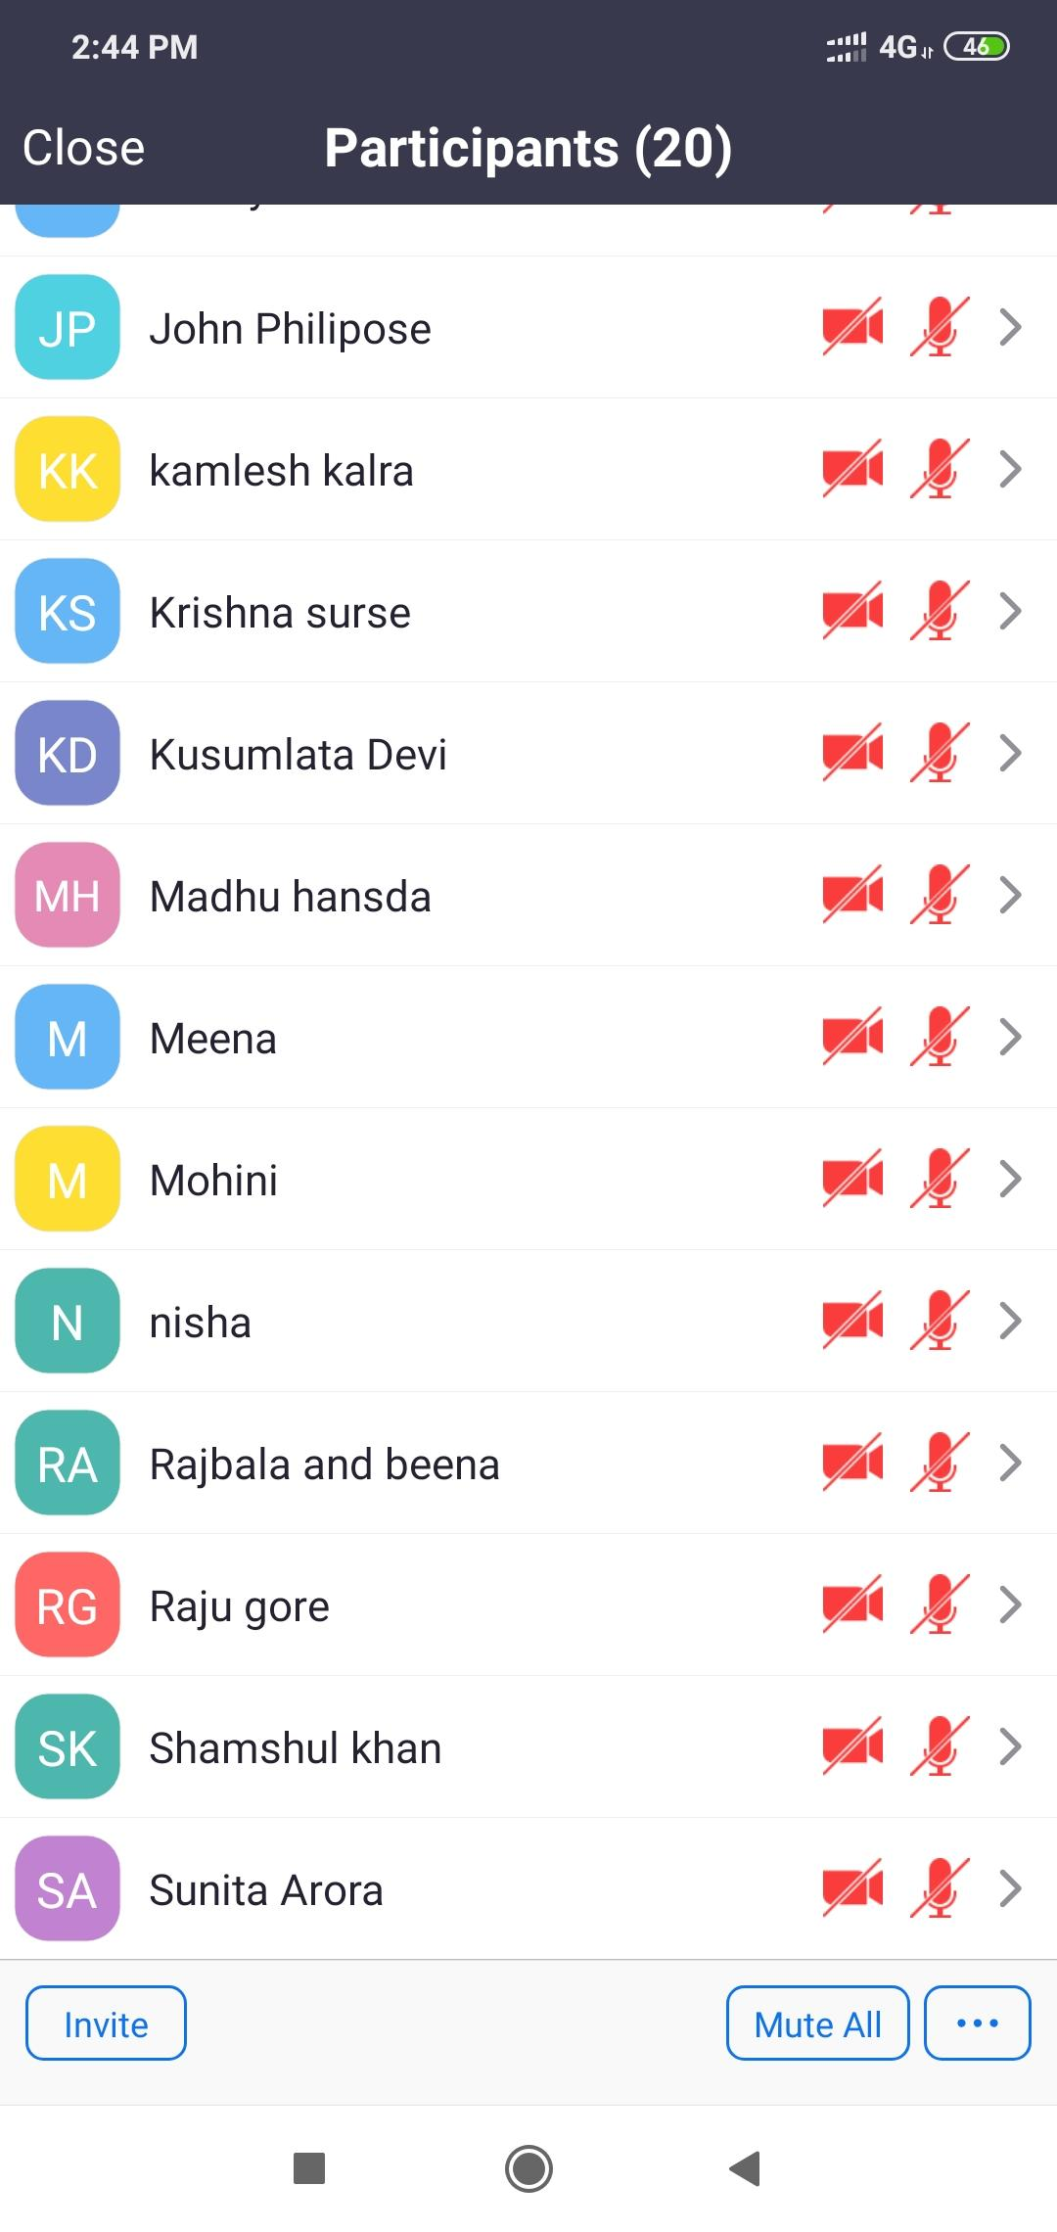
HOSPITALITY

Slide 19
TESTIMONIES
Kamlesh Kalra - During the anointing I felt the touch of holy Spirit, I learnt many things in this school such as love as Christ loves us. Deep understanding of Jesus as host, as servant etc.
Sunita Arora - During anointing a white light came upon her eyes and touched her deeply and immense peace she felt .
Mohini –This class has changed her perspective about how I used to do so much mistakes in our daily life after even knowing Christ, but this hospitality class taught her about hearts and to serve without bitter ness , with love, patience. During anointing I cried and presence of God touched her saying do not be afraid I am here. I will take away all your burdens. Thanks to all the teachers . Blessed us with new energy . Can’t express with words.

Slide 20
TESTIMONIES
Priyanka Arora – During anointing song I cried because my heart was stoned but holy Spirit touched me and melted. Verse that came in my mind is- have faith in Jesus and I will never leave you. I learnt behavior is important, respect everyone small or big whosoever comes in your life.
Sunita - After anointing in my heart, God spoke to me to fast and pray. and I will bless you with all your needs. Here in AOJ the teachings I received is true . I have gone to many places but here is freedom .
Madhu Hansda – I learnt many things about here. Like the word I, Me and myself should not be there and we need to behave correctly with every person.

Slide 21
TESTIMONIES
Nisha – This classes have great blessing in my life. My husband is not drinking much.
Beena – I have many blessing in these classes, as my many families have joined. My husband also listening these classes and started to change. Various aspects of Jesus love, as host, as servant and behavior changes as well. Hospitality gifted us transformation of her heart and perspective, love in all work changes our attitude.
Rajbala - many blessing through these classes, not heard never listened such teachings ,anywhere . My pension also have increased.
Poonam – miracle happen in our house as my daughter online classes started in zoom. Now without fear I can attend zoom online gifts school. As my husband didn’t knew I was attending these classes . Now without fear.
Meena – many blessing I received . I learnt to be less aggressive because my husband left me but now I have realized not to shout and yell at children. Nowadays my husband is talking and helping me to bear all the household expenses. All glory to God.

Slide 22
TESTIMONIES
Neelam sharma - During anointing prayer. The Lord is blessing each participants with his love. He has immersed everyone into his love ocean. All the bitterness is disappearing.
Neha- As I attended Chennai meeting, I saw with my own eyes the true hospitality in their actions, practically I experienced it. Not only by words but with actions, we should walk practice it. Praise God for teaching us hospitality.

Slide 23
FRP-1
Organizer: Sol. Jasmine
Co-ordinator- Sol. Richa
Dated and Time: November 29, 2021- December 12, 2021
6:30 pm to 8:30 pm
Place: Online through Zoom in Mumbai
Language: English

Slide 24
TESTIMONIES
Sol. Fiona: It's so sad I missed so many of her classes.. The classes were really good. God bless Sol. Jasmine.
Sol. Jessie: Not only me, everyone likes her classes. Excellent Richa. I want to connect with her.Praise God.
Sis Fiona, Sis Vani, Sis Merylin, Sis Marina, Sis Jessie, Sis Sheryl – all from different backgrounds attended the classes and were blessed.

Slide 25
David School of worship
Organizer: Sol. Neha
Co-ordinator- Sol. Sanjeeta & Sol. Renu
Date and Time: December 6, 2021- December 13, 2021
6:30 pm to 8:30 pm
Language: Hindi

Slide 26
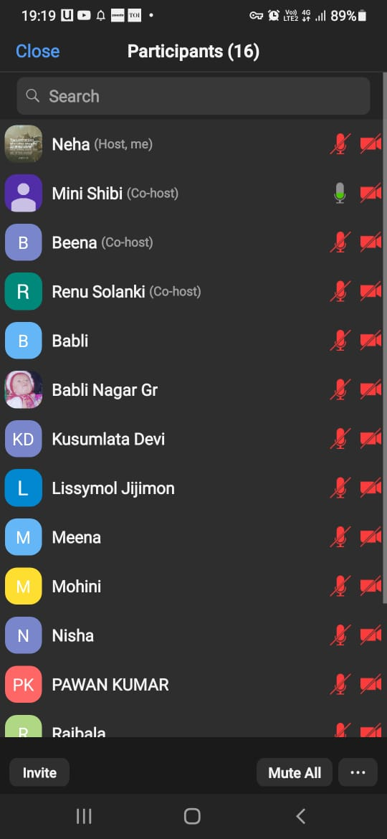
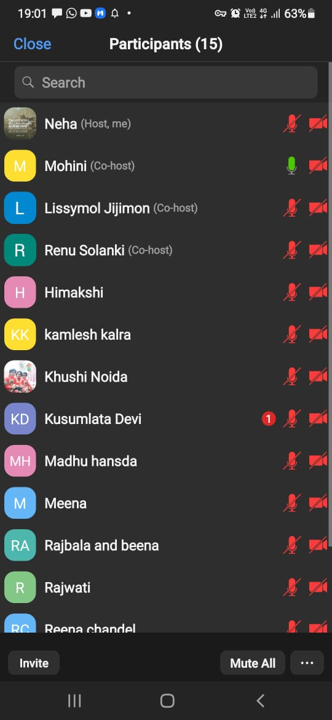
David School of worship
Volunteers for Teachers:
Sol. Khushi
Sol. Sol. Beena (3&4th class)
Sol. Renu (3&4th class)
Sol. Mohini (last class)
Sol. Madhu (3&4th class)

Slide 27
TESTIMONIES
Sol. Mohini: She testified about the first 2 classes and was feeling thankful to God for revealing the vision for India and the answer that she was seeking from God as to why are we not allowed to consume blood, she received in the 2nd class of Tabernacle of David.
Sol. Kusumlata: She attended the classes for the first time and was feeling great to know about how to worship God. Praise God.
Sol. Beena: She testified that her family attended these classes for the first time and they were happy and joyous to learn from all the classes. In the songwriting session, her mother in law who was sick and didn’t know to read and write, for the first time she composed her own song and sang instantly which was unbelievable for her. God was in control of everything. She praised God for these classes.
Sol. Babli: She found the classes really nice and felt blessed. Praise God!
Sol. Khushi: She liked the classes a lot and she praised God for everything

Slide 28
MORNING PRAYER
With the grace of God and towards fulfilment of vision of God, the Capital of India, Delhi was finally divided on 11th October, 2021 into two Zones and from 1st November, 2021 to 3 Zones:
1. Joseph Zone (5 Constituencies of Delhi and Chandigarh) led by Sol. Jasmine and Sol. Mahesh
2. Hosanna Zone (West Delhi Constituency)
led by Sol. Lissy
3. Caleb Zone led by Sol. Khushi, Sol. Nimisha
MORNING WORSHIP CONTINUED MONDAY TO FRIDAY FROM 5:30 AM TO 7 AM IN THE MONTH OF DECEMBER, 2021

Slide 29
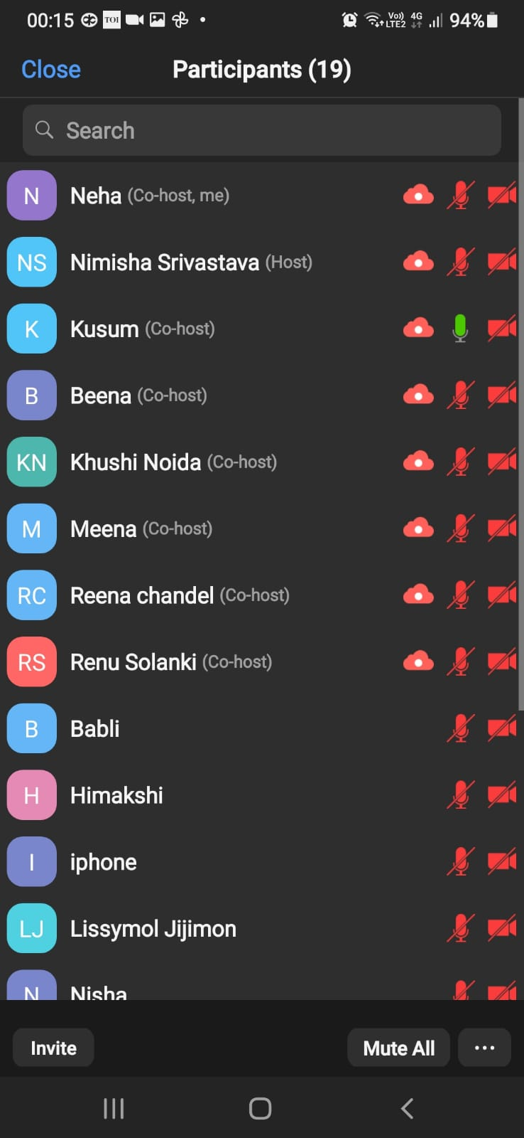
NIGHT PRAYER
NIGHT PRAYER WAS CONDUCTED ON EVERY FRIDAY IN THE MONTH OF DECEMBER, 2021 FROM 11 PM-1 AM FOR DELHI AND CHANDIGADH
NIGHT PRAYER ATTENDANCE

Slide 30
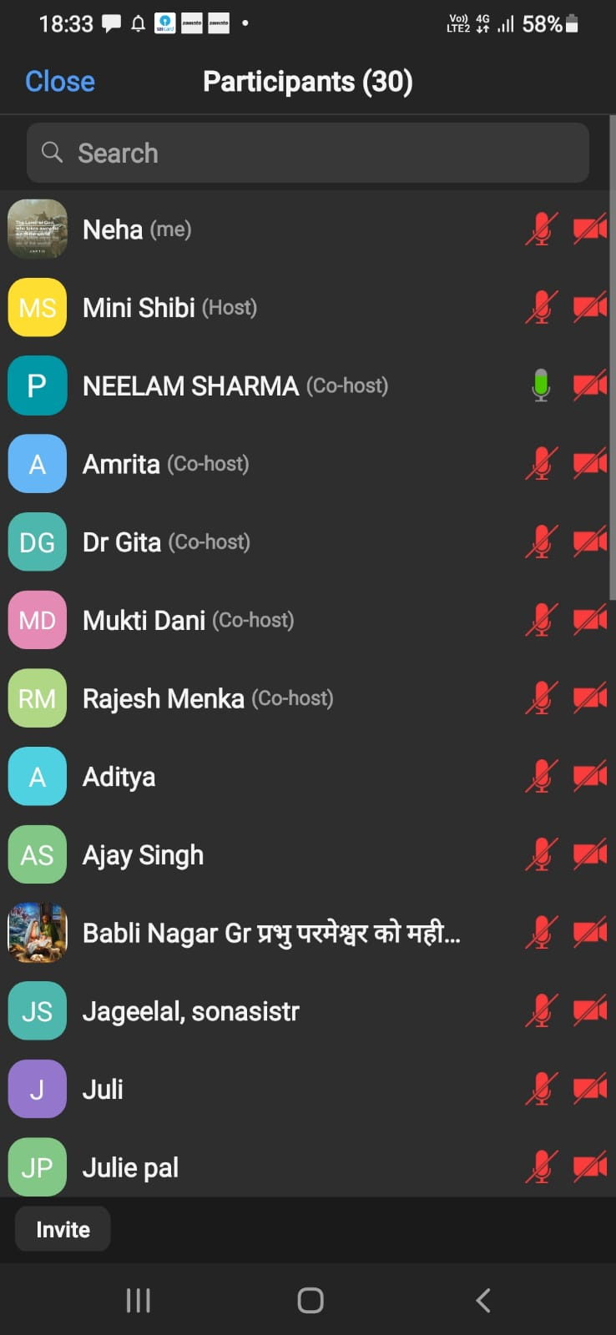
FASTING PRAYER
FASTING PRAYER ATTENDANCE
FASTING PRAYER CONDUCTED WITH ALL THE 9 STATES OF NORTH ZONE TOGETHER ON EVERY FRIDAY OF DECEMBER, 2021 FROM 6-7 PM

Slide 31
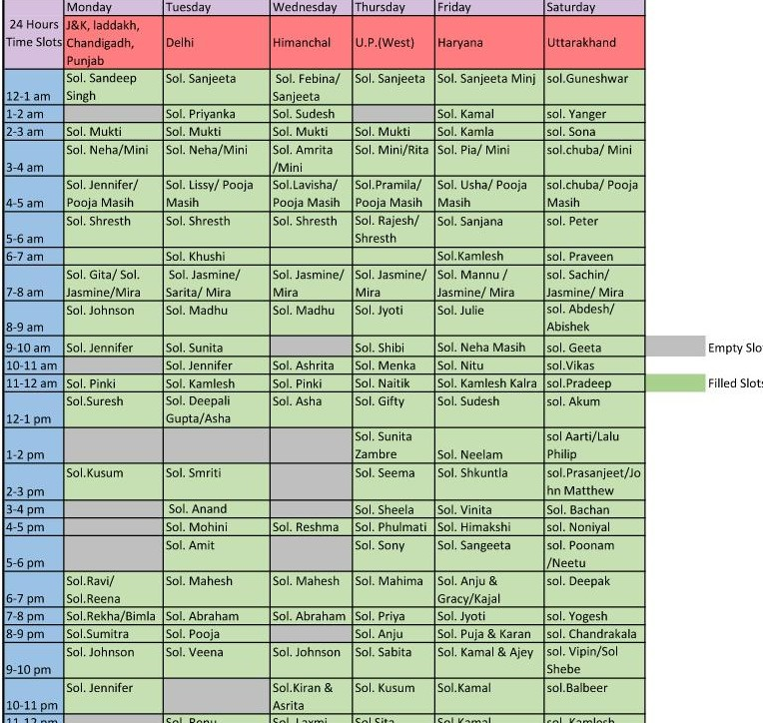
24 HOURS OFFLINE WORSHIP
(EVERY TUESDAY)
Co-ordinator: Sol. Neha
From 20th September, the offline worship started in all the states
of North Zone.
24 hours offline worship is happening in Delhi every Tuesday except on few slots
which are yet to be filled,

Slide 32
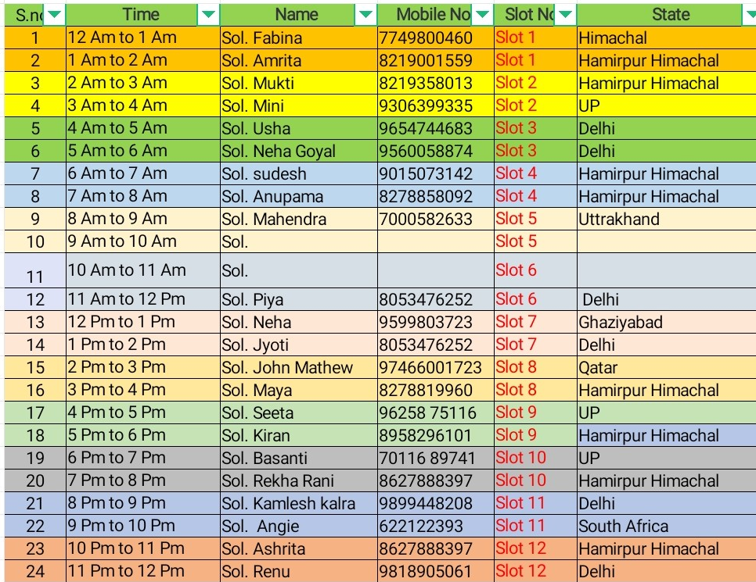
24 HOURS Online WORSHIP
(EVERY SUNDAY)
Co-ordinator: Sol. Ajay
Online Worship is continuing in Delhi also alongwith
all the 9 States of North Zone.

Slide 33

PRAISE GOD FOR HIS MIGHTY DEEDS IN THE CAPITAL OF INDIA !!!
OUR PRAYERS ARE CONTINUALLY BEING ANSWERED IN JESUS MIGHTY NAME.
aMEN !!!

Slide 34
Praise Report
North Region
UP West December 2021

Slide 35
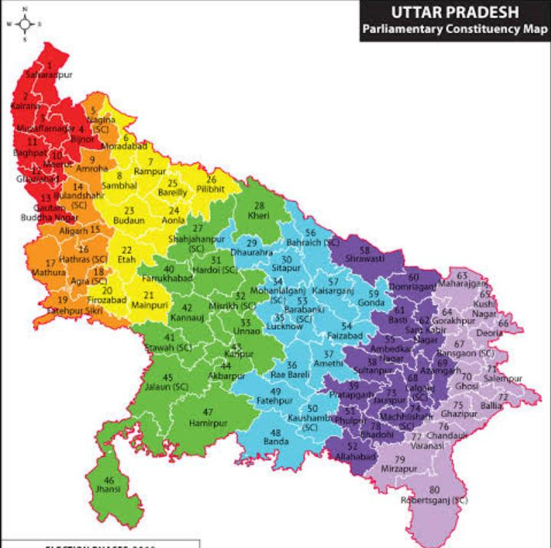
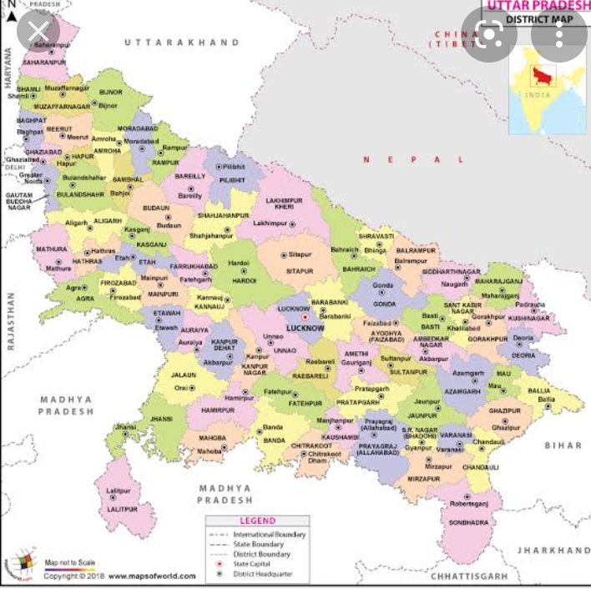

Slide 36
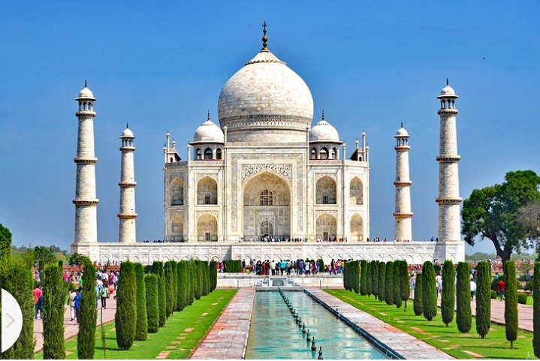

Slide 37
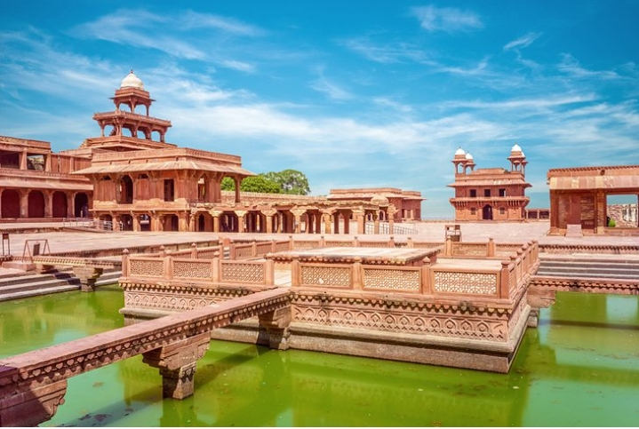

Slide 38
NEW CORE TEAM UP WEST
Speaker – Sol. Menka
Dy. Speaker – Sol. Poonam
Co-ordinator – Sol. Sunita Zambre
Secretary - Sol Mini Shibi

Slide 39
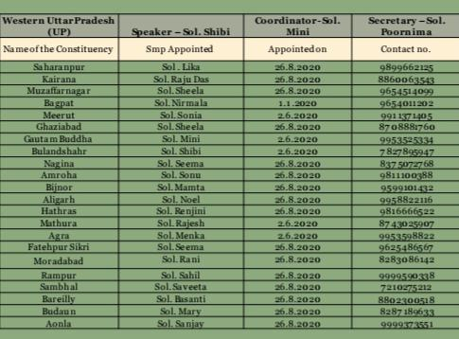
Smp And SMLA constituency

Slide 40
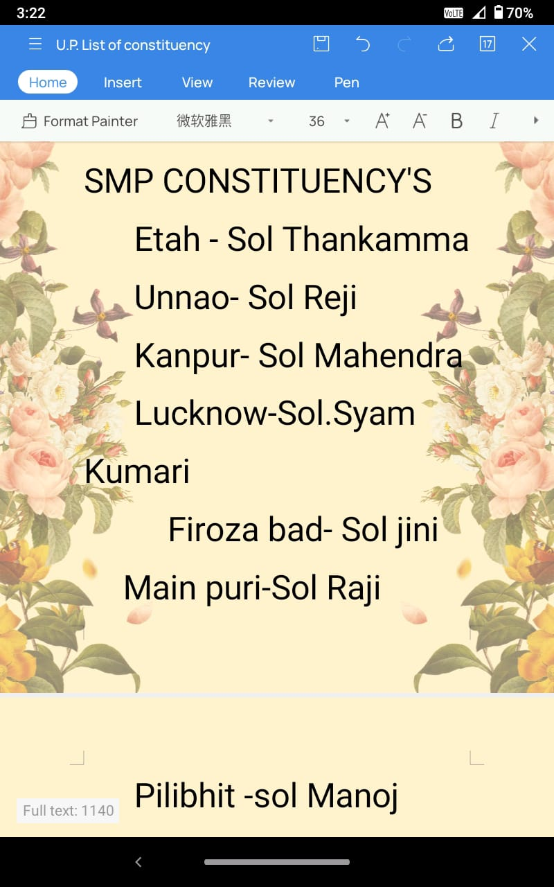
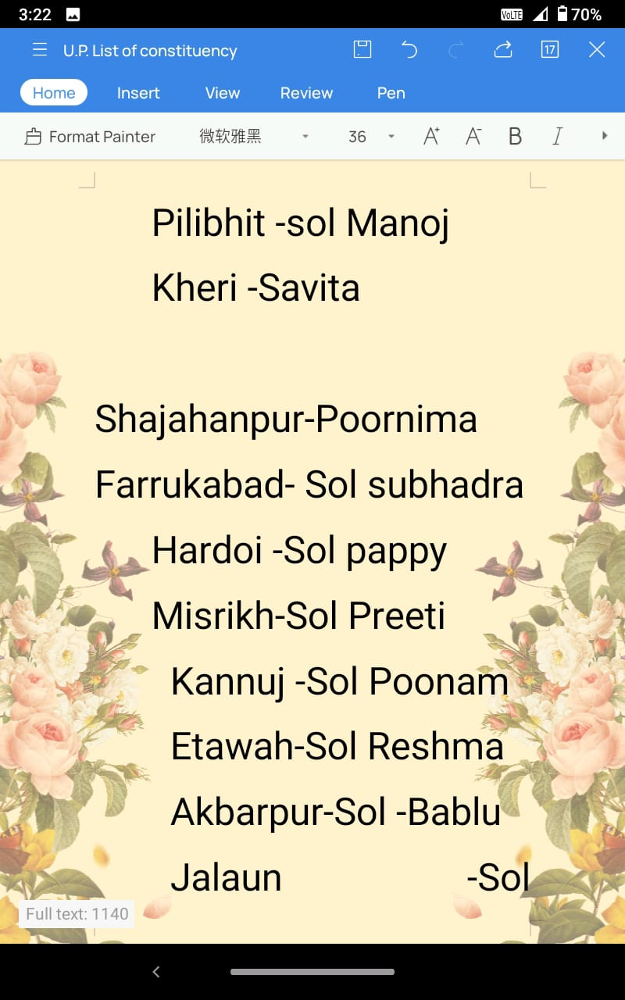

Slide 41
SMP list
Hamirpur -Sol.Sita
Daurahara-sol.Sunita zambre

Slide 42
SMLA list
1.Manish kumar-Fatehpur Sikhri
2.Sanjeev-Kanpur Cantt
3.Priyanka-Govidnagar
4.Babli-Aryanagar
5.Tulika Boro-Barraiely
6.Sateesh-Bhojipur
7.Lakshmi-Meergang

Slide 43
SMLA list
8.Lilly Gracy-Nawabgang
9.Mary Mark-Badaun
10.Sonia-Meerut Cantt
11.Sonu-Amroha
12.Jincy-Bulenshehar
13.Pramod-Dabai

Slide 44
New SMLA list
Agra Cannt -Malti Devi
Agra south -Bhulmati
Agra north- Rajmani
Etmadpur -Tija
Jalesar -sitara

Slide 45
New SMLA List
July pal
Sanjay
Neha

Slide 46
Troop churches
Moses troop church
Leader-Poonam
Members –11

Slide 47
Troop Churches
Ruth Troop Church
Leader-Sunita zambre
Members-8(On line)

Slide 48
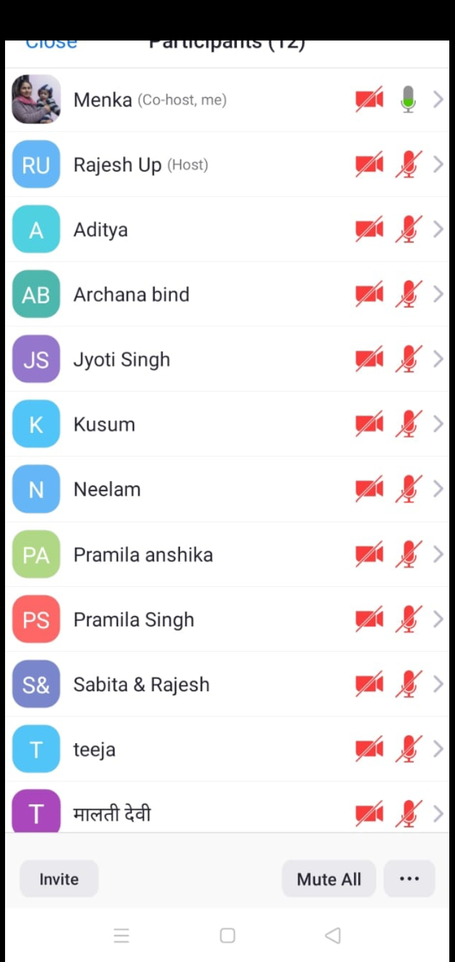
Troop Church
Samuel Troop Church
Leader-Menka
Members -12

Slide 49
Troop Church
Bethlehem Troop church
Leader -Sita
Members-9

Slide 50
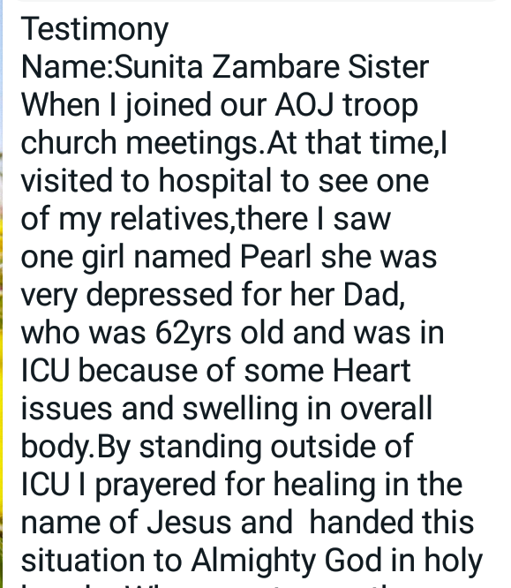
Testimonies

Slide 51
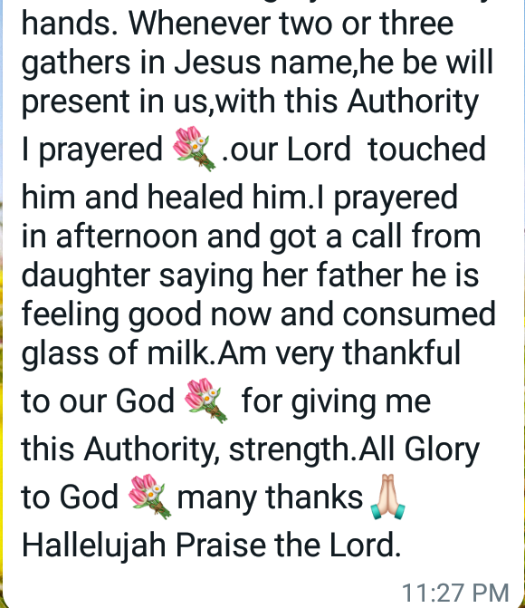
Testimonies Of trooP ChuRch

Slide 52
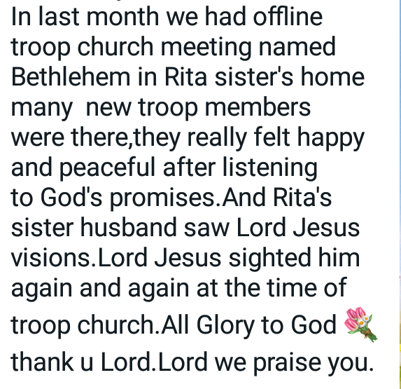

Slide 53
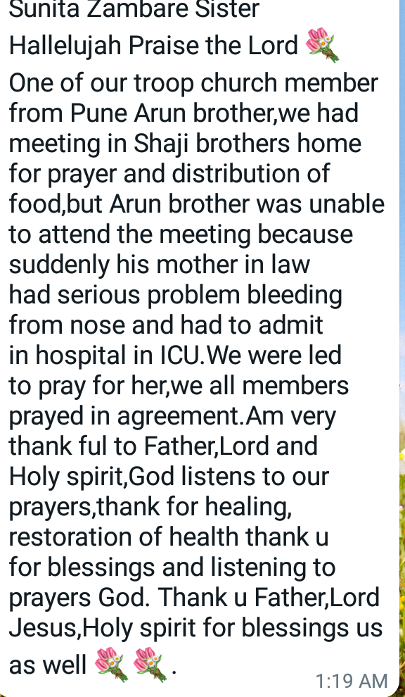

Slide 54
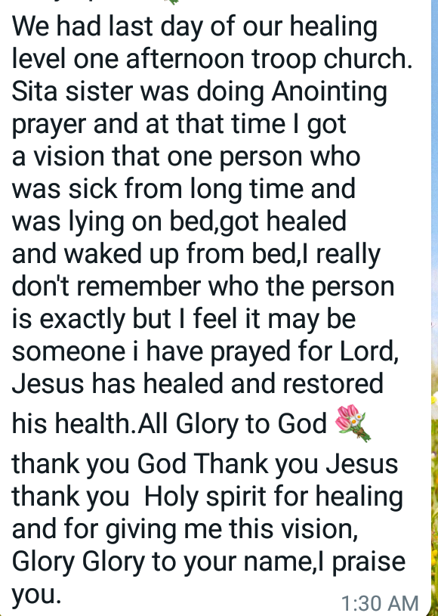

Slide 55
Gift school
Healing level2
Prophecy level1
Hospitality
Frp level1

Slide 56
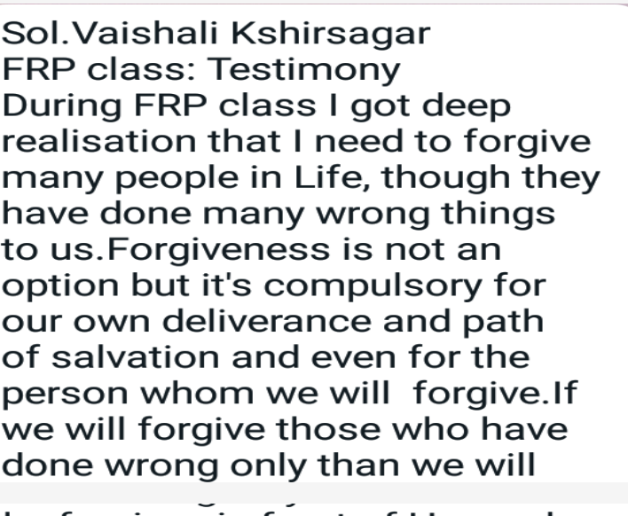

Slide 57
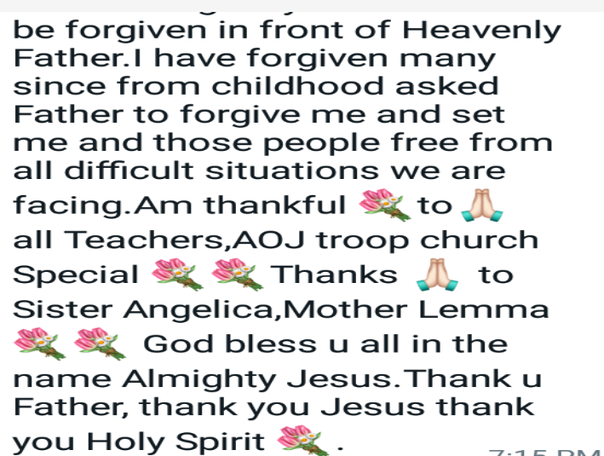

Slide 58
Morning Worship
Morning Worship going on.
Morning Worship Divided into 4 zones.
CANA Zone, Tibirias Zone,Sinai Zone,Moriya zone

Slide 59
Night Prayer
Night prayer is going on every TWICE A MONTH

Slide 60
Prophetic Prayer
Prophetic Prayer going on every day.
Sol. Menaka is leading Prophetic Prayer.
All Sinai Zone members are attending the meetings every day.

Slide 61
Fasting prayer
We are conducting Fasting Prayer every week.

Slide 62
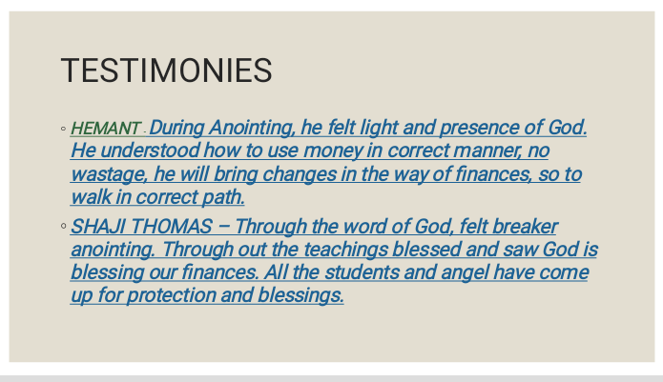

Slide 63
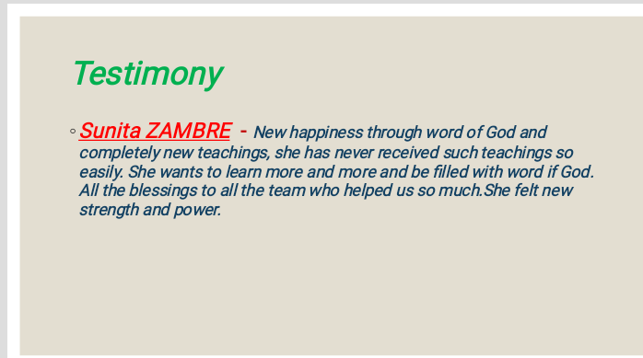

Slide 64


Slide 65
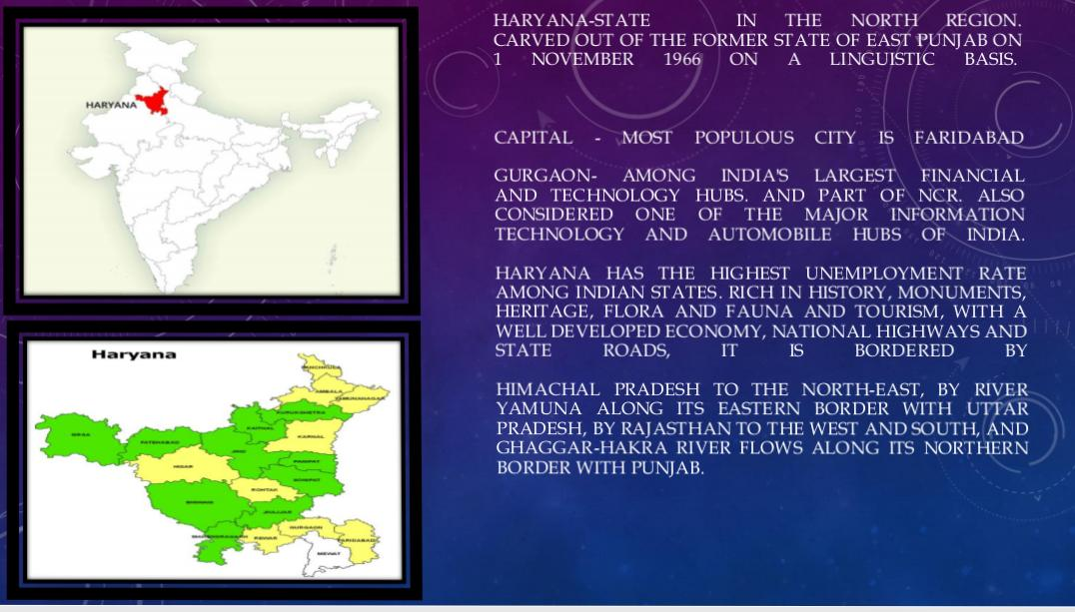

Slide 66
NEW CORE TEAM HARYANA
Speaker – Sol. Sangeeta Michael
Dy. Speaker – Sol. Neelam
Co-ordinator – Sol. Kamlesh Kalara
Secretary – Sol. Kamala

Slide 67
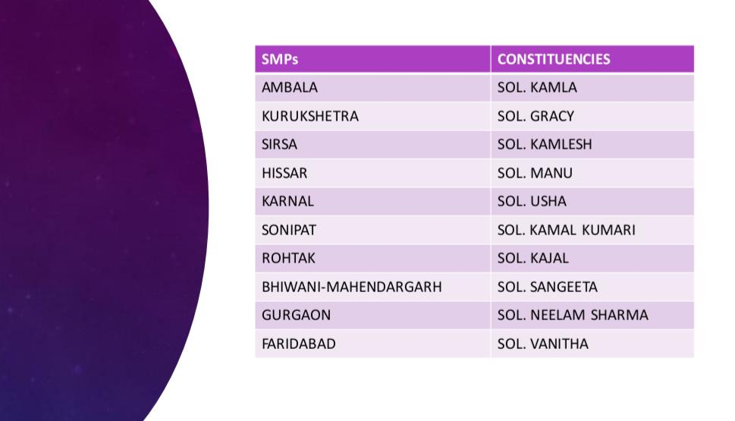

Slide 68


Slide 69
NEW CORE TEAM PUNJAB
Speaker – Sol. Sandeep
Dy. Speaker – Sol. Grace Dipti
Co-ordinator – Sol. Amrit
Secretary – Sol. Hardeep

Slide 70
TROOP CHURCH IN PUNJAB, MALLOT
MOSA TROOP CHURCH ( Total members are 5)
YERMIAH TROOP CHURCH (Total members are 4)
YOEL TROOP CHURCH (Total members are 4 )
Morning prayer 5.30 am to 7 am
Offine work is more than online work
No Gifts school
Testimonies are healings and deliverance from evil spirit.

Slide 71
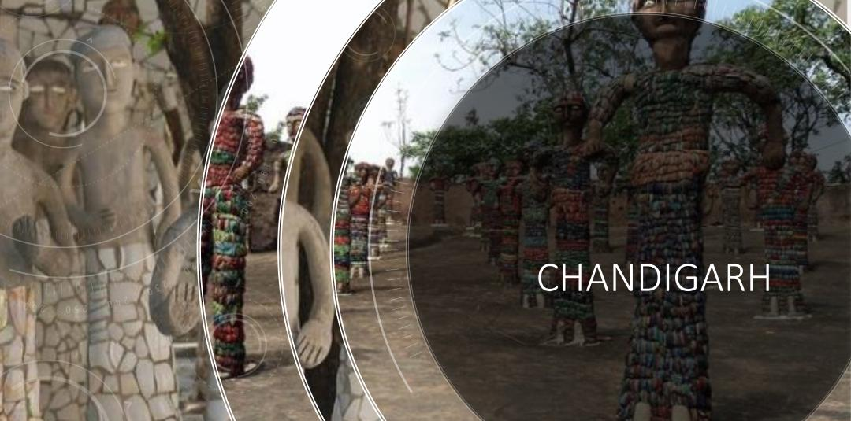

Slide 72
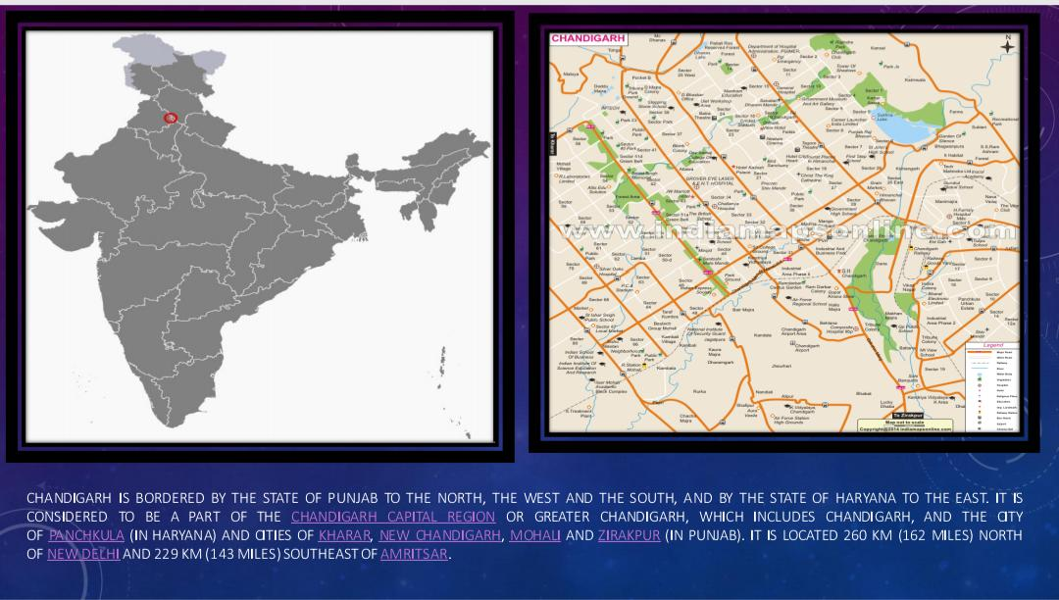

Slide 73
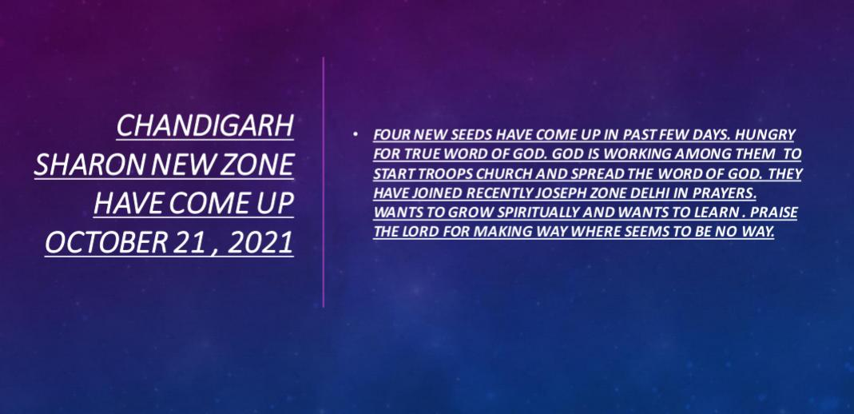

Slide 74
Chandigarh
We are praying for the area that it should grow by the grace of our Lord Jesus Christ.
No Troop churches or gifts school started.

Slide 75
New Core Team for Chandigarh
Deputy Speaker :- Sol. DR. Himakshi
Speaker :- Sol. Jasmine James
Coordinator :- Sol. Renu Solanki

Slide 76


Slide 77
UTTRAKHAND
We are praying for the area that it should grow by the grace of our Lord Jesus Christ.
No Troop churches or gifts school started.

Slide 78
Jammu & Kashmir
LADAKH (UT)

Slide 79
New Core Team for J & K
Speaker :- Sol. Nikita
Deputy Speaker :- Sol. Bharat
Coordinator :- Sol. Beena
Secretary :- Sol. Sunita Arora

Slide 80
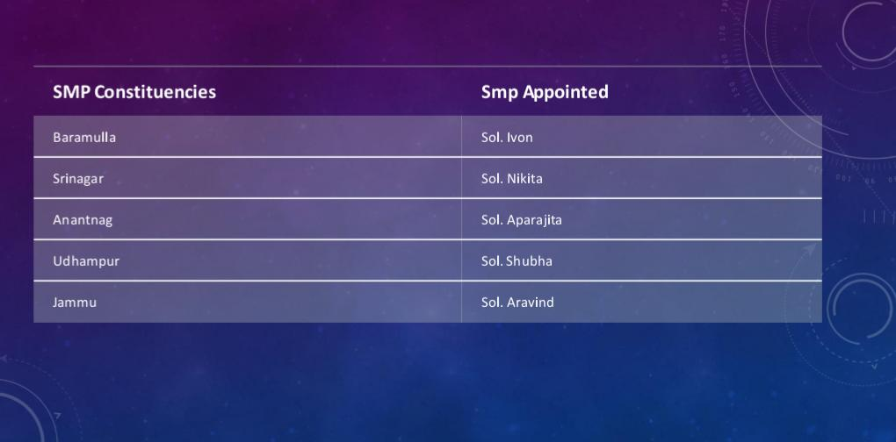

Slide 81
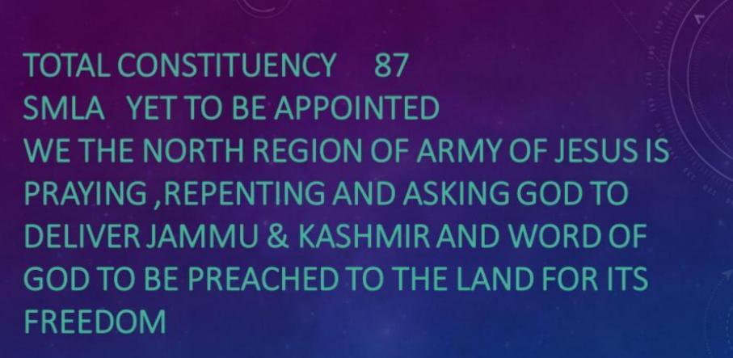

Slide 82
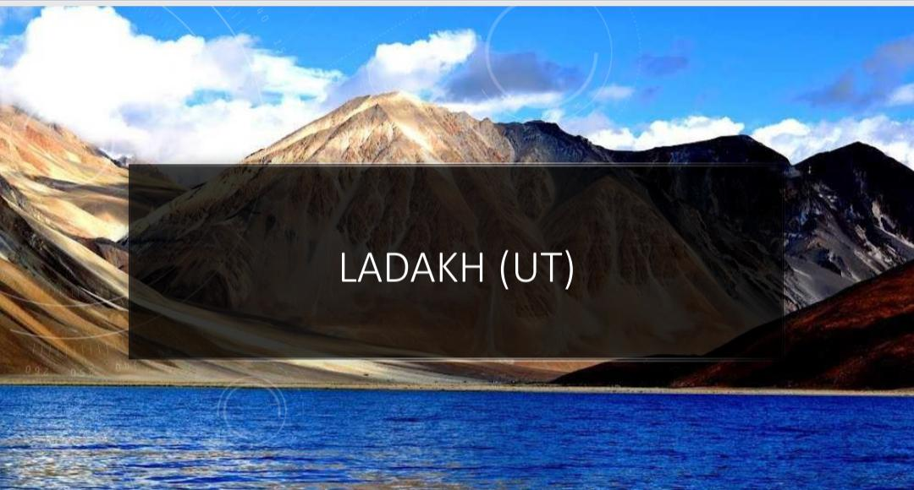

Slide 83
New Core Team for J & K
Speaker :- Sol. Dr Gita
Deputy Speaker :- Sol. Dhruv
Coordinator :- Sol. Khushi
Secretary :- Sol. Priyanka Arora

Slide 84
Ladakh
We are praying for the area that it should grow by the grace of our Lord Jesus Christ.
No Troop churches or gifts school started.

Slide 85


Slide 86
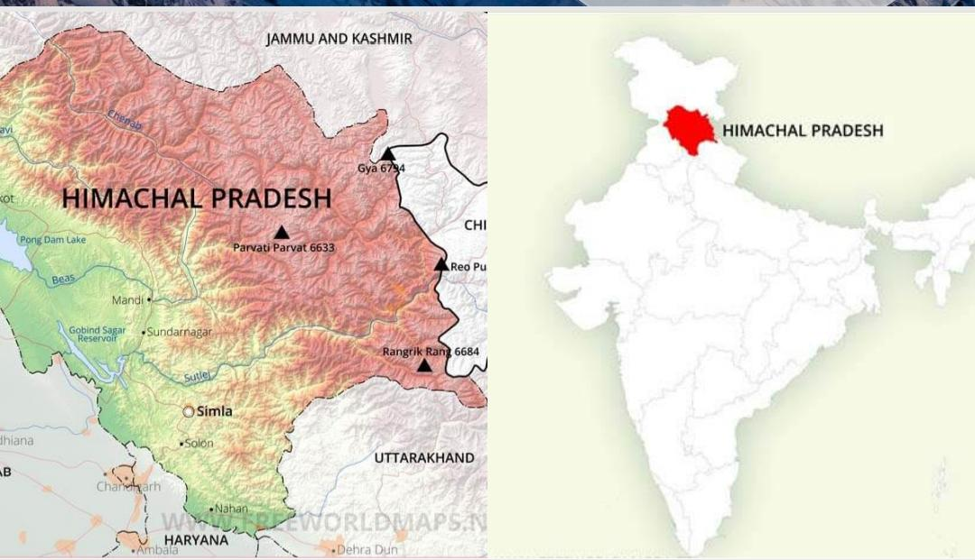

Slide 87
New Core Team for J & K
Speaker :- Sol. Febina
Deputy Speaker :- Sol. Kiran
Coordinator :- Sol. Mukti
Secretary :- Sol. Devkrita

Slide 88
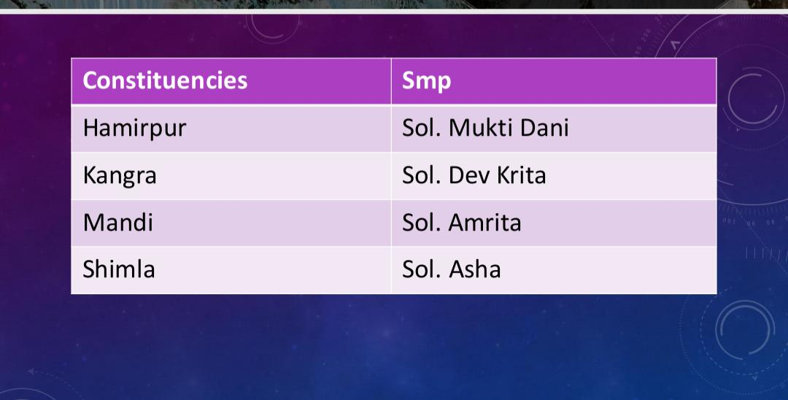

Slide 89
HIMACHAL PRADESH
Night prayer and morning worship Prayer
Nazrath School of Family building from 13.12.2021 to 21.12.2021

Slide 90
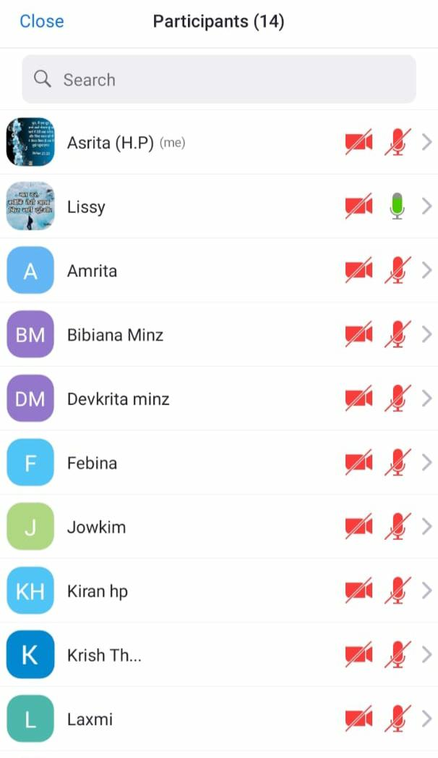

Total Members - 14

Slide 91
TESTIMONY
Ashrita from past 8 years had leg pain. She went everywhere to get healing, Doctors, Ayurveda, and all kinds jaad fukh baba from roadside.After true repentance, I got Healed in healing class.
Her husband was suffering from blood pressure and his veins got torned inside his brain due to which blood was leaking. We went to many doctor but only he got relief from troop church and taking class and now he is recovering..

Slide 92


Slide 93


Slide 94


Slide 95


