Slide 1
NORTH REGION MONTHLY REPORT, NOVEMBER, 2021

Slide 2
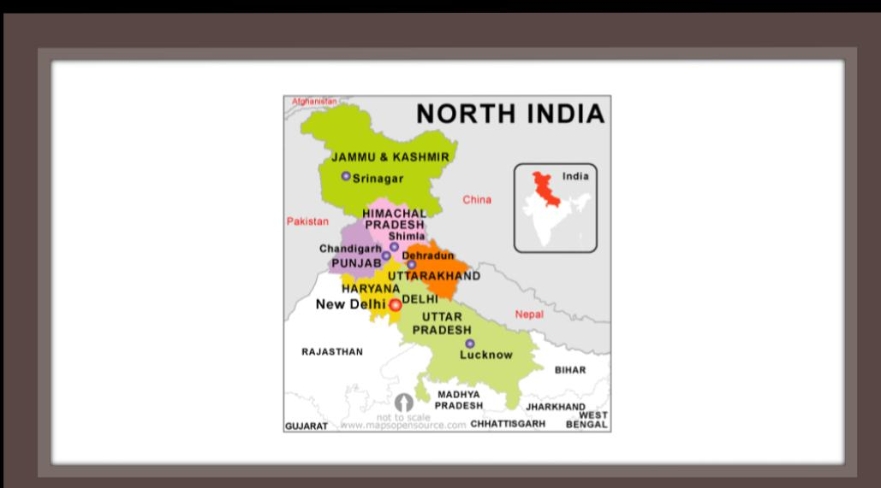

Slide 3
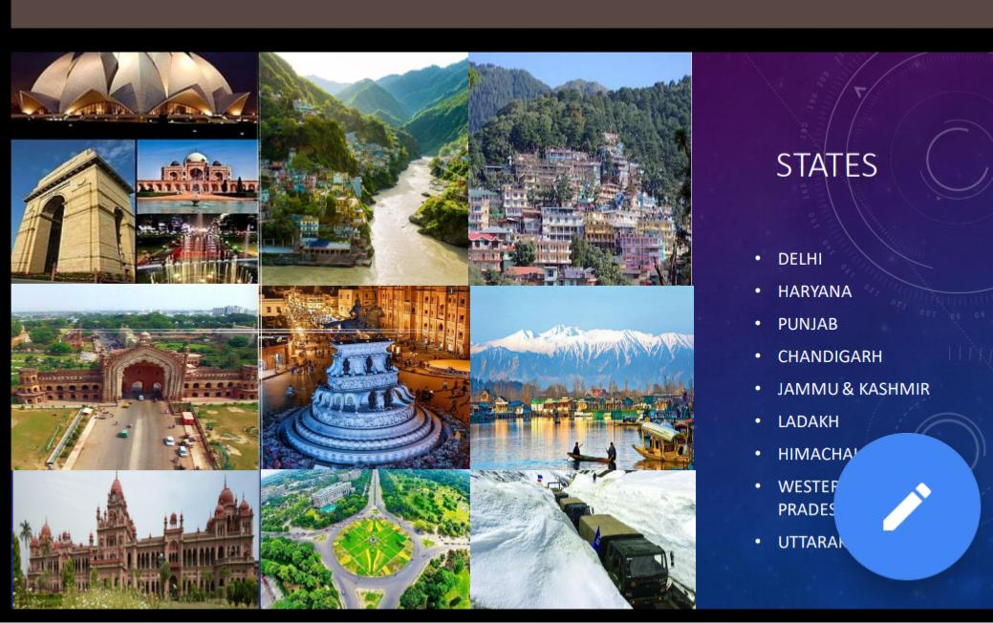

Slide 4
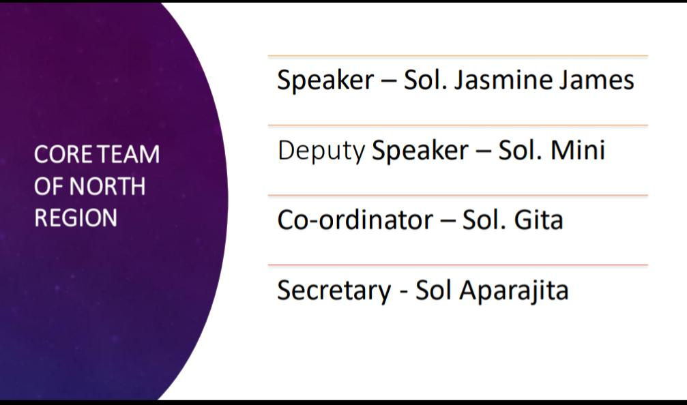

Slide 5
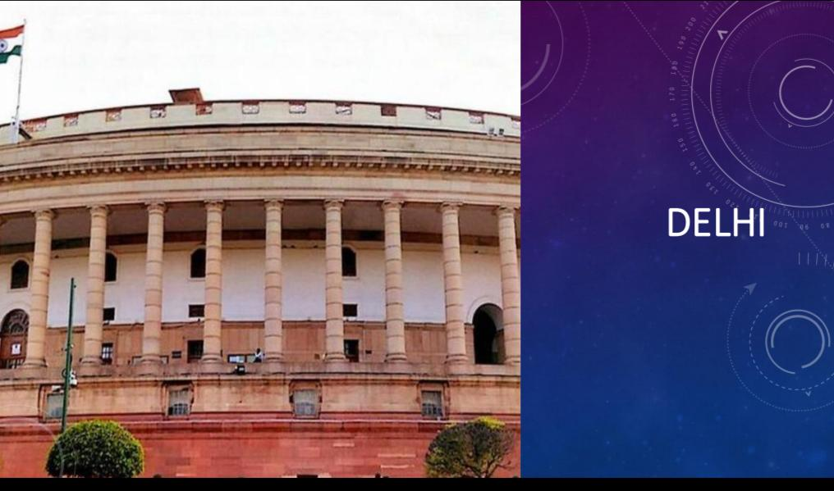

Slide 6
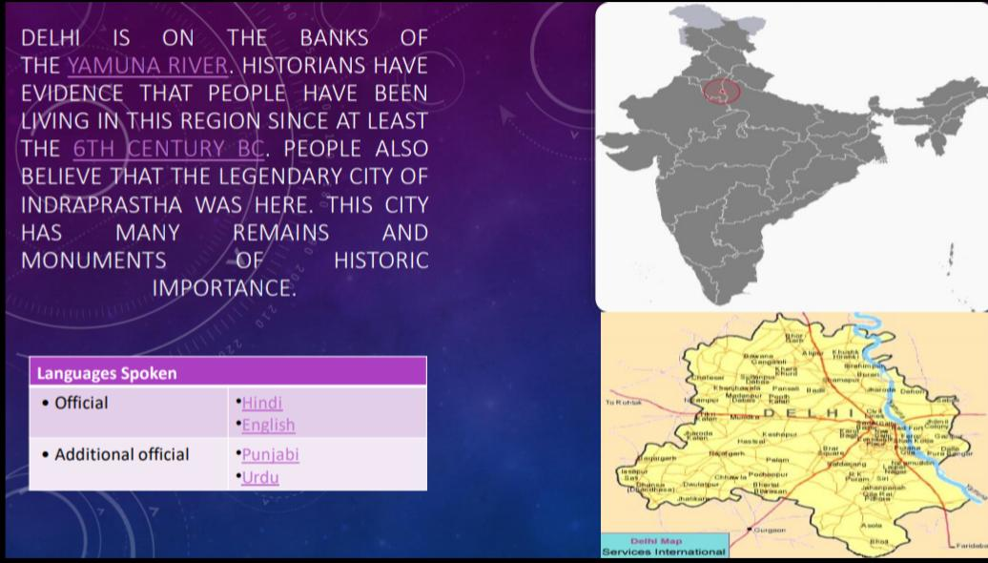

Slide 7
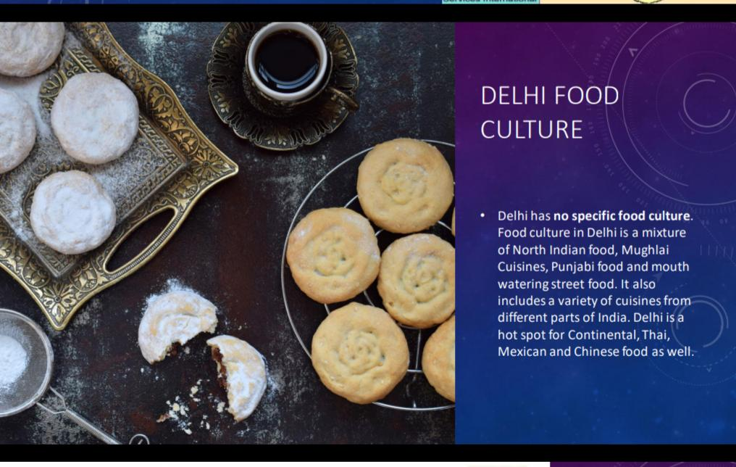

Slide 8
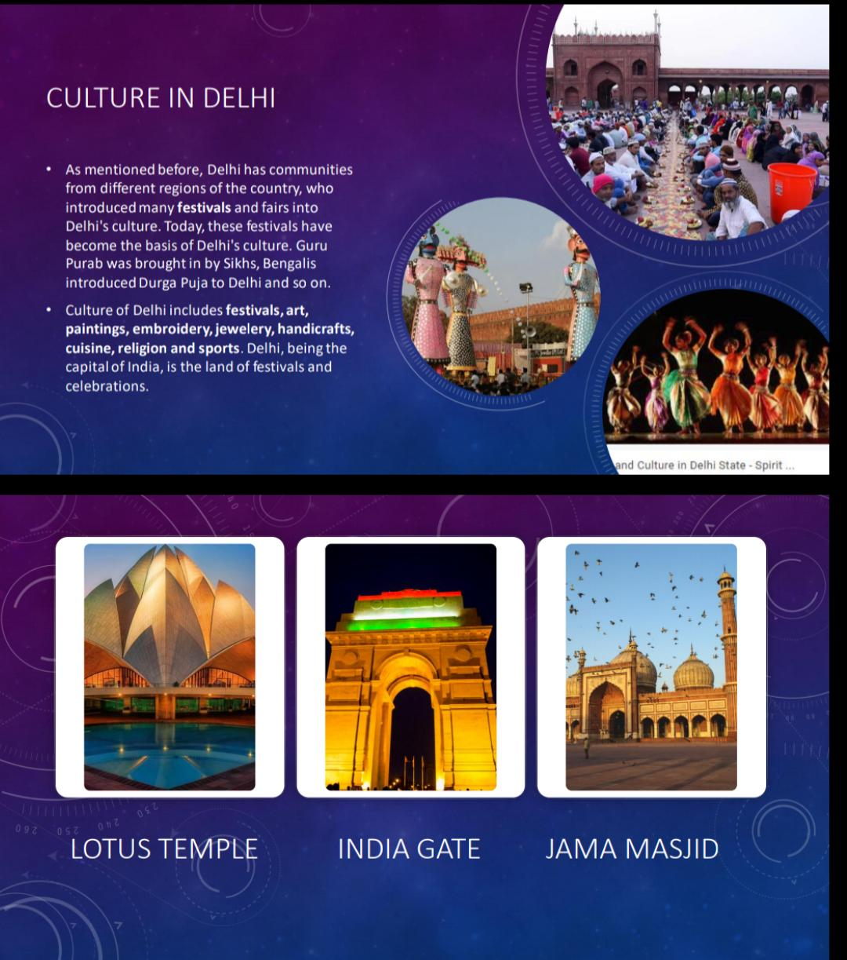

Slide 9
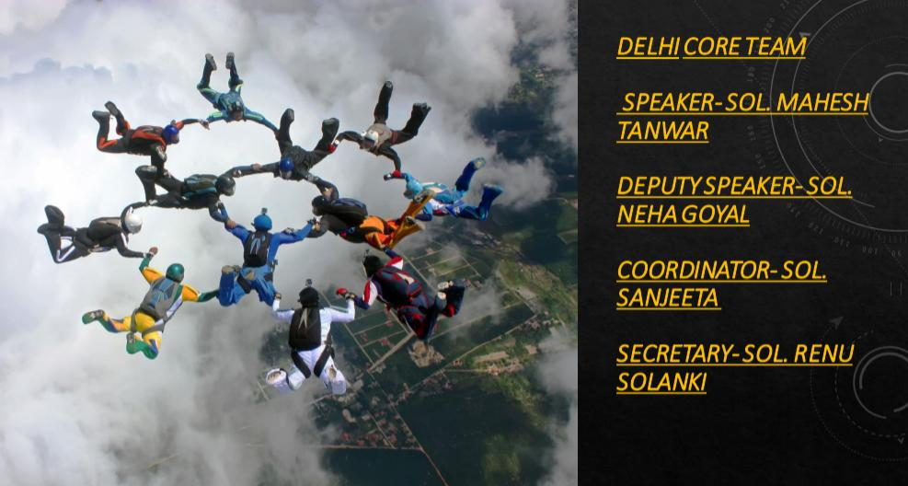

Slide 10
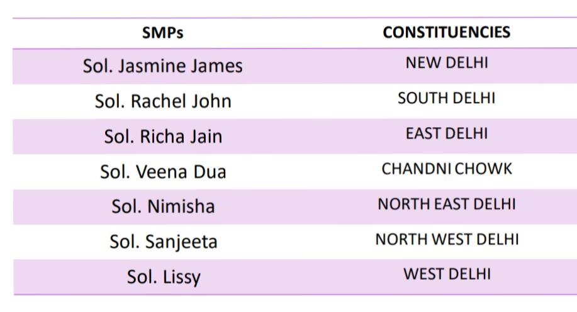

Slide 11
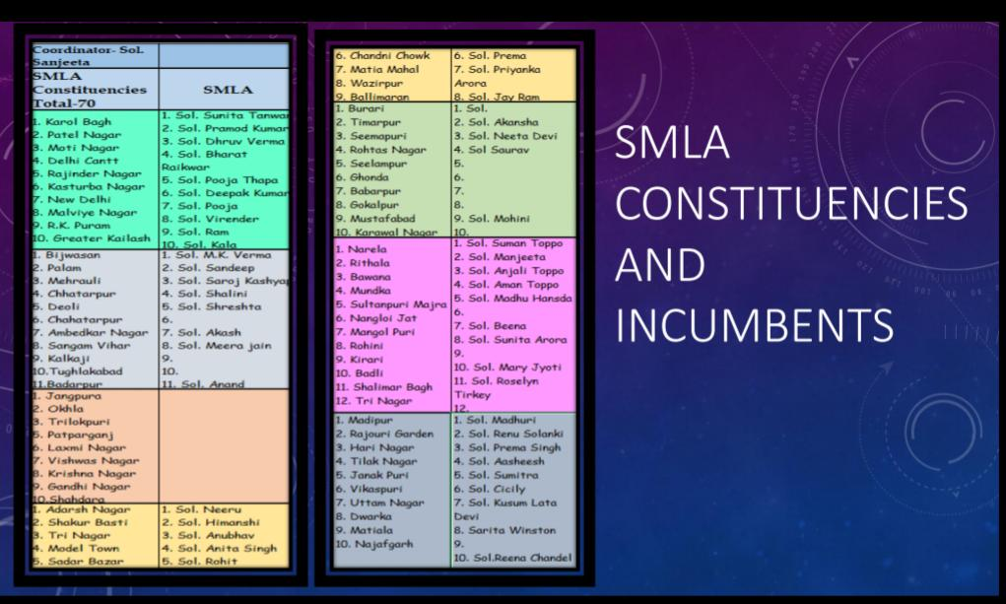

Slide 12
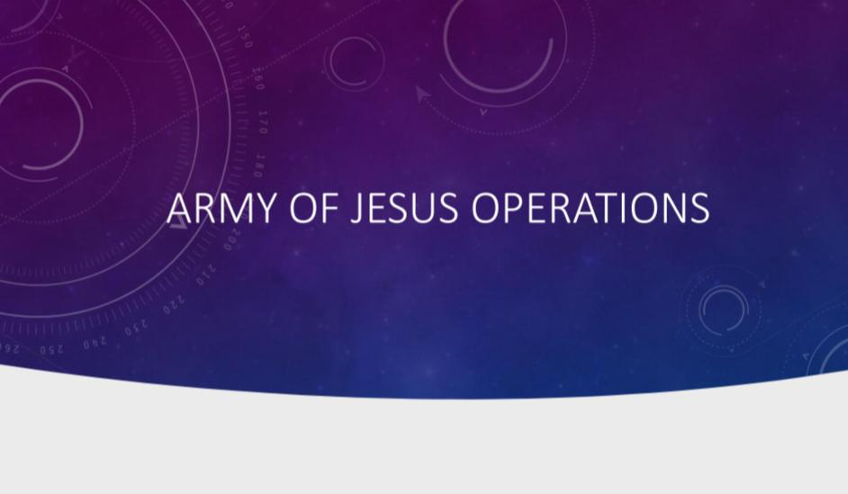

Slide 13
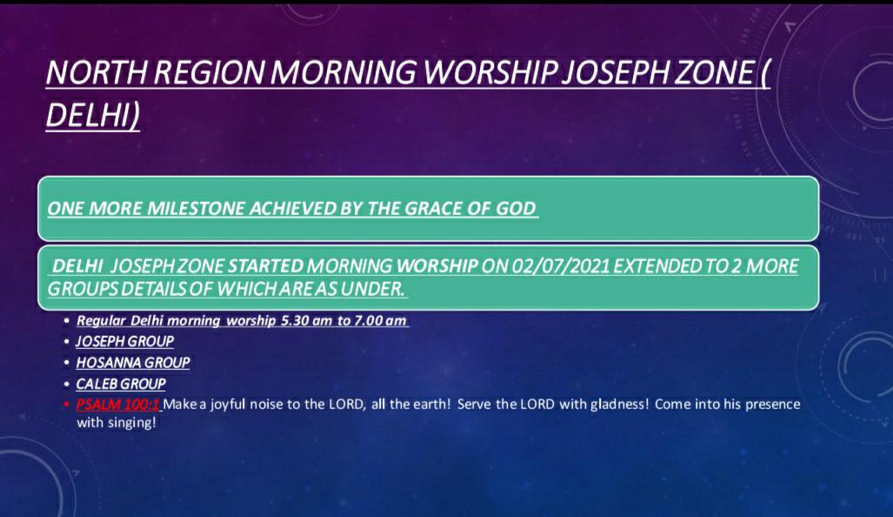

Slide 14
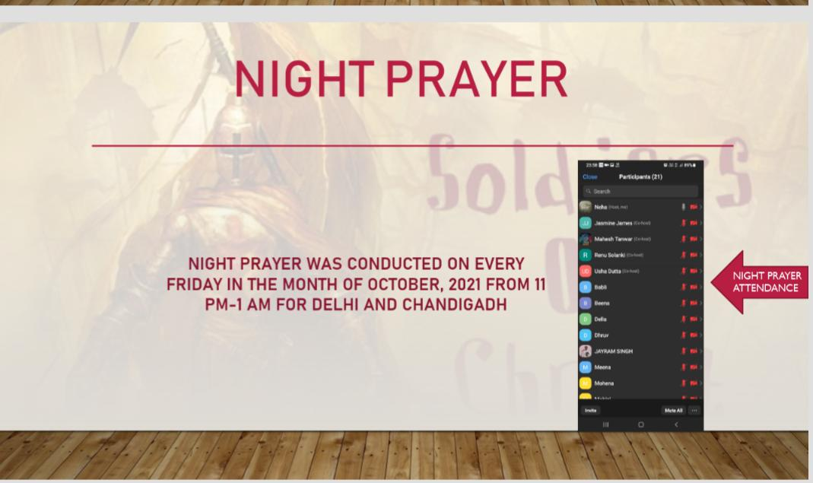

Slide 15
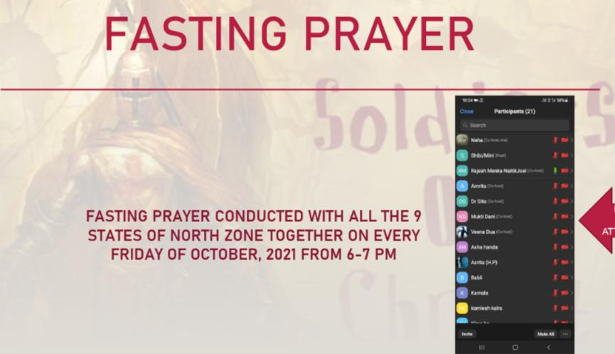

Slide 16
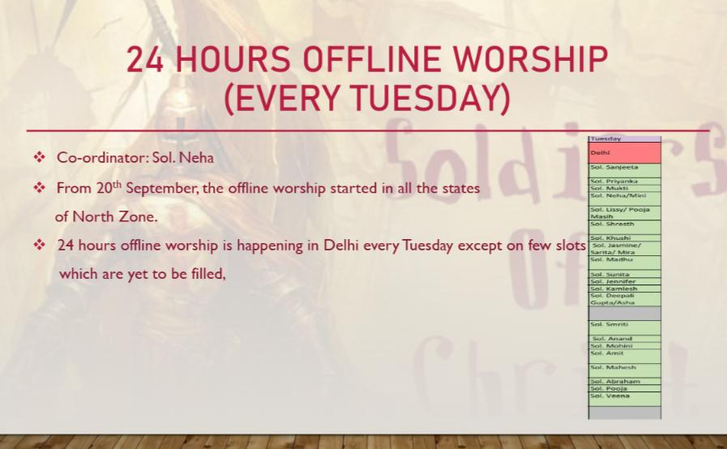

Slide 17
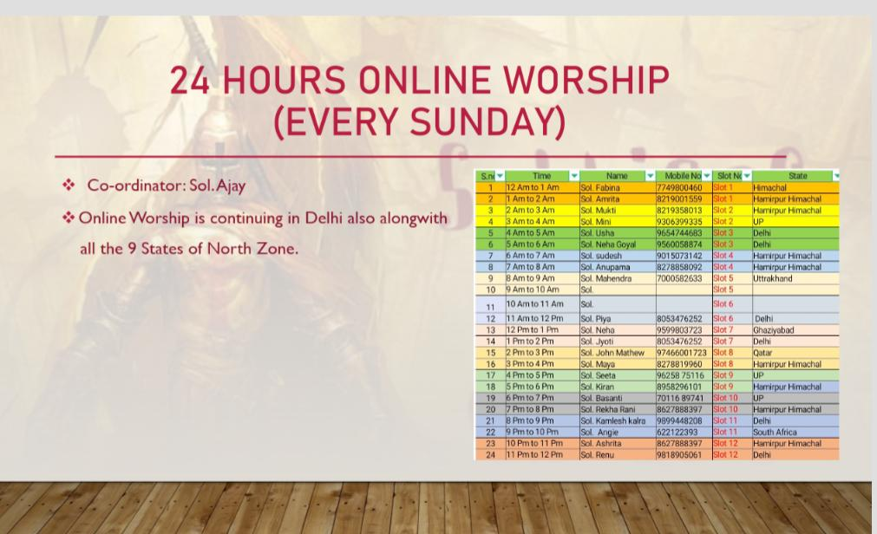

Slide 18
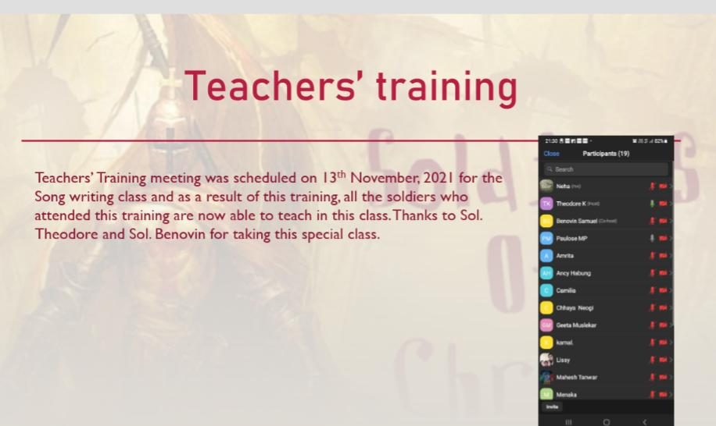

Slide 19
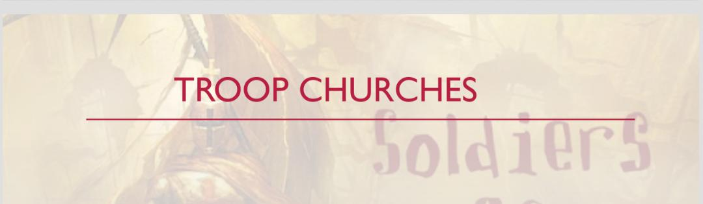

Slide 20
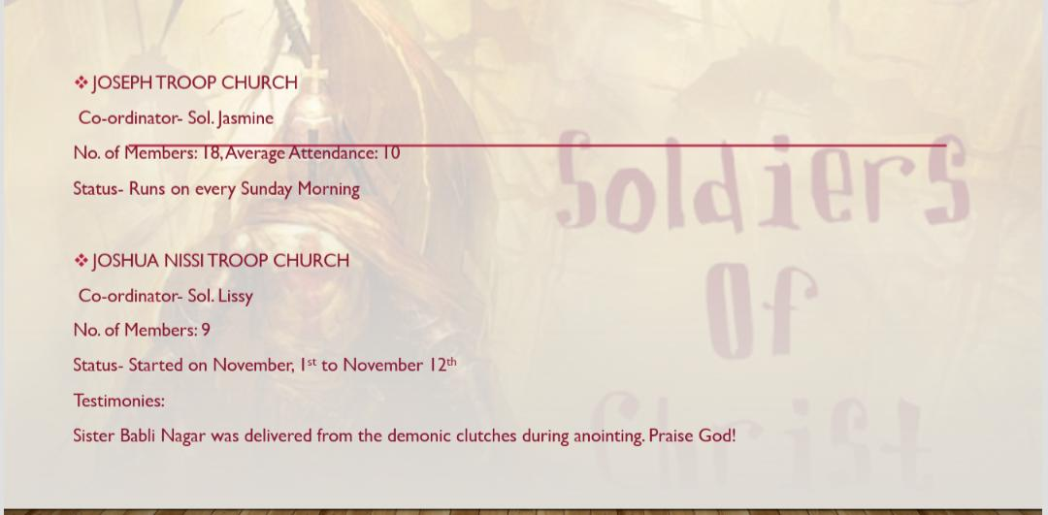

Slide 21
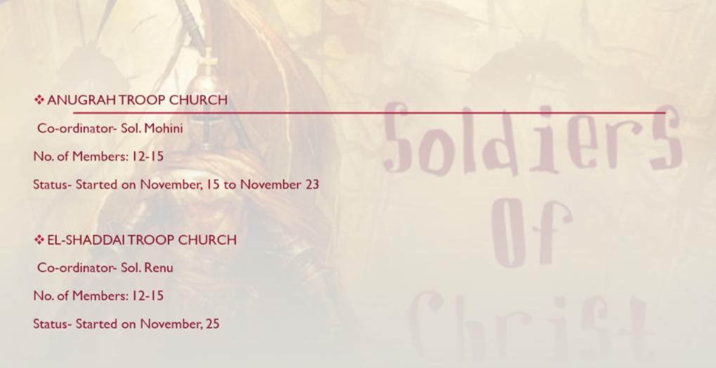

Slide 22
Gifts School Delhi November 2021
FRP level 1
Healing Level 1
FRP level 2
Family Building

Slide 23
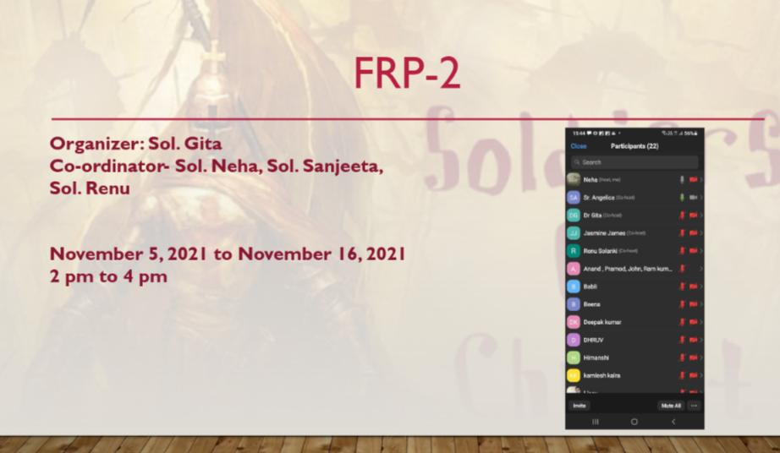

Slide 24
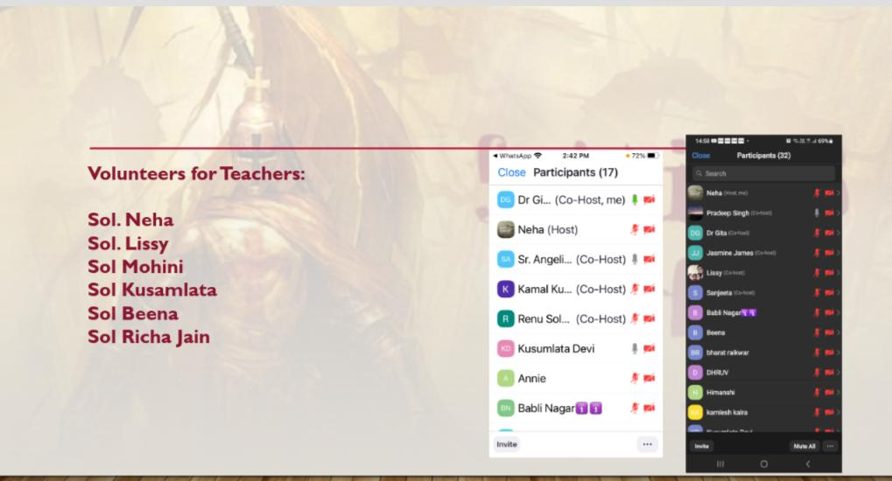

Slide 25
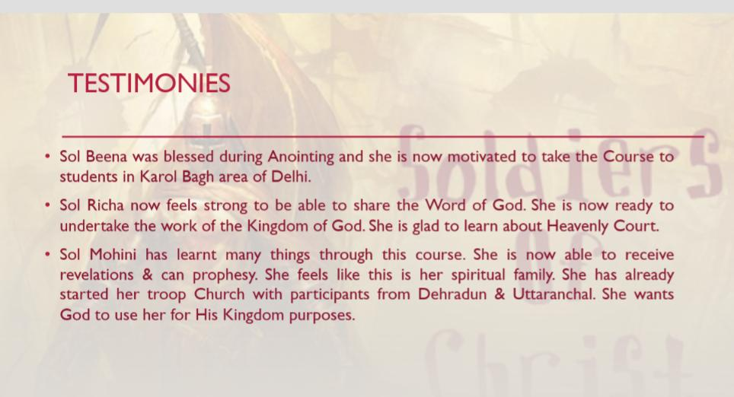

Slide 26
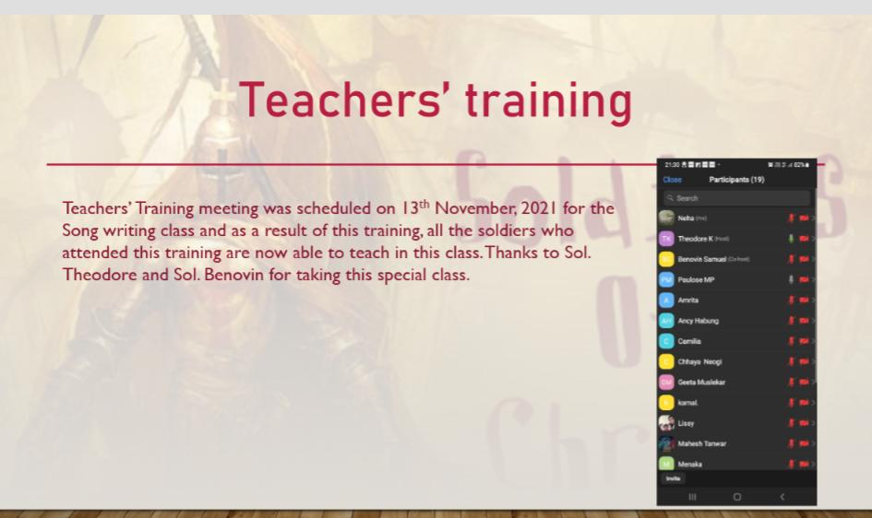

Slide 27
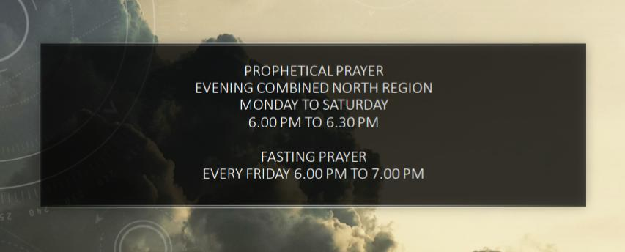

Slide 28
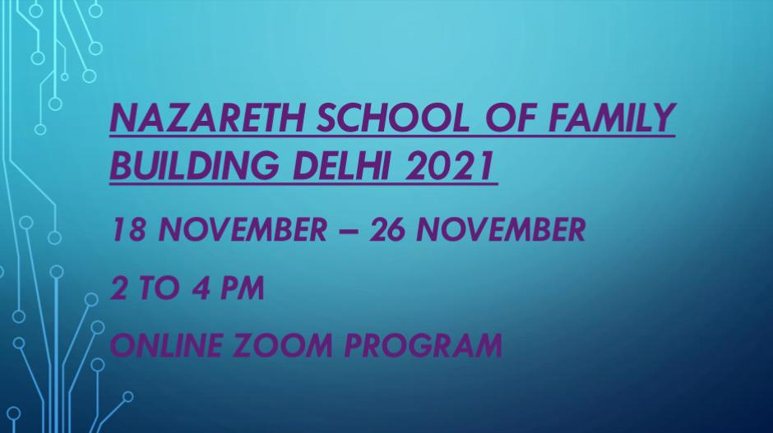

Slide 29
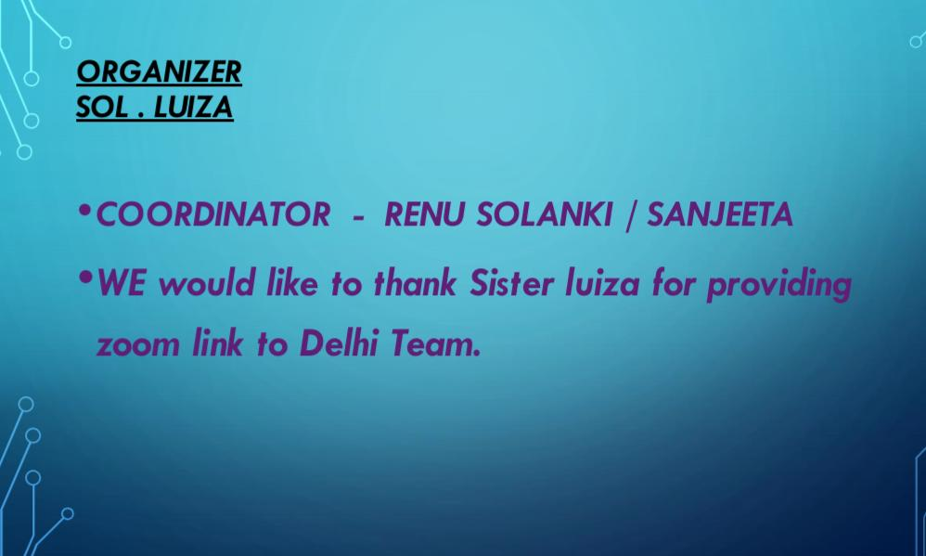

Slide 30
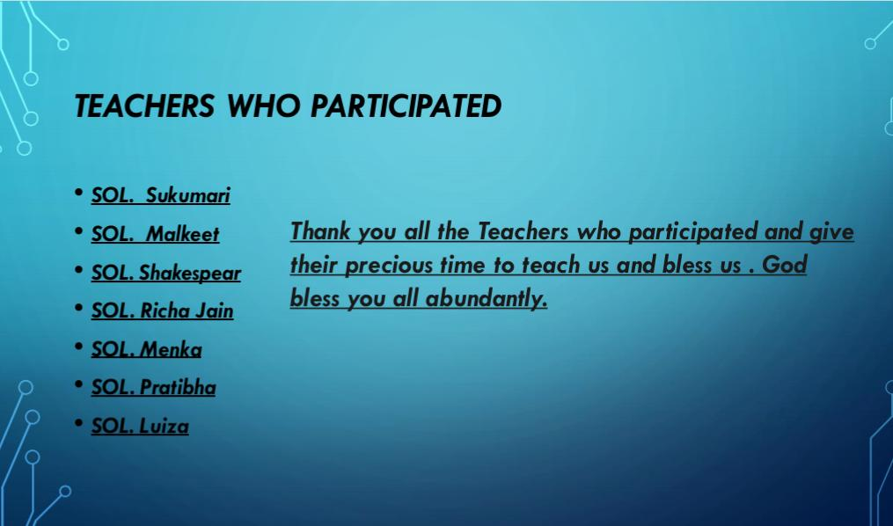

Slide 31
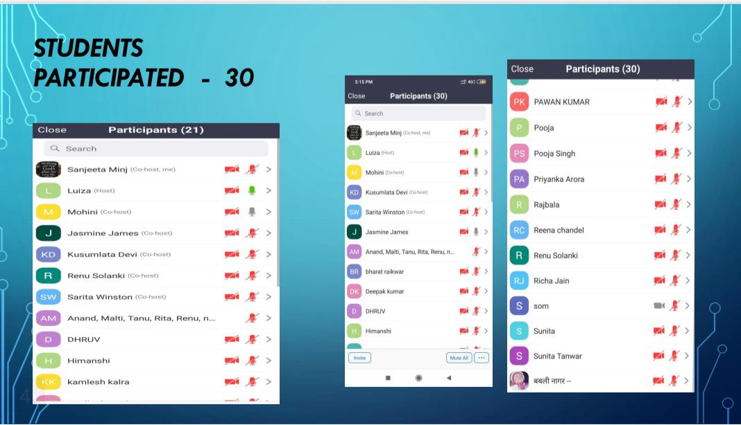

Slide 32


Slide 33
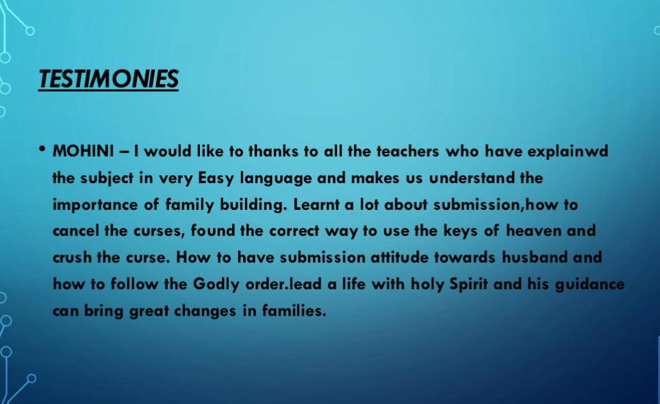

Slide 34
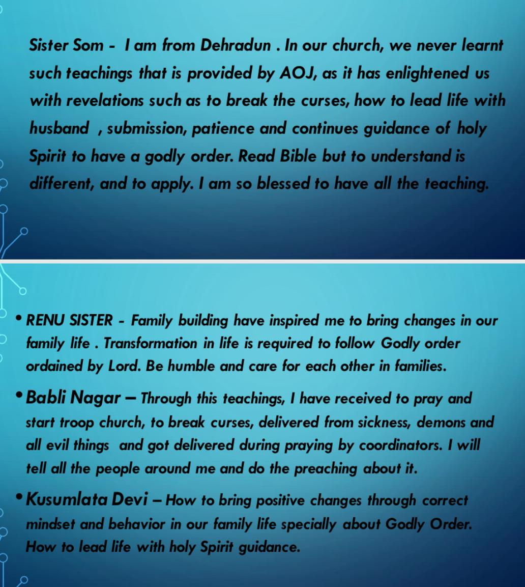

Slide 35


Slide 36
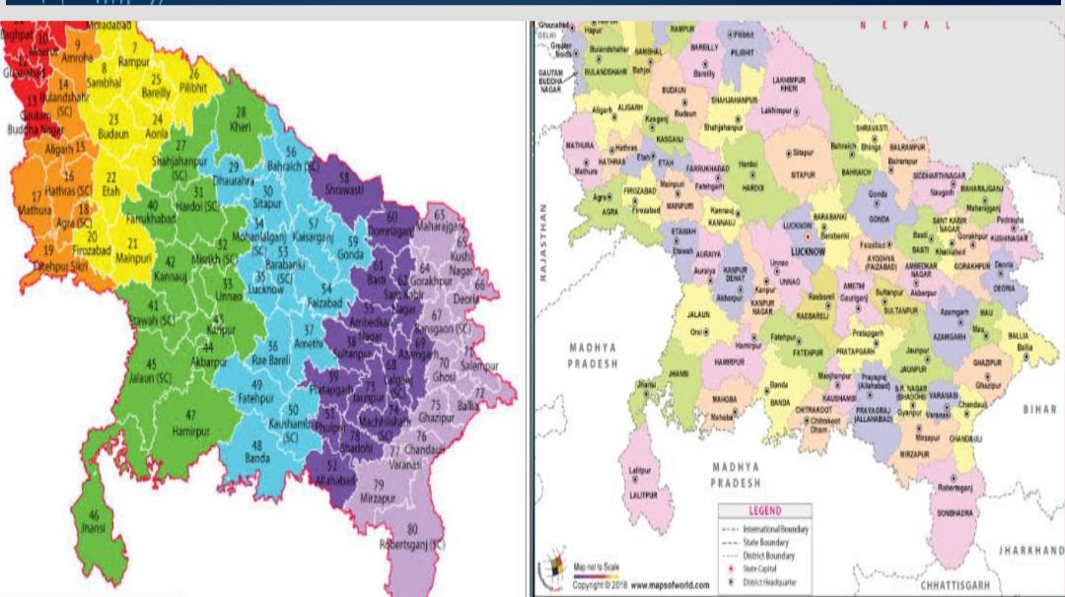

Slide 37


Slide 38
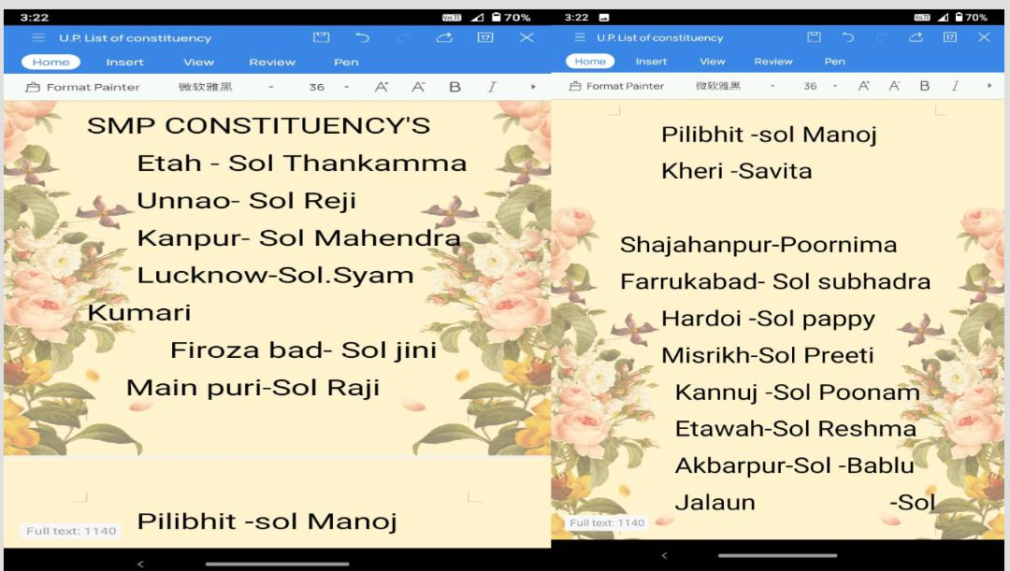

Slide 39


Slide 40
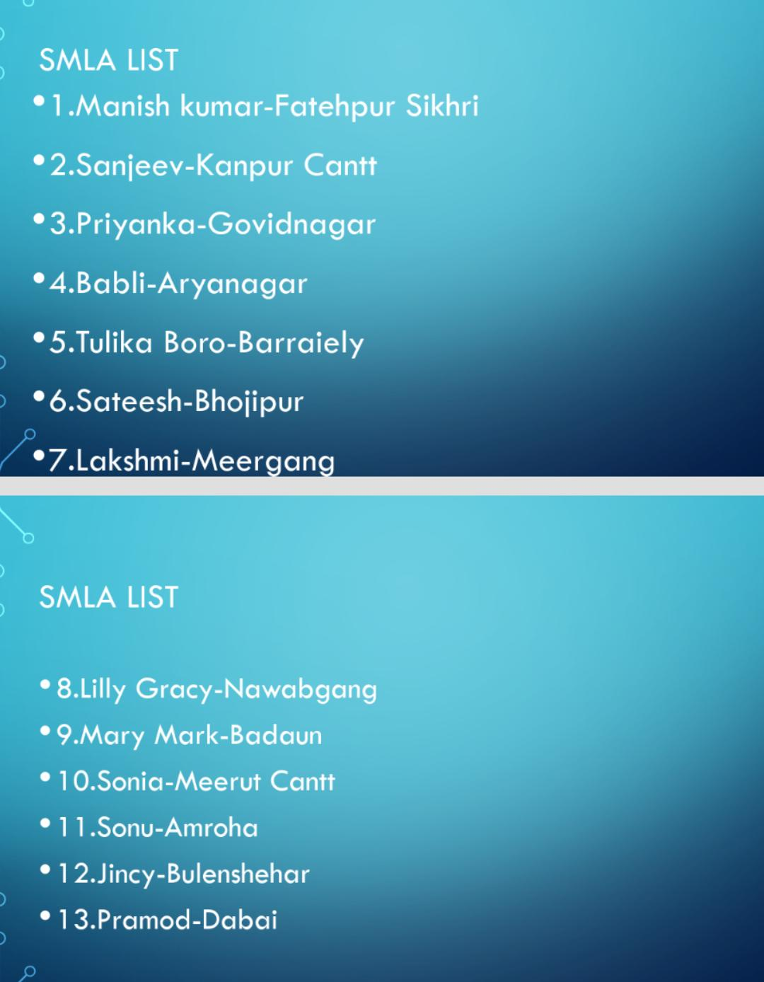

Slide 41
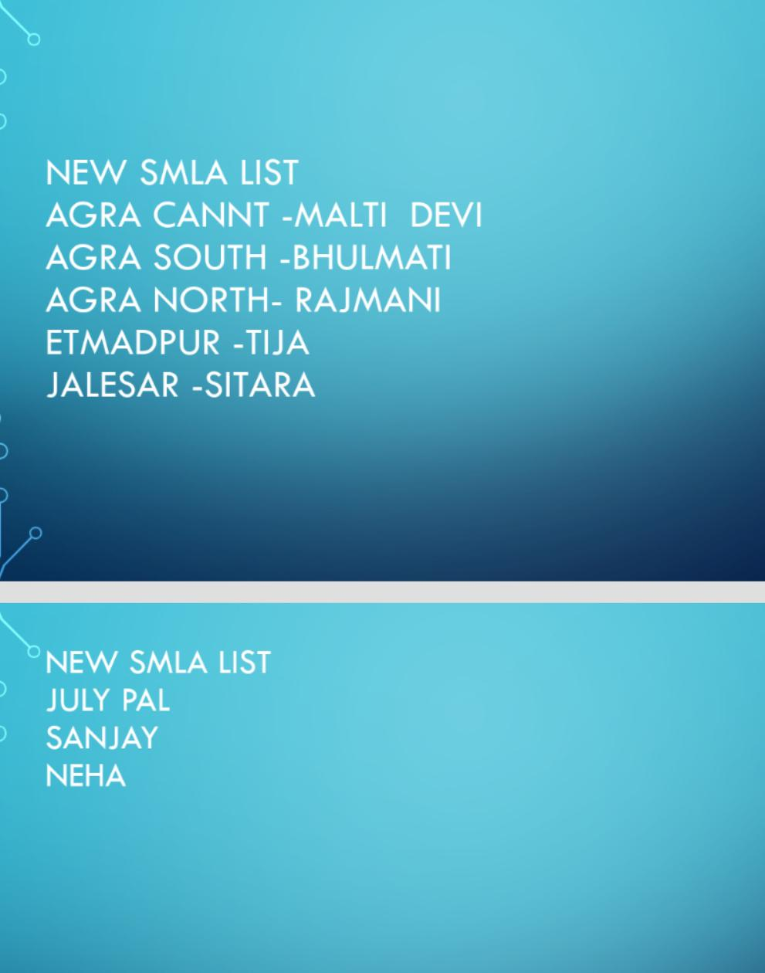

Slide 42
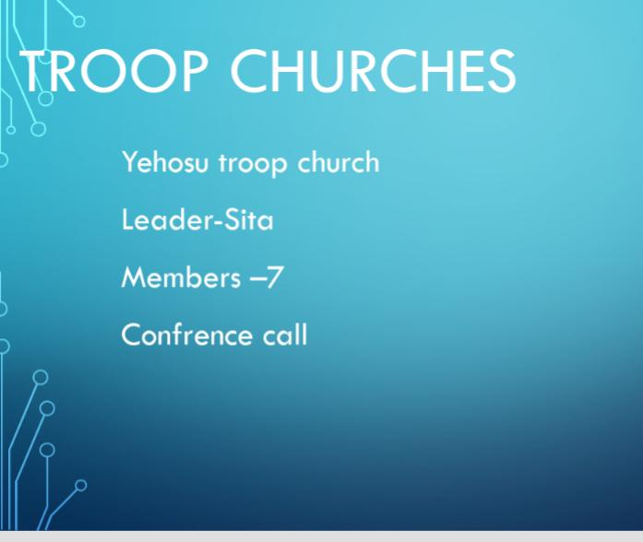

Slide 43
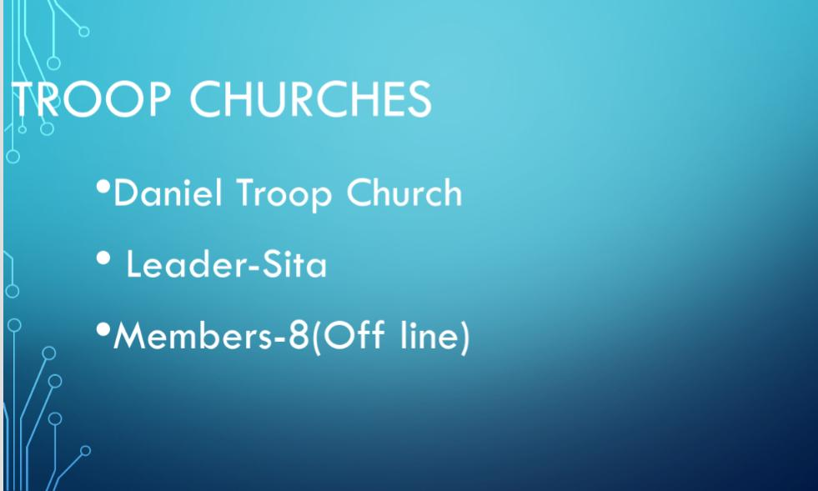

Slide 44
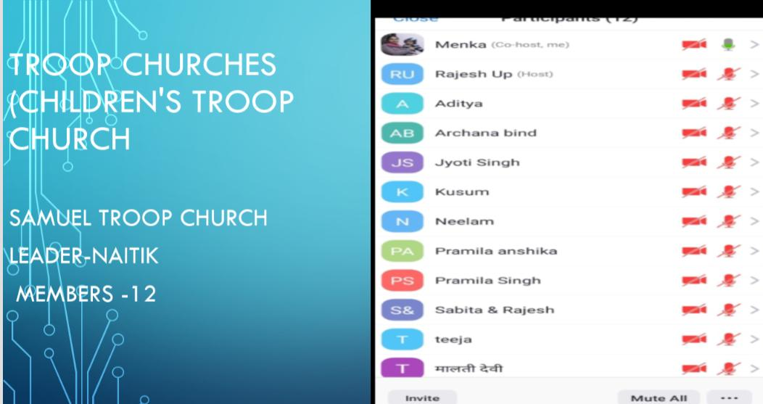

Slide 45


Slide 46
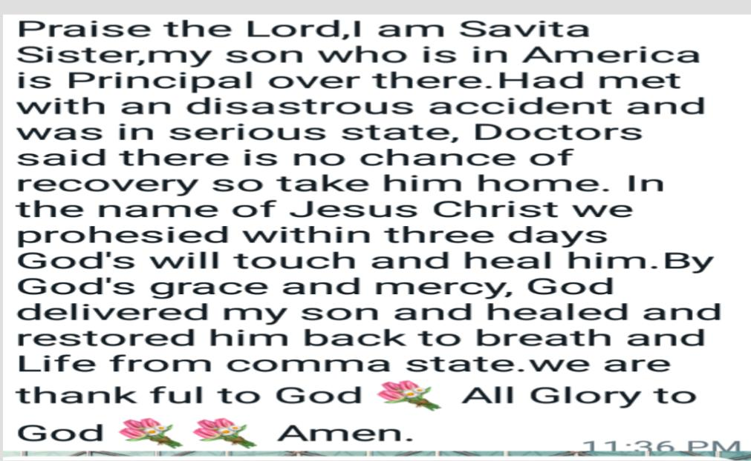

Slide 47
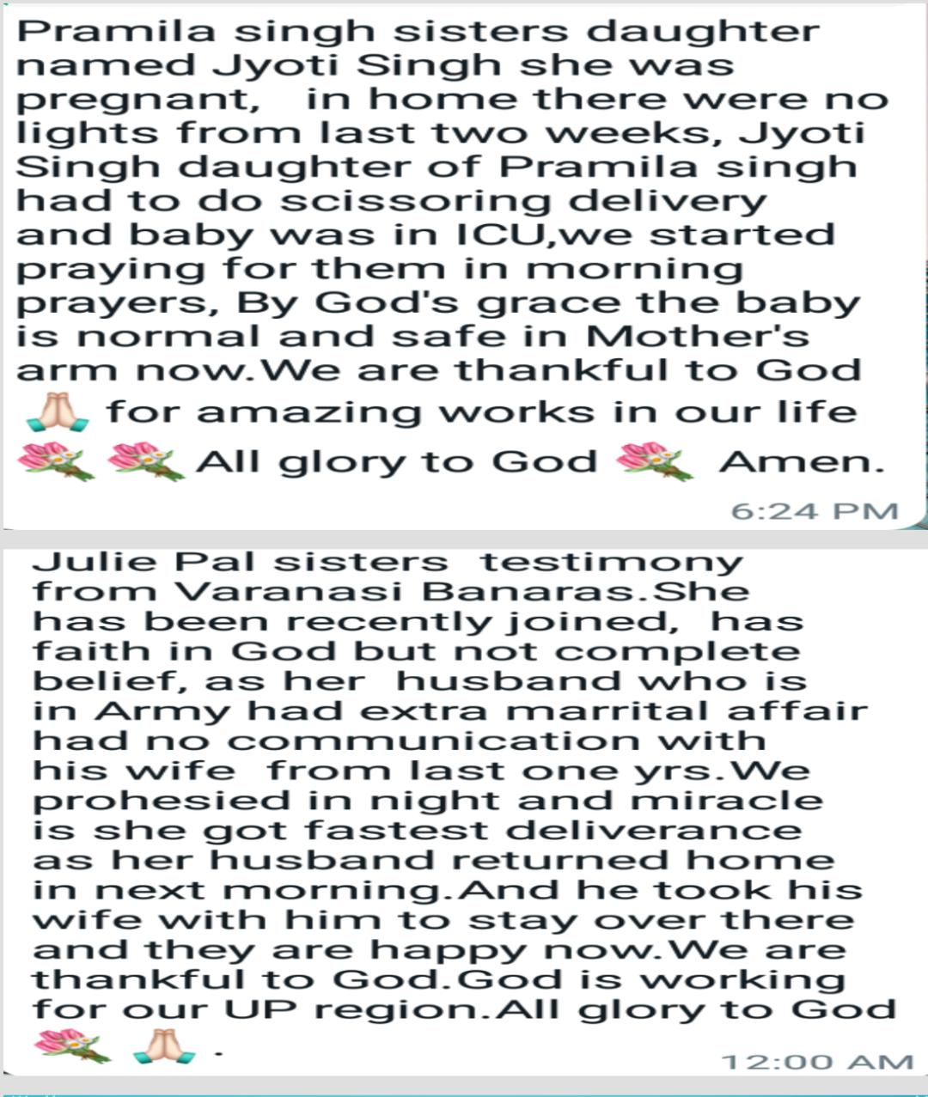

Slide 48
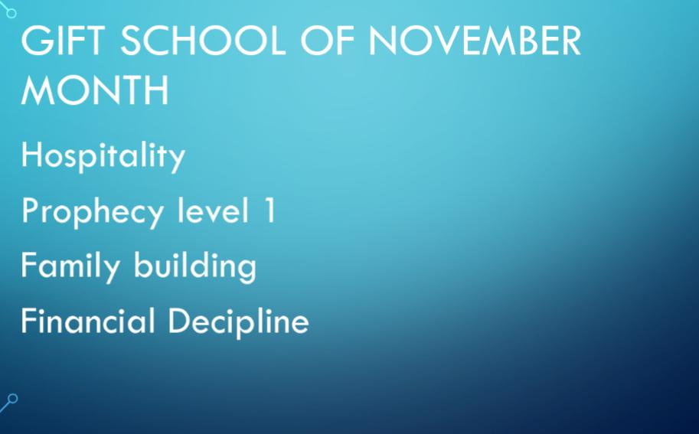

Slide 49
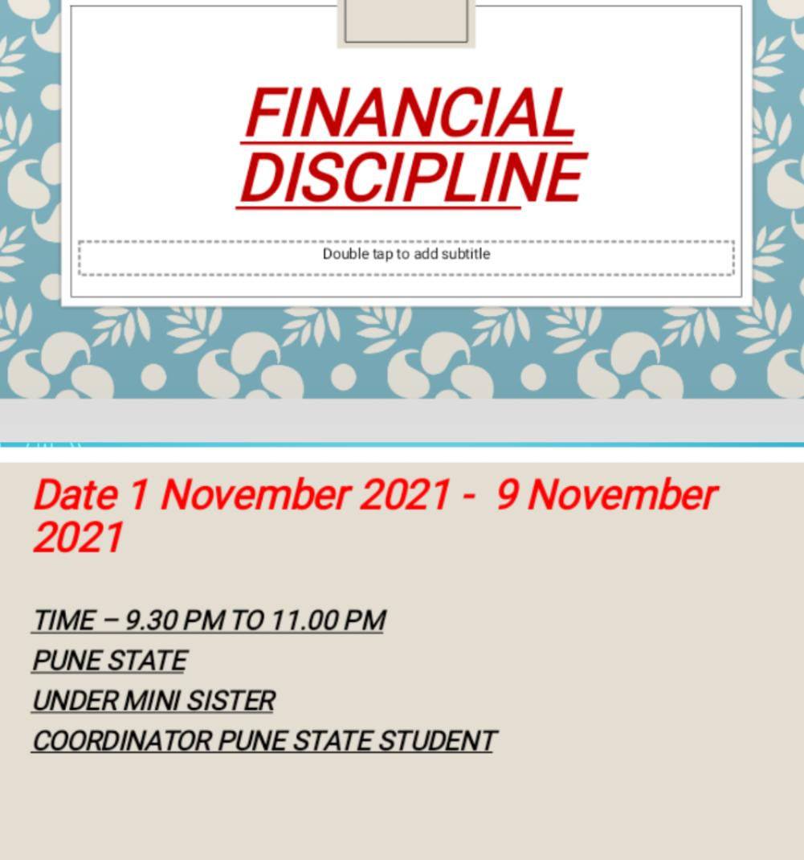

Slide 50
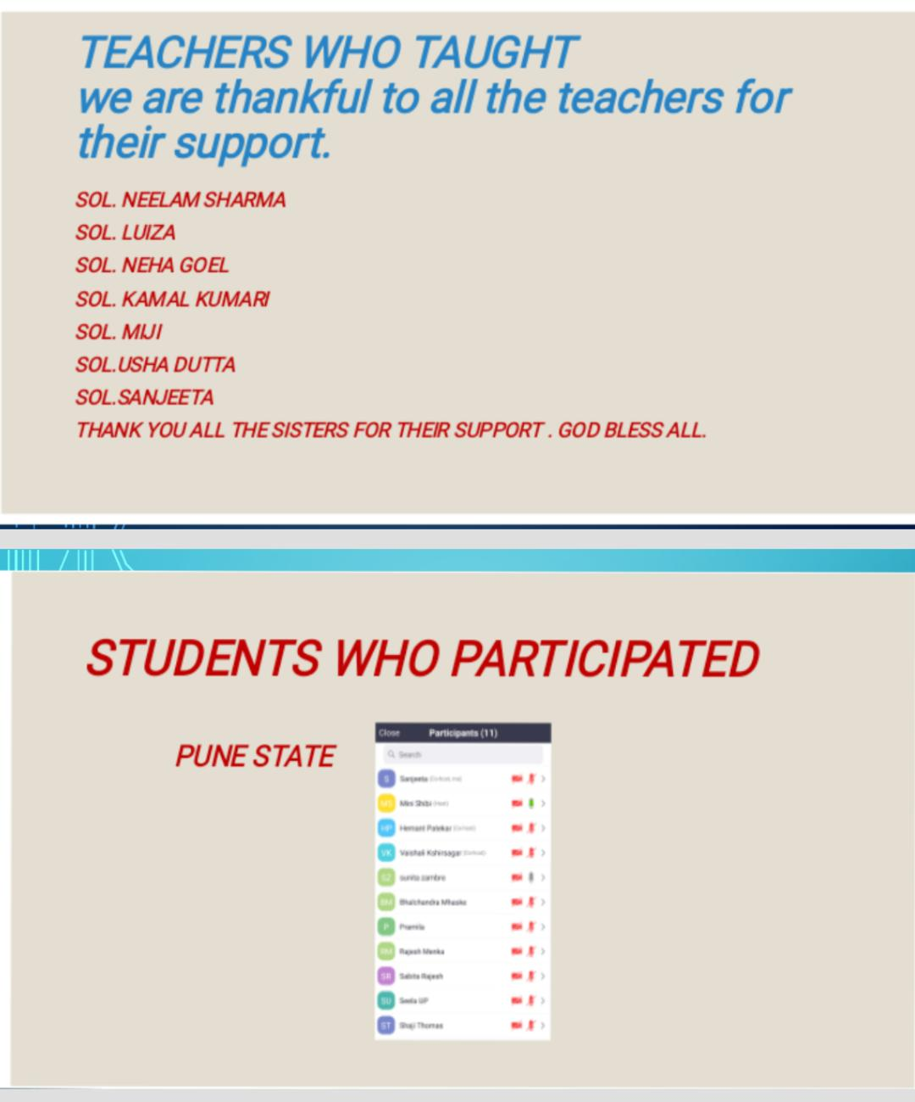

Slide 51
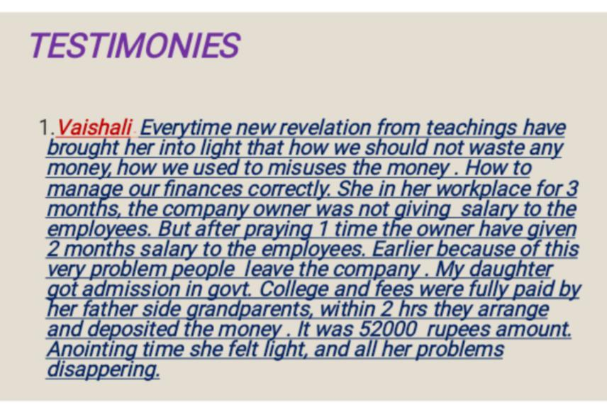

Slide 52
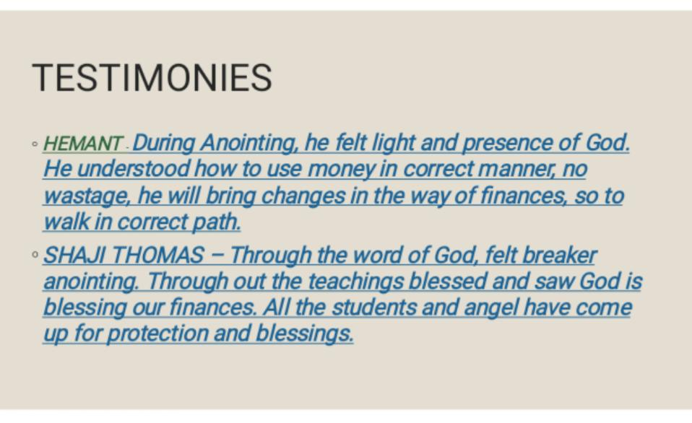

Slide 53
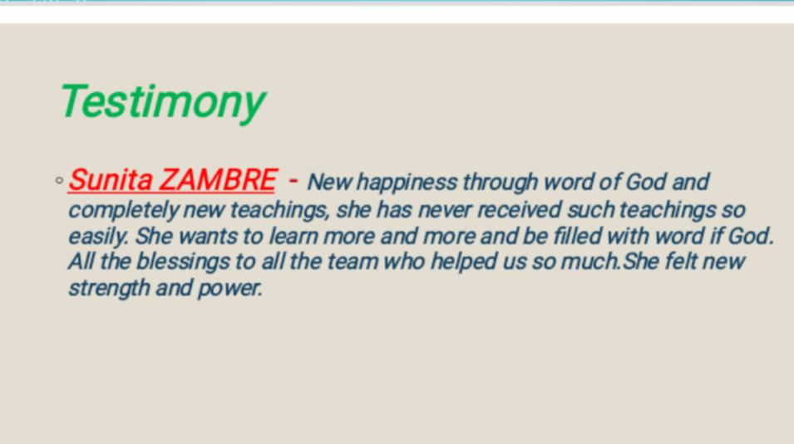

Slide 54
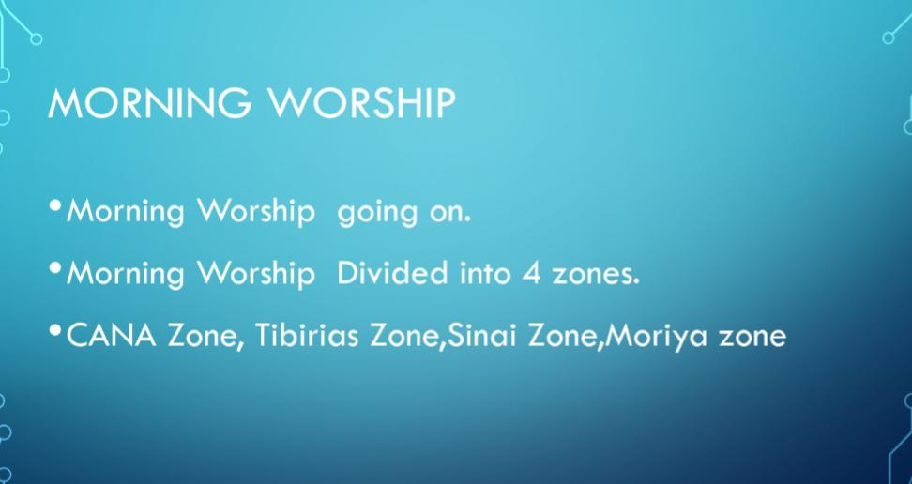

Slide 55
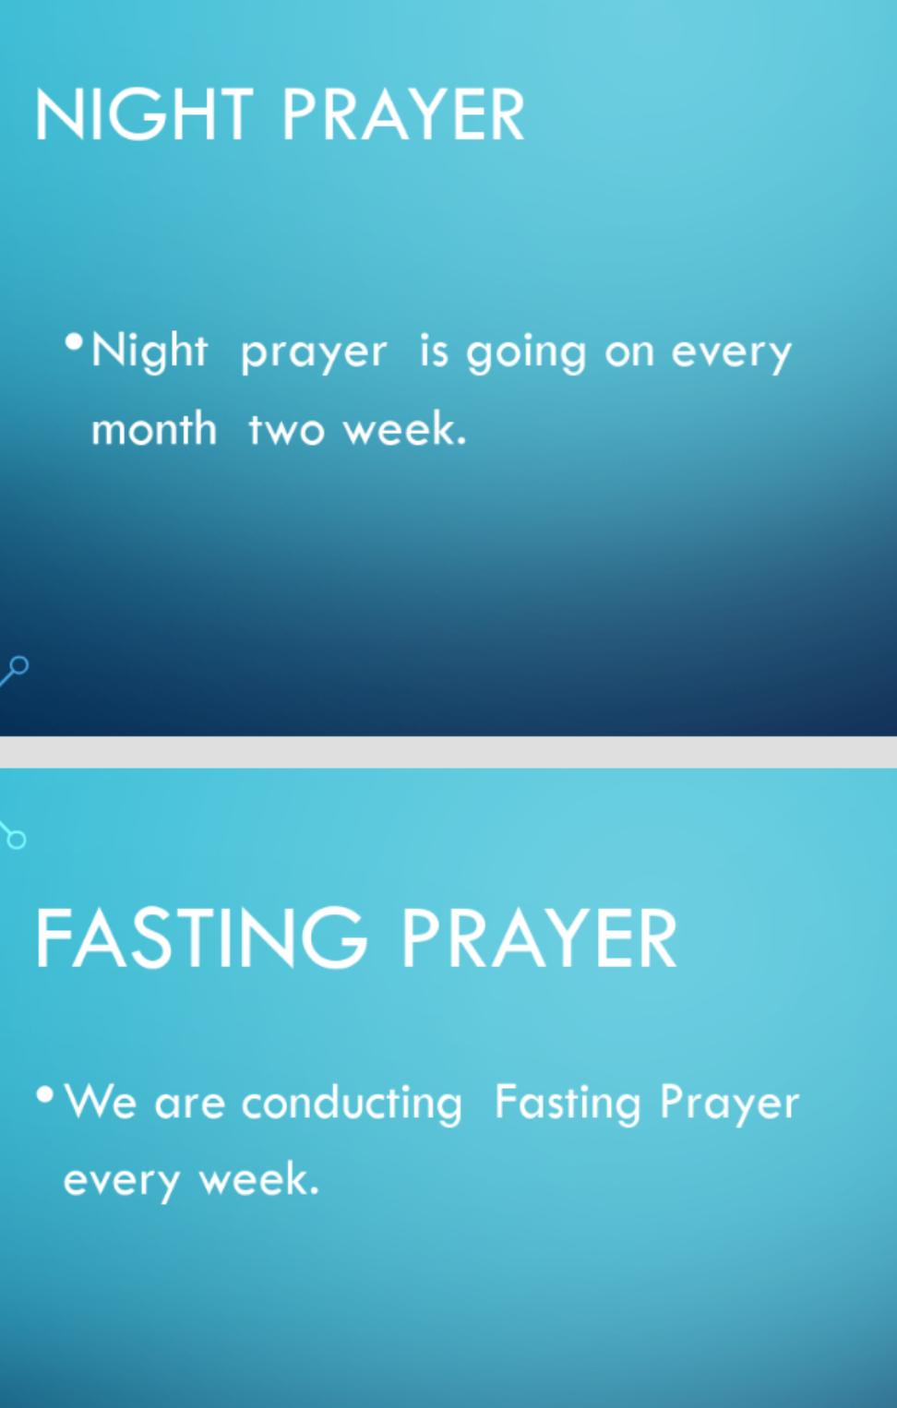

Slide 56
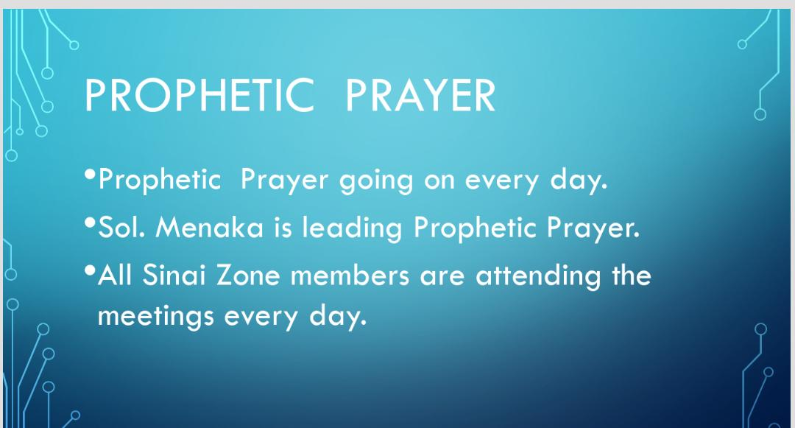

Slide 57


Slide 58
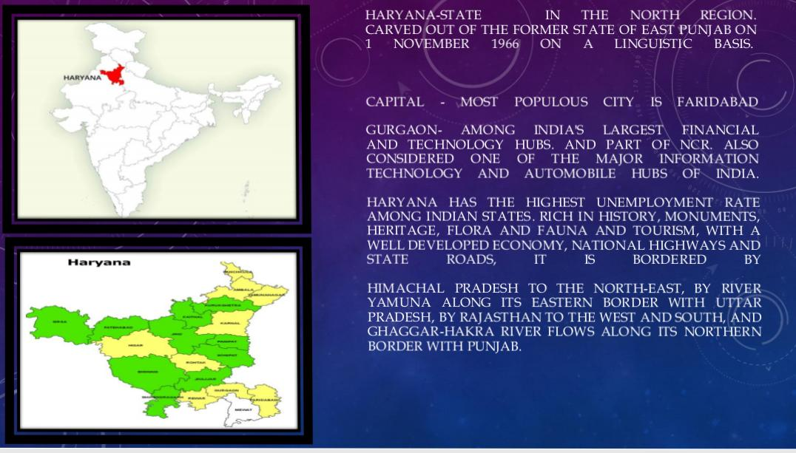

Slide 59


Slide 60


Slide 61
GIFTS SCHOOL IN THE MONTH OF NOVEMBER
family Building – 27 October to 6 November
Hospitality Gift School - 9.11.21

Slide 62
Troop churches
Offline Troop church Continues...
Imannuel troop church leader piya with 10 members.
Elisha troop church leader jyoti with 8 members.

Slide 63
Morning worship Daily
Night prayer 19.11.21
Troop church online conducted in the month of November.
Coordinator prayer everyday 4.30 am.
24 hours worship online prayer every Friday.

Slide 64
TESTIMONY
Sister Sangeeta from Haryana team - As she was conducting troop church but due to less members, it looked like it was failing but still by Gods grace we change the timings and the Lord help us to complete the troop church with 8 members.
I was in my hometown, my husband was trying to get us the tickets but due to the last moment problem and flight tickets were expensive too, But when we prayer in my place with family prayer God made it possible then and there Train tickets got booked, we were able to come back home.

Slide 65
Kamlesh kalra – once she prayed for the lady back in March 21,when she was working in her small tailor shop . She prayed over her to concieved a child. As last 9 years, she could not conceived. The prayed have been answered , she delivered a child.
Vanitha – During morning prayer and worship she prayed with the team for banglore rain. As it was continues raining in banglore. The very next day it was stopped.

Slide 66


Slide 67


Slide 68
TROOP CHURCH IN PUNJAB, MaLLot
MOSA TROOP CHURCH ( Total members are 4)
YEJIKAL TROOP CHURCH (Total members are 5)
MICAH TROOP CHURCH (Total members are 4 )
Morning prayer 5.30 am to 7 am
Offine work is more than online work
No Gifts school
Testimonies are healings and deliverance from evil spirit.

Slide 69


Slide 70


Slide 71


Slide 72
Chandigarh
We are praying for the area that it should grow by the grace of our Lord Jesus Christ.
No Troop churches or gifts school started.

Slide 73


Slide 74


Slide 75
UTTRAKHAND
We are praying for the area that it should grow by the grace of our Lord Jesus Christ.
No Troop churches or gifts school started.

Slide 76
Jammu & Kashmir
LADAKH (UT)

Slide 77


Slide 78


Slide 79
Ladakh
We are praying for the area that it should grow by the grace of our Lord Jesus Christ.
No Troop churches or gifts school started.

Slide 80


Slide 81


Slide 82


Slide 83


Slide 84


Slide 85


Slide 86
HIMACHAL PRADESH
Prerit Troop church 8.11.21 To 15.11.21
Bethseda School of Healing 22.11.21 to 28.11.21
NIGHT prayer and morning worship Prayer

Slide 87


Total Members - 14

Slide 88
TESTIMONY
Ashrita from past 8 years had leg pain. She went everywhere to get healing, Doctors, Ayurveda, and all kinds jaad fukh baba from roadside.After true repentance, I got Healed in healing class.
Her husband was suffering from blood pressure and his veins got torned inside his brain due to which blood was leaking. We went to many doctor but only he got relief from troop church and taking class and now he is recovering..

Slide 89


Slide 90


Slide 91


Slide 92


