Slide 1
PRAISE REPORT
OF
DELHI
OCTOBER 2021

Slide 2
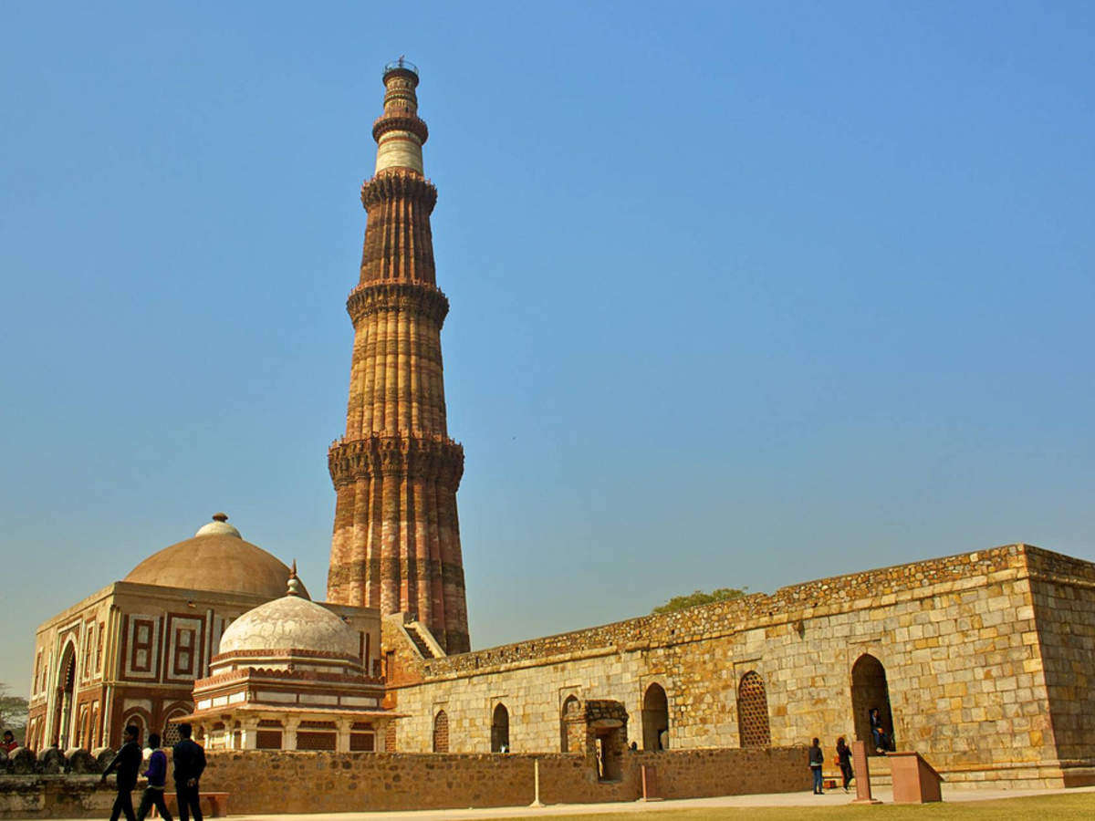
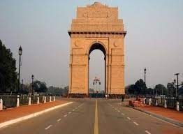
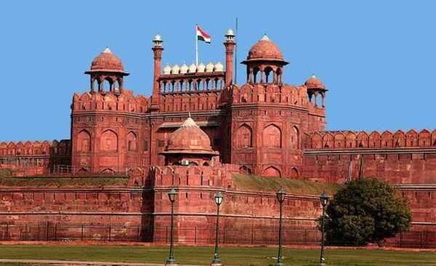
Constituencies
1. New Delhi
2. South Delhi
3. East Delhi
4. Chandni Chowk
5. North East Delhi
6. North West Delhi
7. West Delhi

Slide 3
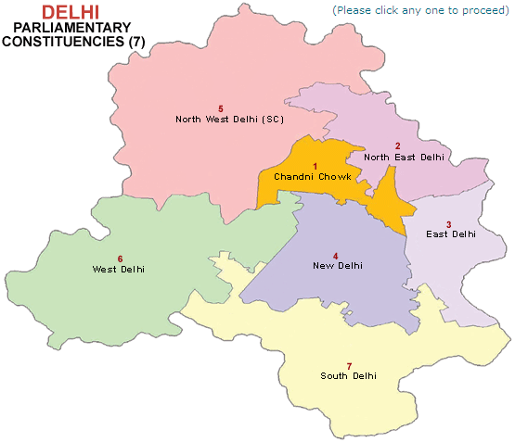

Slide 4
CORE TEAM OF DELHI
Speaker – Sol. Mahesh Tanvar
Dy Speaker – Sol. Neha
Co-ordinator – Sol. Sanjeeta
Secretary - Sol Renu

Slide 9
TROOP CHURCHES

Slide 10
JOSEPH TROOP CHURCH
Co-ordinator- Sol. Jasmine
No. of Members: 18, Average Attendance: 10
Status- Runs on every Sunday Morning
YEHOVAH NISSI TROOP CHURCH
Co-ordinator- Sol. Lissy
No. of Members: 6-7
Status- Started on October, 24th and runs daily through Conference Call

Slide 11
GIFT SCHOOLS

Slide 12
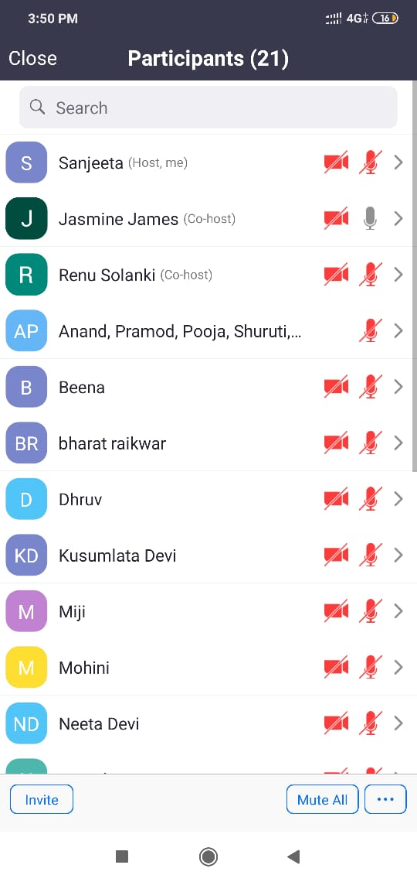
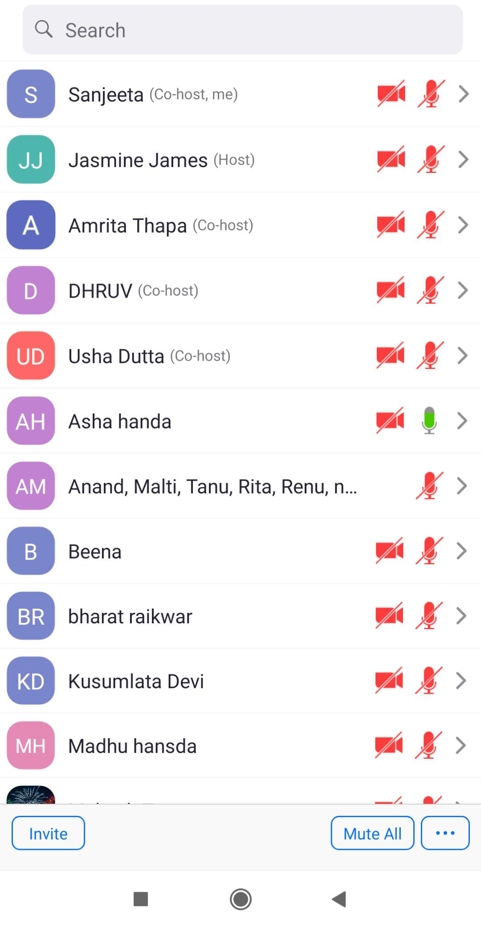
PROPHECY
Co-ordinator- Sol. Sanjeeta & Sol. Renu
September 29, 2021- October 7, 2021
2 pm to 4 pm
Volunteers for Teachers:
Sol. Priyanka
Sol. Mohini
Sol. Asha

Slide 13
S.No. | Date | Class Details | In Charge
1. | 29th September, 2021 | Vision about India and Model Church | Sol. Sanjeeta
2. | 30th September, 2021 | Three Foundational Experiences of a believer | Sol. Miji
3. | 1st October, 2021 | Prophetic Flow | Sol. Gita
4. | 2nd October, 2021 | Visualizing the Word of God & Prophesying in groups | Sol. Veena
5. | 4th October, 2021 | Troop Church | Sol. Usha
6. | 5th October, 2021 | Spiritual Warfare | Sol. Shebe
7. | 6th October, 2021 | Hearing and Seeing the voice of God | Sol. Veena
8. | 7th October, 2021 | Prophecy Life, Practical & Anointing | Sol. Usha & Jasmine

Slide 14
tESTIMONIES
Sol. Mohini: She learnt the gift of prophecy and understood the power of God and activated this gift. She thanked God who is doing things for her development and blessing her in every area of her life. She shared that be it our natural environment and personal spiritual growth, prophecy bring Goodness of God.
Sol. Priyanka - She didn’t know about prophecy can make things possible. She did learn prophecy writing and declaring. She is doing that for family and her life to bring blessing of God in Her family and friends.
Sol. Neeta -She was living her life with discouragement and continues problem in her life but while attending these classes , she is filled with hope, courage and increasing strength to fight opposition from family. She learnt prophecy and now she is applying it bring changes in her life and releasing blessings of Jesus.

Slide 15
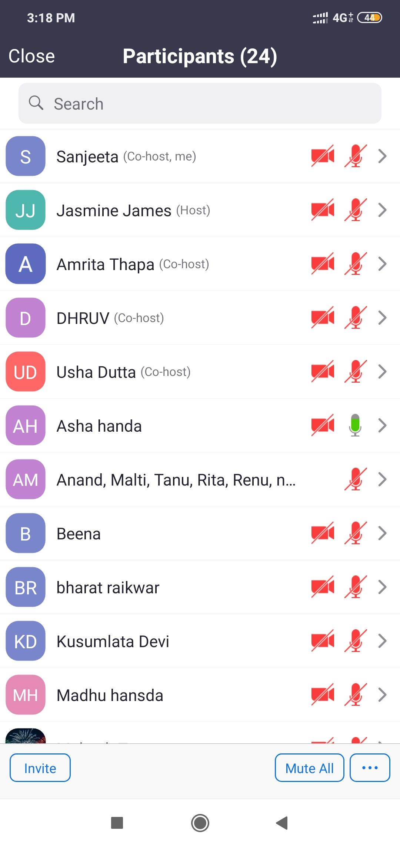
BE FORMED AND FORM (BFF)
Co-ordinator- Sol. Sanjeeta, Sol. Renu,
Sol. Lissy, Sol. Jasmine
October 8, 2021 to October 26, 2021
2 pm to 4 pm, &
4 pm to 6 pm

Slide 16
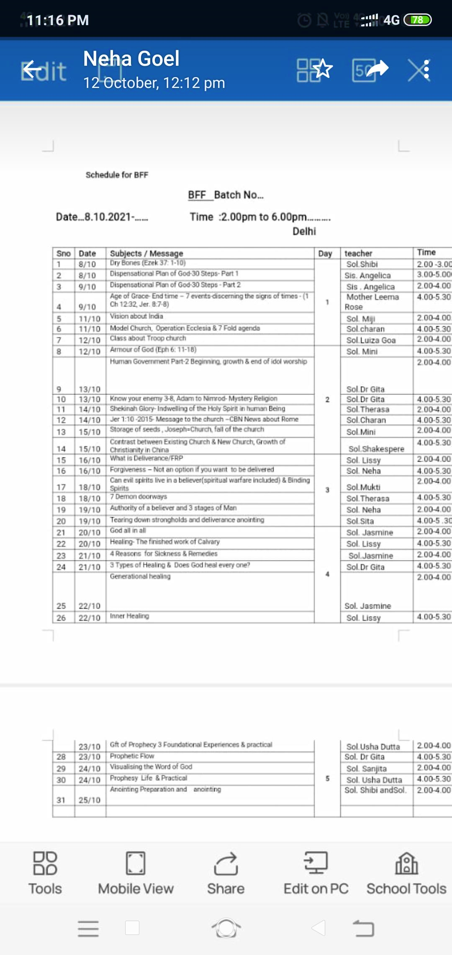

Slide 17
tESTIMONIES
Sol. Neeta: She never went to any church. During the 15 days BFF Training, she felt the grace and love of God. Earlier in her life she used to feel insecure, fear, nervous breakdown in every situation of her life. She has seen many strongholds broken down and Lord has given her strength and courage to fight all the oppositions in her family and around her. During anointing she has cried her heart out to Lord Jesus and felt peace , love of God.
Sol. Kusumlata Devi - Before BFF training she also used to feel fear and nervousness, anxiety. During anointing, she felt the presence of God and tears in her eyes.
Sol. Priyanka Arora - She is happy to receive the knowledge and ready to teach. During anointing she was shaking and crying her.
Sol. Reena - she is feeling peace of God during these 15 days classes . During anointing she was Shivering and felt flying in the sky, light and overwhelmed.

Slide 18
tESTIMONIES
Sol. Madhu Hansda - During this 15 days program , she received the power and grace to speak . She was scared to speak during meetings. She receive the Gift of prophecy and did 2 prophecy as well. She has gain pure knowledge of God so easily through zoom app. How to grow spiritually in holy Spirit with right Bible knowledge and guidance. Many classes have given her healing in her life. Felt light.
Sol. Babli - She lived a lazy life and never valued her own life. She understand the true value of life is to serve God. She receives the knowledge of Bible which opened her eyes. During anointing she felt fire and heat of God.
Sol. Kamlesh Kalra - During this 15 days BFF training, she was not well as she was vomiting for regular 3 days despite of which she attended these classes and felt the grace and power of God have given her deliverance in many areas of her life. Something came out from her mouth and she was delivered.

Slide 19
tESTIMONIES
Sol. Mohini - She joined AOJ this year in the month of August 27 . She was asking God to give her church and people and pastor. But the Lord have given her AOJ where everyone is Equal and anointed, blessed family. By the grace of God, she has learnt so much in these 2 months through zoom app in phone, which is why she is glad that through phone Lord made easier access to reach. The knowledge of Bible which is new eg. Prophecy, healing, holy Communion, anointing for ordinary people, breaking strong holds have help her grow spiritually and given strength to fight opposition. She is receiving the visions and prayers that she asking God is fulfilling so fast.

Slide 20
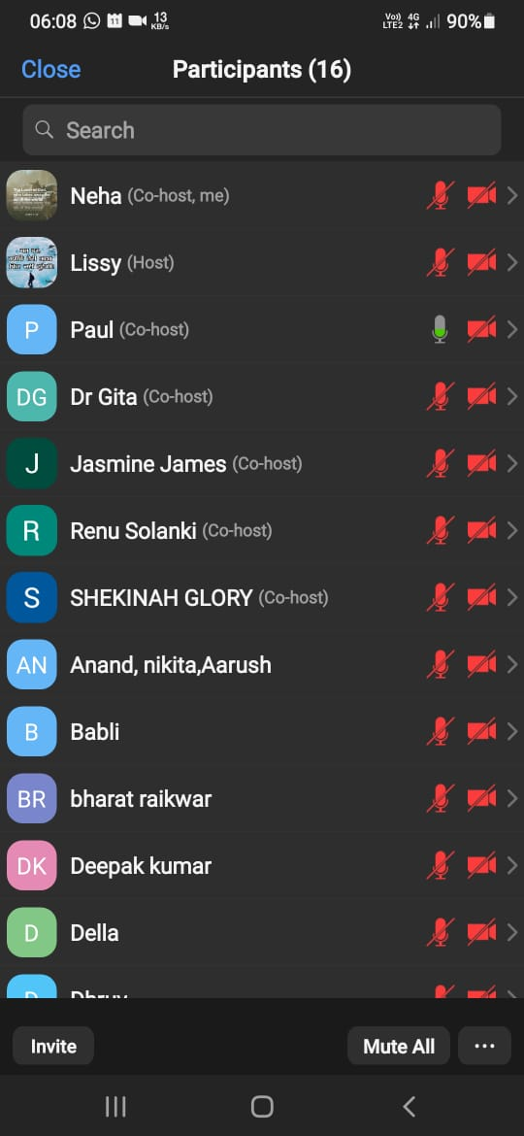
MORNING PRAYER
With the grace of God and towards fulfilment of vision of God, the Capital of India, Delhi was finally divided on 11th October, 2021 into two Zones:
1. Joseph Zone (6 Constituencies of Delhi and Chandigarh) led by Sol. Jasmine and
2. Hosanna Zone (West Delhi Constituency)
led by Sol. Lissy
MORNING WORSHIP CONTINUED MONDAY TO FRIDAY FROM 5:30 AM TO 7 AM IN THE MONTH OF OCTOBER, 2021
HOSANNA ZONE

Slide 21
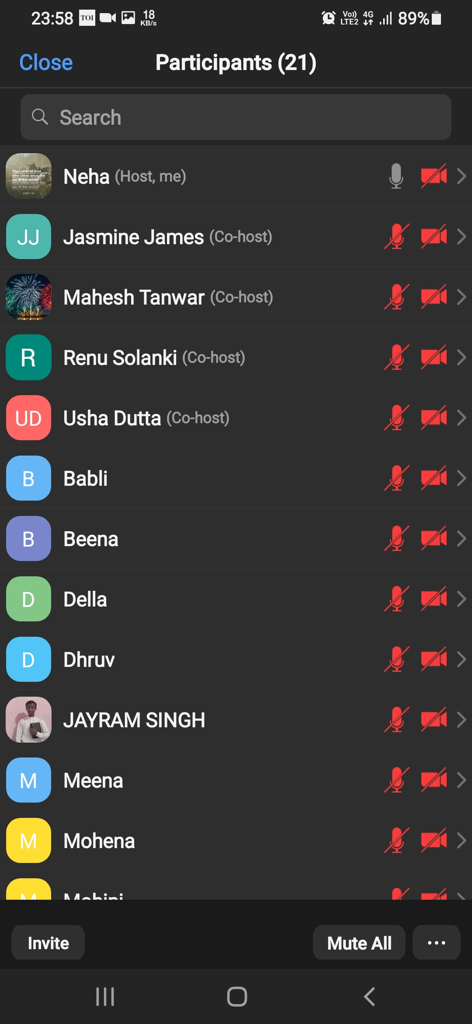
NIGHT PRAYER
NIGHT PRAYER WAS CONDUCTED ON EVERY FRIDAY IN THE MONTH OF OCTOBER, 2021 FROM 11 PM-1 AM FOR DELHI AND CHANDIGADH
NIGHT PRAYER ATTENDANCE

Slide 22
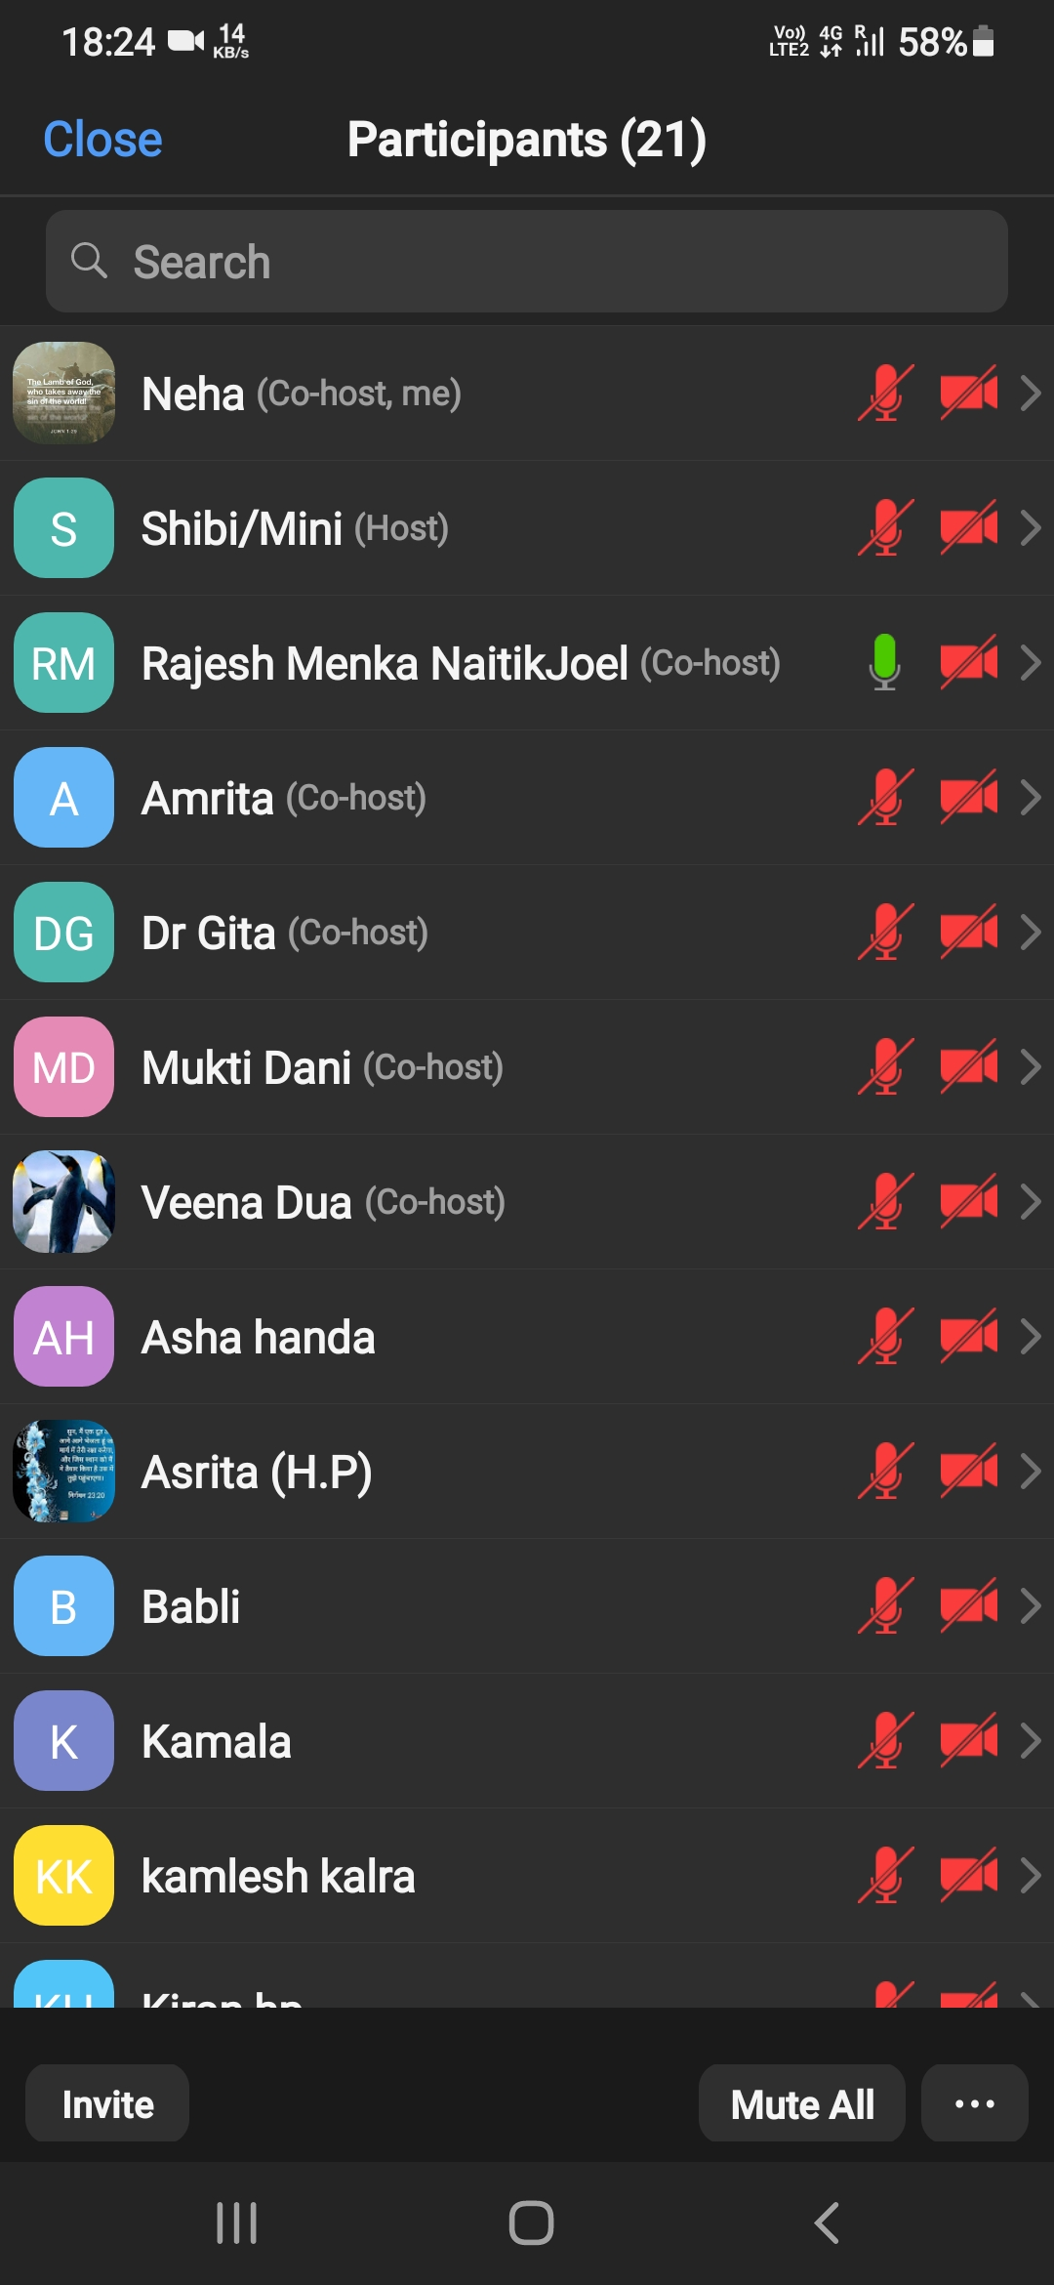
FASTING PRAYER
FASTING PRAYER ATTENDANCE
FASTING PRAYER CONDUCTED WITH ALL THE 9 STATES OF NORTH ZONE TOGETHER ON EVERY FRIDAY OF OCTOBER, 2021 FROM 6-7 PM

Slide 23
WORSHIP

Slide 24
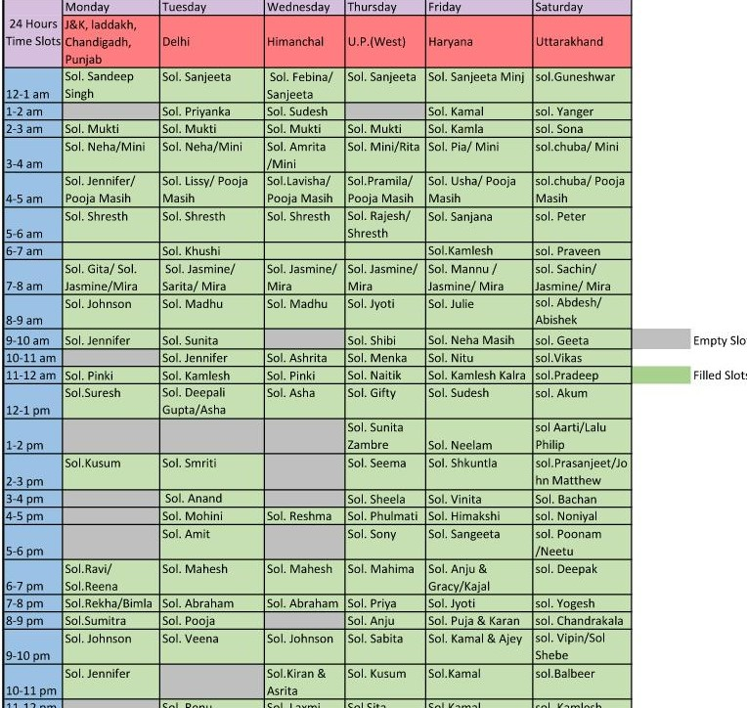
24 HOURS OFFLINE WORSHIP
(EVERY TUESDAY)
Co-ordinator: Sol. Neha
From 20th September, the offline worship started in all the states
of North Zone.
24 hours offline worship is happening in Delhi every Tuesday except on few slots
which are yet to be filled,

Slide 25
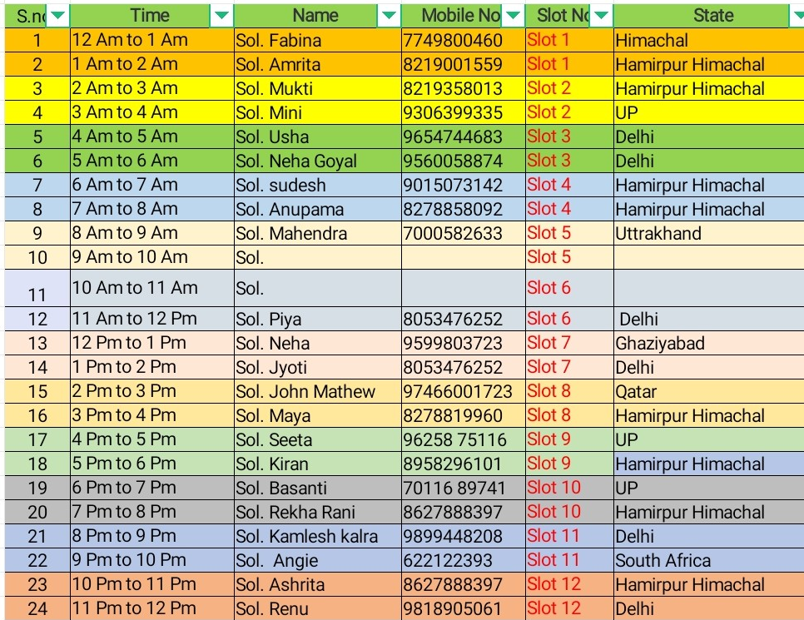
24 HOURS Online WORSHIP
(EVERY SUNDAY)
Co-ordinator: Sol. Ajay
Online Worship is continuing in Delhi also alongwith
all the 9 States of North Zone.

Slide 26
PRAISE GOD FOR HIS MIGHTY DEEDS IN THE CAPITAL OF INDIA !!!
OUR PRAYERS ARE CONTINUALLY BEING ANSWERED IN JESUS MIGHTY NAME.
aMEN !!!

