Slide 1

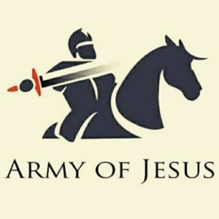
PRAISE REPORT
NORTH REGION
AUGUST 2021

Slide 2

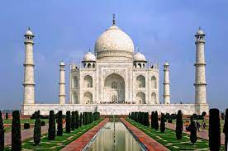
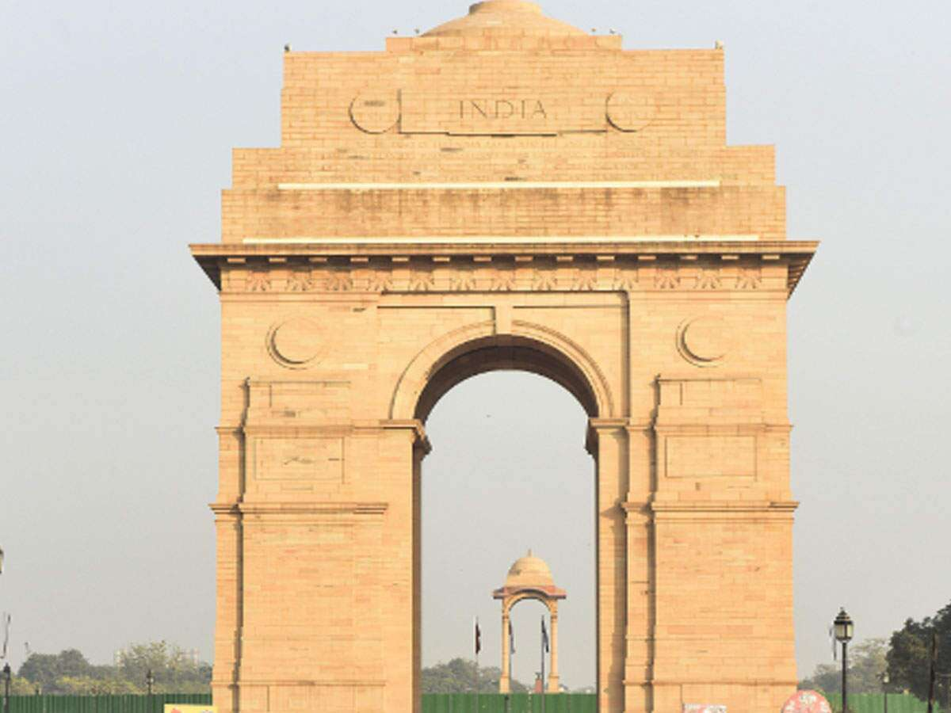
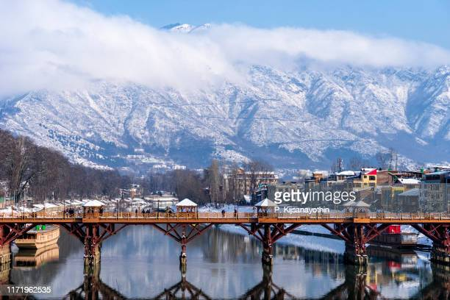
STATES
1. UTTAR PRADESH
2. DELHI
3. HARIYANA
4. PUNJAB
5. UTTARAKHAND
6. CHANDIGARH
7. HIMACHAL PRADESH
8. JAMMU & KASHMIR
9. LADAK

Slide 3
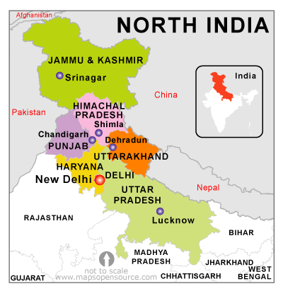

Slide 4
TROOP CHURCHES

Slide 5
TROOP CHURCH REPORT OF AUGUST
Sr. No | State | Number of Troop Churches | Troop Leader | Date of Start | Total Number of Members | New Troop Church Branch Out
1 | Uttar Pradesh West | 1. Micha Troop church | Sol. Shibi | 24.08.2021 | 10 members
 |  | 2. Yeheskel troop church | Sol. Shibi | 09.08.2021 | 7 members
 |  | 3. Yeheskel troop church | Sol. Mini | 16.08.2021 | 8 members
 |  | 4. Isiah troop church | Sol. Mahendra Sigh | 09.08.2021 | 9 members
2 | Chandigarh | Yuhana Troop Church | Sol. Suresh | 12.08.2021 | 11 Members
3 | Delhi | Paul Troop Church | Sol. Jasmine James | 13.07.2021 | 11 Members
 |  | Joseph Troop Church | Sol. Jasmine James | 07.08.2021 | 11 Members
 |  | Rejoice Troop Church | Sol. Lissy | 07.08.2021 | 9 members
4 | Himachal | 1 Troop Church | Sol. Mukti
5 | Punjab | 4 Troop Churches Done

Slide 6
FAMILY BUILDING

Slide 7
FAMILY BUILDING - CHANDIGARH
Training Coordinator : Sol. Johnson Samuel
Duration: 02.08.2021 to 10.08.2021
Time: 09-10.30 PM
Number of Participants: 15 Nos
Testimonies of Participants:
Sol. Ritu testified how she got benefit of listening to word of God. She understood the concept of a Godly family and also got more clarity of Adam and Eve.
Sol. Bimla felt blessed to be in God's presence.
Sol. Suresh thanked and praised God for His word. He claims to be spiritually weak but got strength from hearing word of God and about Godly family. He thanked God for meeting new people.
Number of troop Churches formed: 1 Troop Church (Yuhana Troop Church)

Slide 8
F.R.P

Slide 9
F.R.P - DELHI
Training Coordinator : Sol. Mini
Duration: 13.08.2021 to 21.08.2021
Time: 2.00 to 4.00 PM
Number of Participants: 46 Nos
Testimonies of Participants:
Sol. Priyanka Arora: When I started attending FRP classes, I learnt a lot about forgiveness. Learnt the real meaning of forgiveness. I was not able to forgive quite a few people from the core of my heart. So my heart and mind was lacking peace. FRP classes helped me a lot enabling me to forgive those people who have been the cause of my hurt. In the Inner Healing class today, God healed and delivered me completely from my persistent headache ( which troubled me for quite some time) which was due to forgiveness in my heart. What I learnt in the class I prayed accordingly and that stronghold of deep rooted forgiveness was broken and I got completely healed. Glory and thanks to my Lord and Savior Jesus. Thank u AOJ for all these beautiful classes.
Participants Interested in Teaching:
Sol. Priyanka Arora
Sol. Jayaram
Sol. Neha
Sol. Renu Solanki

Slide 10
F.R.P - CHANDIGARH
Training Coordinator : Sol. Mini
Duration: 13.08.2021 to 29.08.2021
Time: 9.00 to 10.30 PM
Number of Participants: 12 Nos
Testimonies of Participants:
1. Sol.Bimla praised God for helping her to pray. During lockdown she was not able to hear word of God or pray. After attending the classes she got delivered from busyness and now she is able to sit in prayer for more than 30 mins.
2. Sol. Suresh thanked God for blessing him through the class. He was able to understand how forgiveness is the main aspect of deliverance from demonic strongholds.
Participants Interested in Teaching:
Sol. Sagar Prince
Sol. Babli

Slide 11
F.R.P – HIMACHAL PRADESH
Training Coordinator : Sol. Mini
Duration: 14.08.2021 to 21.08.2021
Time: 7.00 to 8.30 PM
Number of Participants: 11 Nos
Testimonies of Participants:
1. Sol. Asrita: There have been so many problems in her life. Between wife and husband. There was no harmony between them. Through the FRP classes. There was unity in their family life.
2. Sol. Febina: Through the FRP classes. Gained this knowledge that the evil spirit can dwell in the life of a believer. This was the first time they had received this knowledge.
Participants Interested in Teaching:
Sol. Mukti Dani
Sol. Amrita

Slide 12
F.R.P – UTTAR PRADESH WEST
Training Coordinator : Sol. Mini
Duration: 13.08.2021 to 21.08.2021
Time: 2.00 to 4.00 PM
Number of Participants: 10 Nos
Testimonies of Participants:
1. Sol. Sita saw a vision. A huge crowd was coming towards light of God. One person had a bond in His tongue. Satan was tied to him, that bond was opened. Glory To God
2. Sol. Basanti used to go to church earlier. But didn't know about the forts. Well understood through FRP class. Glory to God 3.)Poonam-Attended A class for the first time. Got to learn a lot of new things. Lord blessed me a lot. She felt good. Glory To God
Participants Interested in Teaching:
Sol .Menka
Sol. Rajesh
Sol. Sita
Sol. Poonam
Sol. Mahendra

Slide 13
HEALING

Slide 14
HEALING – DELHI
Training Coordinator : Sol. LISSY
Duration: 23.08.2021 to 28.08.2021
Time: 2.00 to 4.00 pm
Number of Participants: 13 Nos
Testimonies of Participants:
1. Sol. Priyanka Arora: When I started attending FRP classes, I learnt a lot about forgiveness. Learnt the real meaning of forgiveness. I was not able to forgive quite a few people from the core of my heart. So my heart and mind was lacking peace. FRP classes helped me a lot enabling me to forgive those people who have been the cause of my hurt. In the Inner Healing class today, God healed and delivered me completely from my persistent headache which troubled me for quite some time) which was due to forgiveness in my heart. What I learnt in the class I prayed accordingly and that stronghold of deep-rooted forgiveness was broken and I got completely healed.
Glory and thanks to my Lord and savior Jesus. Thank you AOJ for all these beautiful classes.
Participants Interested in Teaching:
Sol. Priyanka Arora
Sol. Renu
Sol. Jayram

Slide 15
HEALING – UTTAR PRADESH WEST
Training Coordinator : Sol. LISSY
Duration: 24.08.2021 to 01.09.2021
Time: 4.00 to 6.00 pm
Number of Participants: 13 Nos
Testimonies of Participants:
Participants Interested in Teaching:
Sol. Menaka
Sol. Rajesh
Sol. Poonam
Sol. Sita
Sol. Mahendra

Slide 16
HEALING – HIMACHAL PRADESH
Training Coordinator : Sol. LISSY
Duration: 24.08.2021 to 31.08.2021
Time: 7.00 to 8.30 pm
Number of Participants: 10 Nos
Testimonies of Participants:
Participants Interested in Teaching:
Sol. Mukti
Sol. Amrita

Slide 17
HOSPITALITY

Slide 18
HOSPITALITY – UTTAR PRADESH WEST
Training Coordinator : Sol. Kamal Kumari
Duration: 13.08.2021 to 21.09.2021
Time: 4.00 to 6.00 pm
Number of Participants: 15 Nos
Testimonies of Participants:
Participants Interested in Teaching:
Sol. Menaka
Sol. Rajesh

Slide 19
MORNING PRAYER

Slide 20
STATES CONDUCTING MORNING PRAYERS
UTTAR PRADESH
  Cana Zone
  Sinai Zone
DELHI – Joseph Zone
HARIYANA – Moses Zone
PUNJAB – Moses Zone
UTTARAKHAND –
CHANDIGARH, Jammu & Kashmir and Ladak – Sharon Zone (Started on 29.08.2021
Himachal Pradesh – Abraham Zone

Slide 21
NIGHT PRAYER

Slide 22
NIGHT PRAYER CONDUCTED TOGETHER WITH ALL STATES
01.08.2021 Common night prayer conducted with all states
08.08.2021 Himanchal & Chandigarh Conducted night prayer with all states attended
15.08.2021 Uttar Pradesh conducted night prayer all states attended
22.08.2021 Common night prayer conducted

Slide 23
FASTING PRAYER

Slide 24
FASTING PRAYER CONDUCTING WITH ALL STATES TOGETHER ON ALL FRIDAYS

Slide 25
PROPHETICAL PRAYER

Slide 26
PROPHETIC PRAYER FROM MONDAY TO THURSDAY AND SATURDAY – 6.00 PM TO 6.30 PM
Date: 03.08.2021, Time: 6-6: 30 pm Revelations received in todays prophetic prayer:
1. Prayer for protection, boldness and willingness to die for Lord's work: John 16:33 “I have told you these things, so that in me you may have peace. In this world you will have trouble. But take heart! I have overcome the world. ”James 1:2," Consider it pure joy, my brothers and sisters, whenever you face trials of many kinds.“
2. Prayer for smooth operation of Gift Schools: Vision shared by Sol Neelam: She saw lighthouses lightening the path of many. Gift schools will be like lighthouses bringing many to the knowledge of God. Amen Vision shared by Sol Ivone: He saw a desert signifying the need to spread the word through these gift schools. Amen
3. Prayer for disciplining Youth: Vision shared by Sol Neha: The way Hannah dedicated Samuel to God and he served God right from his childhood, in the same way, every parent should dedicate their child to God and need to pray for them fervently. Amen

Slide 27
PROPHETIC PRAYER FROM MONDAY TO THURSDAY AND SATURDAY – 6.00 PM TO 6.30 PM
Date: 04.08.2021, Time: 6-6: 30 pm Revelations received in todays prophetic prayer:
Prayer for Unity in North Zone
Prayer for faithful discharge of responsibilities given to AOJ Soldiers Acts 2:46-47, "And day by day, attending the temple together and breaking bread in their homes, they received their food with glad and generous hearts, praising God and having favor with all the people. And the Lord added to their number day by day those who were being saved."Philippians 2:2," Complete my joy by being of the same mind, having the same love, being in full accord and of one mind.“
Prayer for opportunities of livelihood for all AOJ Soldiers so that they support their families well:Psalm 119:33-35, "Teach me, O Lord, the way of your statutes; and I will keep it to the end. Give me understanding, that I may keep your law and observe it with my whole heart. Lead me in the path of your commandments, for I delight in it."Jeremiah 29:11,"For I know the plans I have for you, declares the Lord, plans for welfare and not for evil, to give you a future and a hope.“
A very large gate like India Gate with a very narrow passage. There was great light on the other side signifying the light is before us and the gate is open as of now. Now is the time to walk away from the darkness to the bright light of God.

Slide 28
PROPHETIC PRAYER FROM MONDAY TO THURSDAY AND SATURDAY – 6.00 PM TO 6.30 PM
Date: 05.08.2021, Time: 6 - 6: 30 pm Revelations received during Prophetic Prayer:
Prayer for National Worship Festival: Vision (Sol Neha) National Worship Festival seemed like National Harvest Festival as the Lord reminded of His word, " Harvest is plentiful but laborers are few..(Luke 10:2) Later on the other vision which was shared was a confirmation that people are waiting to be told the truth of the gospel, are we ready for this? Isaiah 26:4,"Trust in the Lord forever, for the Lord God is an everlasting rock."Psalm 126:5‭-‬6,"Those who sow in tears shall reap with shouts of joy! He who goes out weeping, bearing the seed for sowing, shall come home with shouts of joy, bringing his sheaves with him.“
Prayers for Transform India Program (TIP) of AOJ James 1:27,"Religion that is pure and undefiled before God the Father is this: to visit orphans and widows in their affliction, and to keep oneself unstained from the world.“ Matthew 5- Sermon on the mount John 1:11‭-‬12,"He came to his own, and his own people did not receive him. But to all who did receive him, who believed in his name, he gave the right to become children of God.“ Psalm 41:1,"Blessed is the one who considers the poor! In the day of trouble the Lord delivers him.“
Prayer for 21 program of AOJ: John 14:18, “I will not leave you as orphans; I will come to you.“ John 10:10,"The thief comes only to steal and kill and destroy. I came that they may have life and have it abundantly."1 John 4:4,"Little children, you are from God and have overcome them, for he who is in you is greater than he who is in the world.“ Vision shared by Sol. Mannu /Sol. Kamala There are green trees standing firm in the ground being interpreted as children and young believers are ready to be taught in the right manner and they need right direction.

Slide 29
PROPHETIC PRAYER FROM MONDAY TO THURSDAY AND SATURDAY – 6.00 PM TO 6.30 PM
Date: 07.08.2021, Time: 6 - 6: 30 pm Revelations received during Prophetic Prayer:
Prayer for obedience to the Word of God: Hebrew 4:12,"For the word of God is living and active, sharper than any two-edged sword, piercing to the division of soul and of spirit, of joints and of marrow, and discerning the thoughts and intentions of the heart. " Luke 18:8," l tell you, he will give justice to them speedily. Nevertheless, when the Son of Man comes, will he find faith on earth?”1 John 3:18,"Little children, let us not love in word or talk but in deed and in truth.
Prayer for Deliverance:-Psalm 121:1‭-‬2,"I lift up my eyes to the hills. From where does my help come? My help comes from the Lord, who made heaven and earth.
Prayer for Children's wellness:-Sol Neelam shared that parents should repent for their forefathers' sins and break the generational curses.
Prayer for deliverance from spiritual blindness:-Ephesians 1:17,"that the God of our Lord Jesus Christ, the Father of glory, may give you the Spirit of wisdom and of revelation in the knowledge of him. "Mark 4:11‭-‬12,"And he said to them, “To you has been given the secret of the kingdom of God, but for those outside everything is in parables, so that “‘they may indeed see but not perceive, and may indeed hear but not understand, lest they should turn and be forgiven.’”

Slide 30
PROPHETIC PRAYER FROM MONDAY TO THURSDAY AND SATURDAY – 6.00 PM TO 6.30 PM
Date: 09.08.2021, Time: 6 - 6: 30 pm Revelations received during Prophetic Prayer:
2 Chronicles 7:14,"if my people who are called by my name humble themselves, and pray and seek my face and turn from their wicked ways, then I will hear from heaven and will forgive their sin and heal their land.“
Matthew 5:14, “You are the light of the world. A city set on a hill cannot be hidden.
Date: 10.08.2021, Time: 6 - 6: 30 pm Revelations received during Prophetic Prayer:
Prayer against idol worship: Vision: the way walls were broken down in Joshua 6:5, all the strongholds will be destroyed. Amen
Prayer for opening of educational institutions:
Prayer against pompous celebration of festivals:

Slide 31
PROPHETIC PRAYER FROM MONDAY TO THURSDAY AND SATURDAY – 6.00 PM TO 6.30 PM
Date: 11.08.2021, Time: 6 - 6: 30 pm Revelations received during Prophetic Prayer:
Prayer for success of FRP Class1 Corinthians 15:58,"Therefore, my beloved brothers, be steadfast, immovable, always abounding in the work of the Lord, knowing that in the Lord your labor is not in vain.“
Prayer for increase in love towards each other John 13:35, "By this all people will know that you are my disciples, if you have love for one another.”1 Corinthians13:1," If I speak in the tongues of men and of angels, but have not love, I am a noisy gong or a clanging cymbal."1 John 4:7,"Beloved, let us love one another, for love is from God, and whoever loves has been born of God and knows God.“ Vision shared( Sol Neelam) This church is a family and If we as a family will have love towards each other, new members will join us.
Prayer for provision of resources to continue Children Troop Church:2 Corinthians 1:4,"who comforts us in all our affliction, so that we may be able to comfort those who are in any affliction, with the comfort with which we ourselves are comforted by God.
"Closing Prayer: Isaiah 43:18‭-‬19,“Remember not the former things, nor consider the things of old. Behold, I am doing a new thing; now it springs forth, do you not perceive it? I will make a way in the wilderness and rivers in the desert."

Slide 32
PROPHETIC PRAYER FROM MONDAY TO THURSDAY AND SATURDAY – 6.00 PM TO 6.30 PM
Date: 12.08.2021, Time: 6 - 6: 30 pm Revelations received during Prophetic Prayer:
Prayer against idol worship :Micah 5:13,"and I will cut off your carved images and your pillars from among you, and you shall bow down no more to the work of your hands"
Prayer for opening of educational institutions:
Prayer for protection of survivors in flood.
Date: 13.08.2021, Time: 6:35- 6: 55 pm Revelations received during Fasting Prayer:
Prayer to destroy demon doorways of Pride: Psalm 75:4,"I say to the boastful, ‘Do not boast,’ and to the wicked, ‘Do not lift up your horn;" 1 Corinthians 1:31,"so that, as it is written, “Let the one who boasts, boast in the Lord.” James 4:10,"Humble yourselves before the Lord, and he will exalt you." Vision (shared by Sol. Neelam): The house we build out of playing cards takes a lot of effort but when they fall it doesn't take even a moment. In the same way the Lord raises a believer and prospers, but as soon as the ego comes, it does not take even a moment for a believer to lose his blessings.
Prayer for lost souls: John 8:32, "and you will know the truth, and the truth will set you free.” Matthew 9:37‭-‬38,"Then he said to his disciples, “The harvest is plentiful, but the laborers are few; therefore pray earnestly to the Lord of the harvest to send out laborers into his harvest.”
Prayer to keep ourselves as Holy as our God is Holy: 1 Corinthians 3:16‭-‬17,"Do you not know that you are God’s temple and that God’s Spirit dwells in you? If anyone destroys God’s temple, God will destroy him. For God’s temple is holy, and you are that temple." Hebrews 4:16,"Let us then with confidence draw near to the throne of grace, that we may receive mercy and find grace to help in time of need."

Slide 33
PROPHETIC PRAYER FROM MONDAY TO THURSDAY AND SATURDAY – 6.00 PM TO 6.30 PM
Date: 14.08.2021, Time: 6 - 6: 30pmRevelations received during Prophetic Prayer:
Prayer for peaceful celebration of 75th Independence day : Philippians 4:6‭-‬7,"do not be anxious about anything, but in everything by prayer and supplication with thanksgiving let your requests be made known to God. And the peace of God, which surpasses all understanding, will guard your hearts and your minds in Christ Jesus."
Prayer for right use of our freedom of Speech: Matthew 12:36,"I tell you, on the day of judgment people will give account for every careless word they speak."
Prayer to stop the increasing crimes: Genesis 4:7,"If you do well, will you not be accepted? And if you do not do well, sin is crouching at the door. Its desire is contrary to you, but you must rule over it.” James 1:19‭-‬20,"Know this, my beloved brothers: let every person be quick to hear, slow to speak, slow to anger; for the anger of man does not produce the righteousness of God."

Slide 34
PROPHETIC PRAYER FROM MONDAY TO THURSDAY AND SATURDAY – 6.00 PM TO 6.30 PM
Date: 16.08.2021, Time: 6 - 6: 30 pm Revelations received during Prophetic Prayer:
Prayer for deliverance in Lord Ephesians 2:8‭-‬9,"For by grace you have been saved through faith. And this is not your own doing; it is the gift of God, not a result of works, so that no one may boast."
Prayer for the Spiritual Preparedness and taking control of the city: 2 Chronicles 14:7," And he said to Judah, “Let us build these cities and surround them with walls and towers, gates and bars. The land is still ours, because we have sought the Lord our God. We have sought him, and he has given us peace on every side.” So they built and prospered." Psalm 1:3,"He is like a tree planted by streams of water that yields its fruit in its season, and its leaf does not wither. In all that he does, he prospers."
Prayer for fearlessness: Proverbs 1:33,"but whoever listens to me will dwell secure and will be at ease, without dread of disaster.”

Slide 35
PROPHETIC PRAYER FROM MONDAY TO THURSDAY AND SATURDAY – 6.00 PM TO 6.30 PM
18th AUGUST, 202112;06 a.m.In the mighty name of our Lord Jesus,King of Kings and Lord of Lords,O BELIEVERS IN BODY OF CHRIST IN AFGHANISTAN ,hear the Word of God:==================== Isaiah 59:19 So shall they fearThe name of the Lord from the west,And His glory from the rising of the sun; When the enemy comes in like a flood,The Spirit of the Lord will lift up a standard against him.Deuteronomy 28:6-76 “Blessed shall you be when you come in, and blessed shall you be when you go out.7 “The Lord will cause your enemies who rise against you to be defeated before your face; they shall come out against you one way and flee before you seven ways. Psalm 91He who dwells in the secret place of the Most HighShall abide under the shadow of the Almighty.I will say of the Lord, “He is my refuge and my fortress;My God, in Him I will trust.”Surely He shall deliver you from the snare of the [a]fowlerAnd from the perilous pestilence.He shall cover you with His feathers,And under His wings you shall take refuge;His truth shall be your shield and [b]buckler.You shall not be afraid of the terror by night,Nor of the arrow that flies by day,Nor of the pestilence that walks in darkness,Nor of the destruction that lays waste at noonday.A thousand may fall at your side,And ten thousand at your right hand;But it shall not come near you.Only with your eyes shall you look,And see the reward of the wicked.Because you have made the Lord, who is my refuge,Even the Most High, your dwelling place,No evil shall befall you,Nor shall any plague come near your dwelling;For He shall give His angels charge over you,To keep you in all your ways.In their hands they shall [c]bear you up,Lest you [d]dash your foot against a stone.You shall tread upon the lion and the cobra,The young lion and the serpent you shall trample underfoot.“Because he has set his love upon Me, therefore I will deliver him;I will [e]set him on high, because he has known My name.He shall call upon Me, and I will answer him;I will be with him in trouble;I will deliver him and honor him.With [f]long life I will satisfy him,And show him My salvation.”2 Timothy 312 Yes, and all who desire to live godly in Christ Jesus will suffer persecution. -------. 14 But you must continue in the things which you have learned and been assured of, knowing from whom you have learned them, 15 and that from childhood you have known the Holy Scriptures, which are able to make you wise for salvation through faith which is in Christ Jesus.Ephesians 117 that the God of our Lord Jesus Christ, the Father of glory, may give to you the spirit of wisdom and revelation in the knowledge of Him, 18 the eyes of your understanding being enlightened; that you may know what is the hope of His calling,I DECREE AND DECLARE THAT ➡️God gives wisdom to believers in Afghanistan to decide whether to stay in their country or flee and make appropriate arrangements . They would find safe ways to access the Word of God and communicate with other believers.➡️God grants them discernment to make wise decisions regarding safety, continuing in the work of the Ministry and divine protection over believers, whether they choose to go or stay.➡️ God would make “seeing eyes blind” , make a web of protection around them and anyone who might be looking for secret Afghan Christians would not discover them.➡️Our brothers and sisters will persevere through difficulties and persecution. God gives them supernatural strength to be a lighthouse [and] a minister of the Gospel, despite what they know is coming.➡️God transforms the hearts of Talibanis, Afghanis and Muslims and opens the eyes of their conscience to receive the Messiah in their lives.➡️God’s peace and protection will envelop the believers and their families and that they will experience supernatural guidance and protection.➡️Countries in South Asia, Pakistan, and India will be able to give refuge to those seeking safety.➡️Change of verdict in favour of the 229 Christian missionaries, who have been sentenced to death tomorrow afternoon by the Afghan Islamists. ➡️Protection over Quaragosh, the largest Christian city in Iraq. ➡️The Heavenly Angelic Forces help to sustain the church in Afghanistan.I seal this decree with the precious blood of Lord Jesus and the Holy Spirit. (Esther 8:8, Lk 22:20, Heb 9:12,15, Eph 1:13, 4:30).AMEN.HALLELUJAH!

Slide 36
PROPHETIC PRAYER FROM MONDAY TO THURSDAY AND SATURDAY – 6.00 PM TO 6.30 PM
Date: 26.08.2021, Time: 6 - 6: 30 pm Revelations received during Prophetic Prayer:
Prayer for childless ladies: We should nullify the effects of generational curses by asking forgiveness from the Lord. Psalm 113:9,"He gives the barren woman a home, making her the joyous mother of children. Praise the Lord!"
Prayer for bringing back to the believers in the Lord: John 1:23,"He said, “I am the voice of one crying out in the wilderness, ‘Make straight the way of the Lord,’ as the prophet Isaiah said.”
PRAISE THE LORD. God Gave Grace to Sol. Neha to record all these revelations and verses received during the prophetic prayers. May God Bless Her Abundantly.

