Slide 1

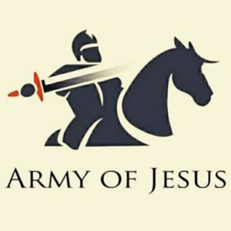
PRAISE REPORT
NORTH REGION
SEPTEMBER 2021

Slide 2

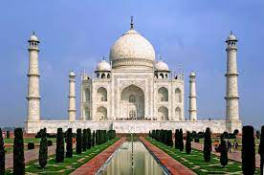
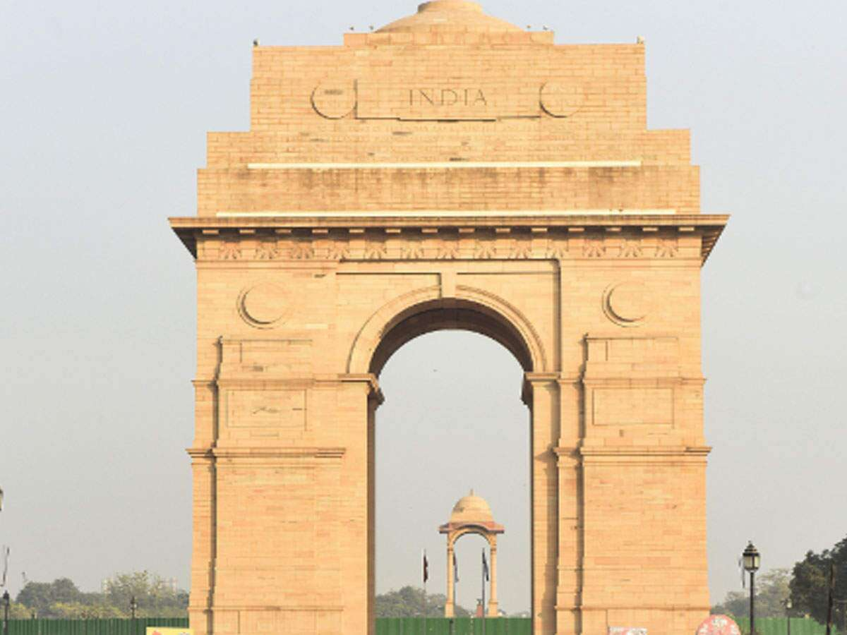
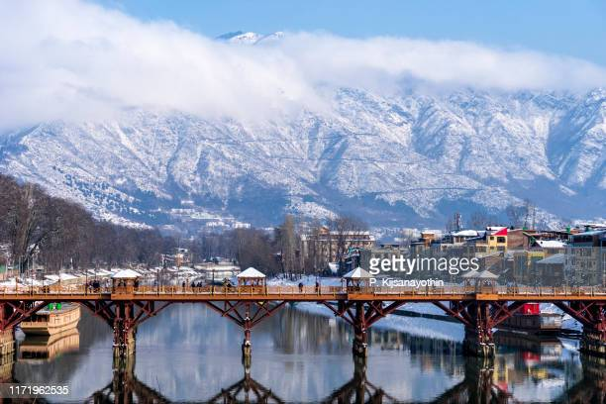
STATES
1. UTTAR PRADESH
2. DELHI
3. HARYANA
4. PUNJAB
5. UTTARAKHAND
6. CHANDIGARH
7. HIMACHAL PRADESH
8. JAMMU & KASHMIR
9. LADDAKH

Slide 3
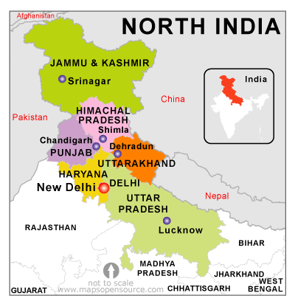

Slide 4
CORE TEAM OF NORTH REGION
Speaker – Sol. Jasmine James
Dy Speaker – Sol. Mini and Sol. Shibi
Co-ordinator – Sol. Gita
Secretary - Sol Aparajita

Slide 5
TROOP CHURCHES

Slide 6
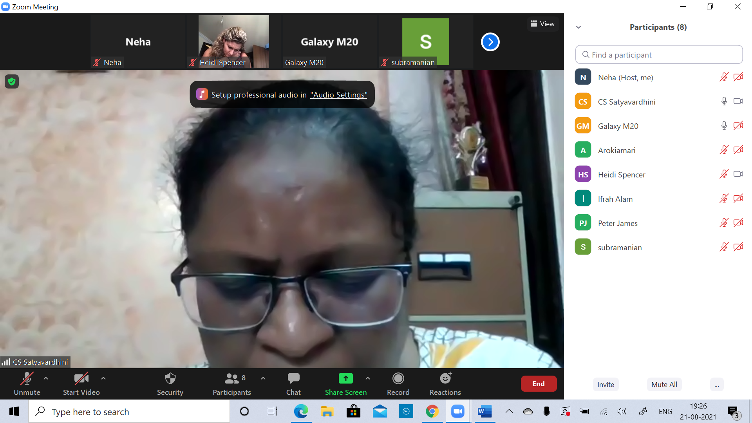
DELHI
ADONAI TROOP CHURCH
Co-ordinator- Sol. NEHA
No. of Members: 9
Status- Started on Aug, 21 (Every Saturday) …Still Continuing
MARY TROOP CHURCH
Co-ordinator- Sol. NEHA
No. of Members: 7, Average Attendance: 2-3
Status- Sep, 15 to Sep, 23, 2021
Testimony of Meera Jain: I feel really blessed by these meetings. I wish to continue meeting like this and read and know the word of God.

Slide 7
JOSEPH TROOP CHURCH
Co-ordinator- Sol. JASMINE
No. of Members: 18, Average Attendance: 10
Status- Runs on every Sunday Morning
MAHIMA TROOP CHURCH
Co-ordinator- Sol. LISSY
No. of Members: 8 , Average Attendance: 3
Status- Sep. 3 to Sep.11, 2021

Slide 8
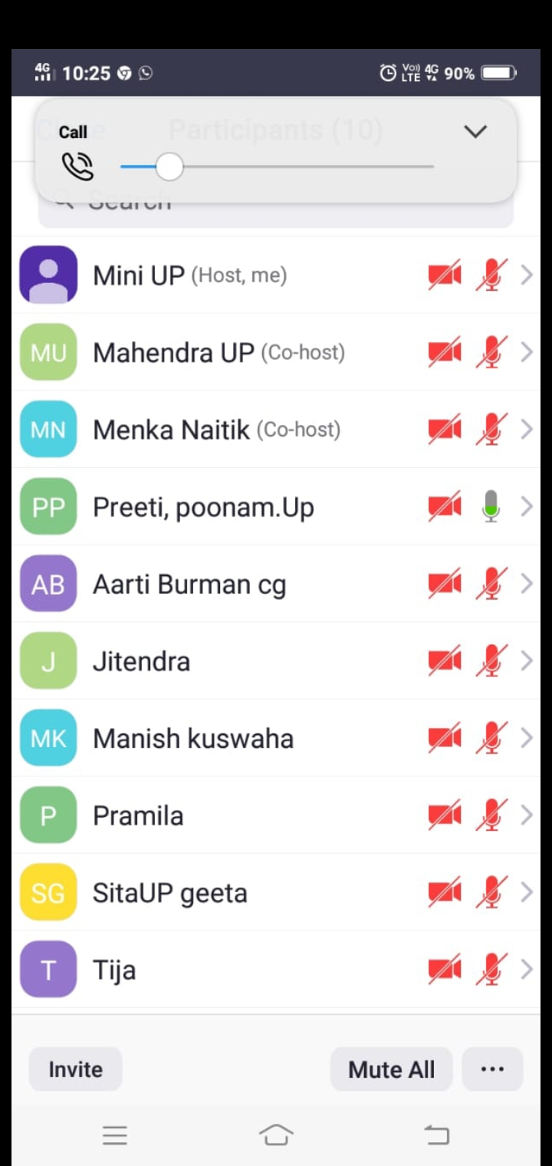
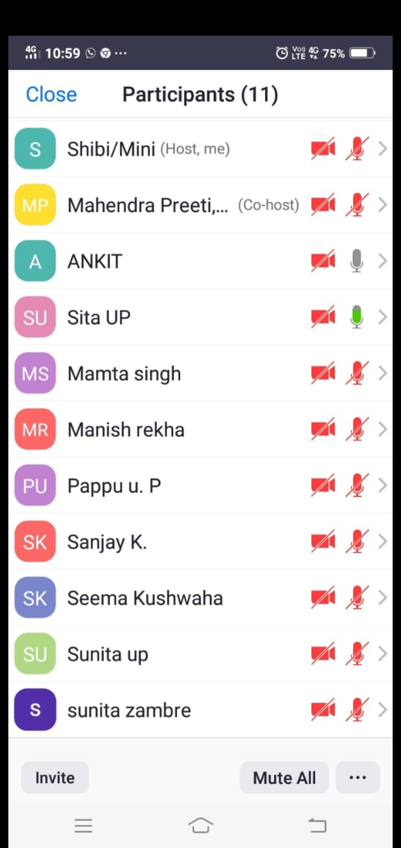
U.P. (WEST)
Micah Troop Church
Co-ordinator- Sol. Mahendra
No. of Members: 10
Status-Complete
Horeb Troop Church
Co-ordinator- Sol. Sita
No. of Members: 11
Status- Sep, 15 to Sep, 23

Slide 9
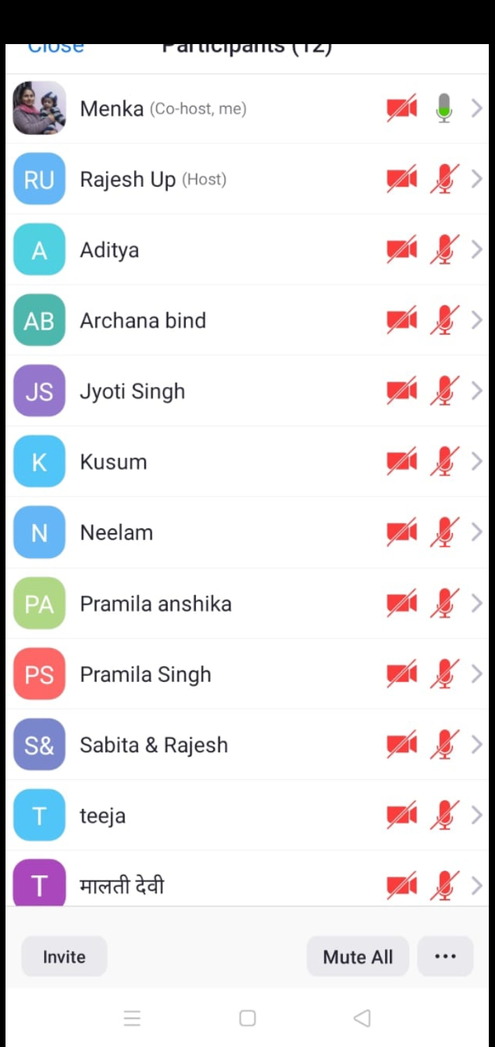
U.P. (WEST)
Angel Troop Church
Co-ordinator- Sol. Naitik
No. of Members: 12
Status-Complete

Slide 10
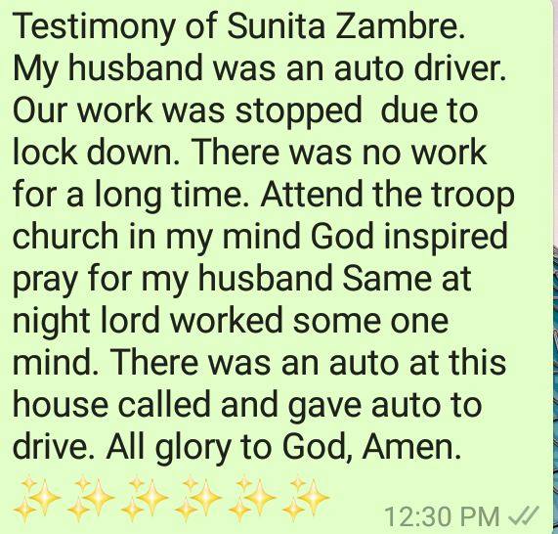
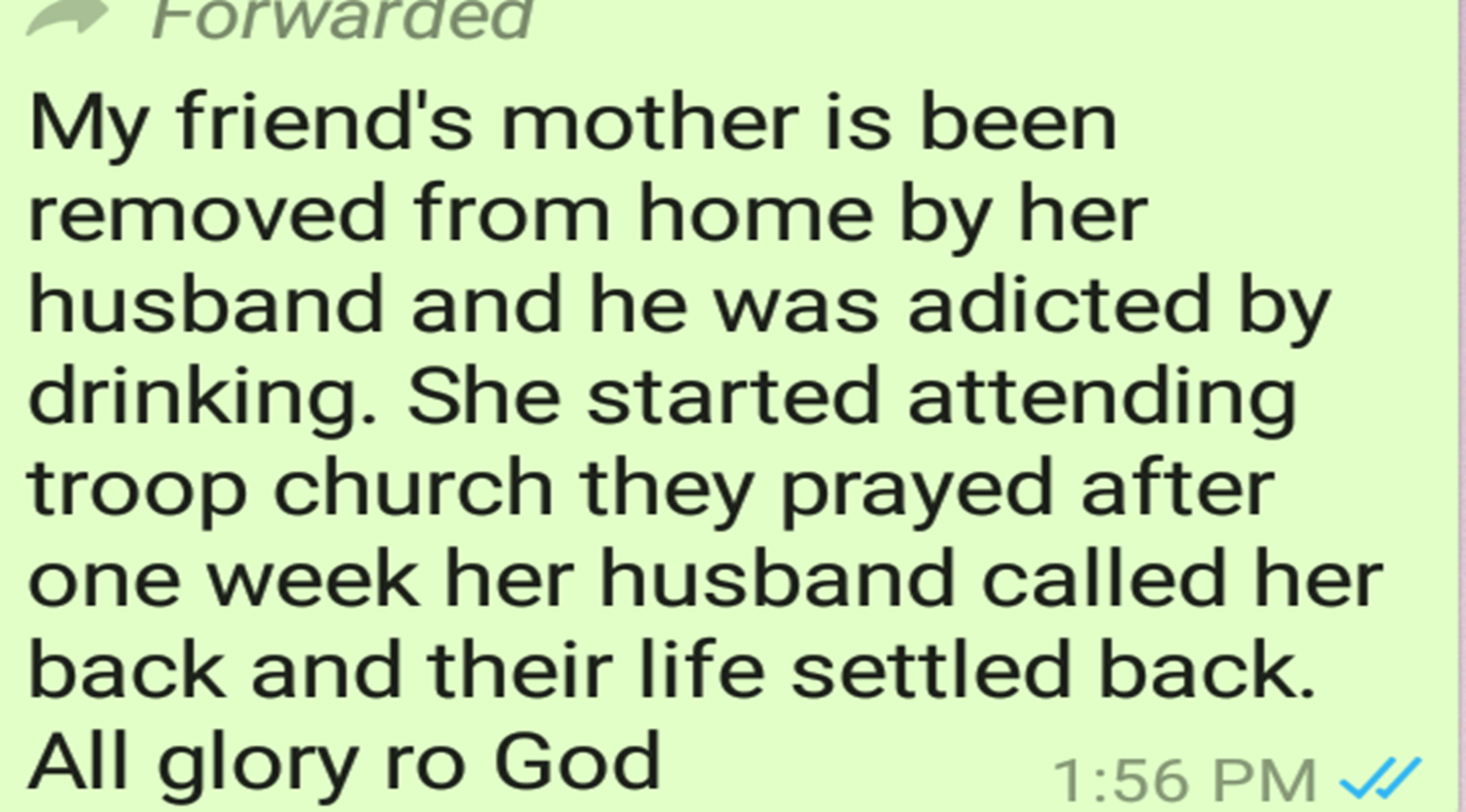
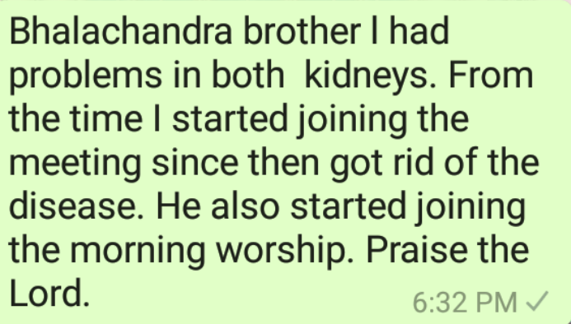
U.P. (WEST)
Testimonies of Troop Churches:

Slide 11
HARYANA
IMMANUEL TROOP CHURCH
Co-ordinator- Sol. PIYA
No. of Members: 10
Status- Still Continuing
ELIJAH TROOP CHURCH
Co-ordinator- Sol. JYOTI
No. of Members: 8
Status- Still Continuing

Slide 12
YAHOWA TROOP CHURCH
Co-ordinator- Sol. USHA
No. of Members: 8
Status- Still Continuing
ESTHER TROOP CHURCH
Co-ordinator- Sol. KAMLESH
No. of Members: 10
Status- Still Continuing

Slide 13
UTTARAKHAND
CANAAN TROOP CHURCH
Co-ordinator- Sol. CHUBA
No. of Members:
Status- Ongoing

Slide 14
HIMANCHAL
ELOHIM TROOP CHURCH
Co-ordinator- Sol.
No. of Members: 12
Status- Sep, 1 to Sep, 8
Testimony: My name is Ashrita, I have a short testimony. On the 2nd day of the day at around 2 pm when I was at work, I started feeling dizzy or I felt like I am short of breath and I was sweating a lot. I was not able to understand what to do, then I prayed to the Lord, whatever sins I have committed knowingly, forgive me. I asked for forgiveness and I felt good. I was healed before evening. God healed me. I thank the Lord, may the Lord be glorified by this testimony. Amen
ZECHARIAH TROOP CHURCH
Co-ordinator- Sol.
No. of Members: 3 (Through Conference Call)
Status- Sep, 20 to Sep, 27
Testimony: One Sister who couldn’t read the Bible and didn’t know how to pray, she learnt to read the Bible and pray also. She was extremely happy and praised God. Amen

Slide 15
PUNJAB
PATRAS (PETER) TROOP CHURCH
Co-ordinator- Sol. HARDEEP
No. of Members: 35
Status- Ongoing
Bro. Jagmeet Kalvinder, Sister Karamjeet and Reeta coming up very well by Gods’ Grace. Out of this Patras Troop Church, one new Yakoob Troop Church started with 4 Troop members. Bro Hardeep separately conducting Yirmiah Troop with 10 new members and Bro Sandeep conducting one New Yuhanna Troop with four members. One major testimony - One lady completely healed of breast cancer. Praise the Lord !

Slide 16
GIFT SCHOOLS

Slide 17
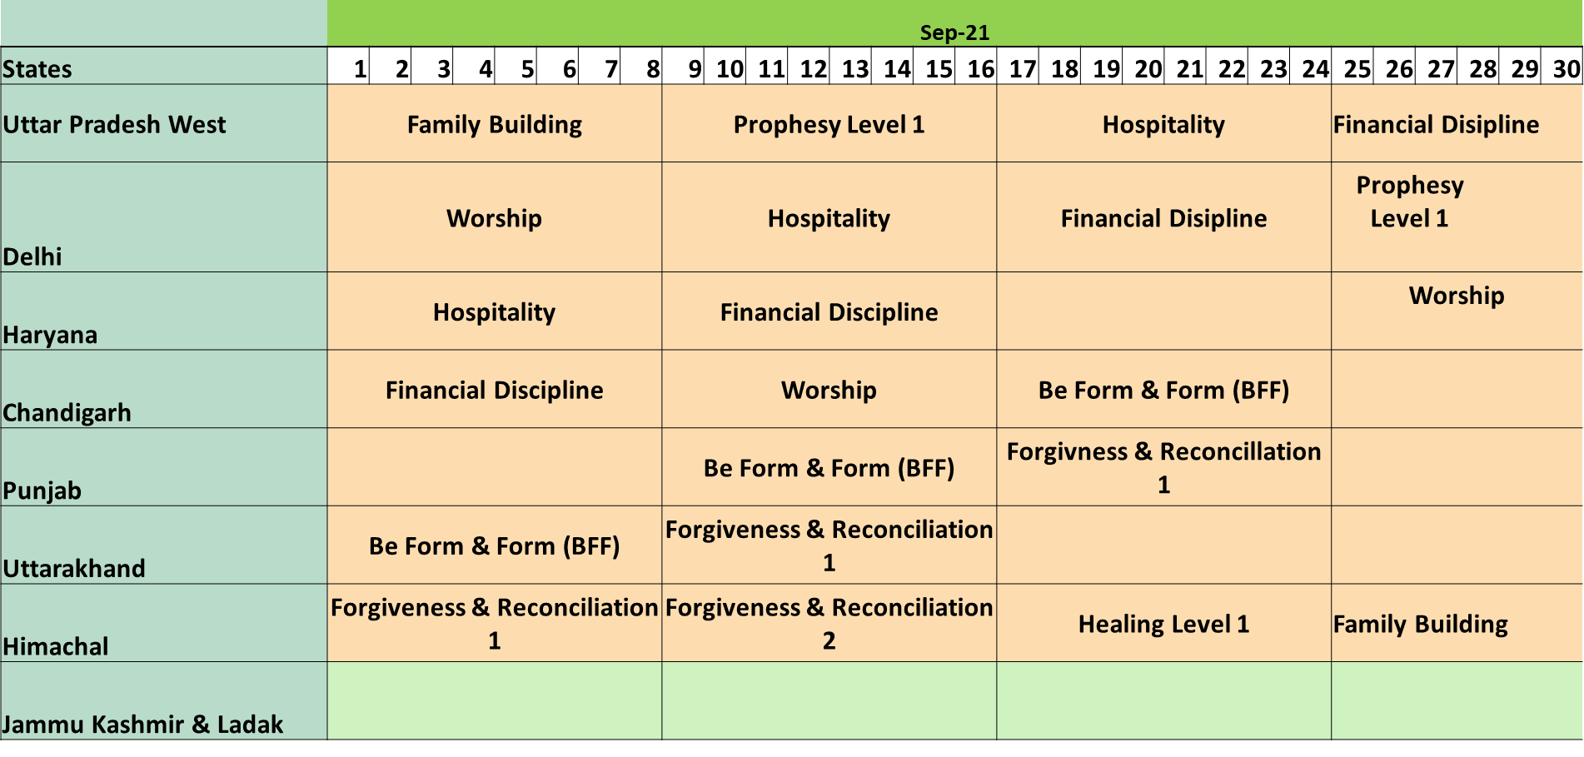
Gift schools of September

Slide 18
MORNING PRAYER

Slide 19
STATES CONDUCTING MORNING PRAYERS
UTTAR PRADESH
  Cana Zone
  Sinai Zone
  Tiberias Zone
DELHI – Joseph Zone
HARIYANA – Moses Zone
PUNJAB – Moses Zone
UTTARAKHAND –
CHANDIGARH, Jammu & Kashmir and Ladak – Sharon Zone (Started on 29.08.2021
Himachal Pradesh – Abraham Zone

Slide 20
Morning Worship
Morning Worship continued separately in U.P. West (3 groups), Delhi, Haryana, Himanchal and Chandigarh (with J&K and Laddakh).
Testimonies: Sister Mohini from Delhi who joined AOJ on 27th August asked Lord on 29th August the meaning of this Army of Jesus and with the help of Holy Spirit, she understood the meaning of Army as do not rest (aaram), put your I, me and myself behind and Ministry means go on straight, don’t look around which is according to Isaiah 41:10. Praise God. Amen
Sister Neeta Devi from Delhi whose husband deserted her and she had no clue what to do now. In morning worship she got prayed and praise God her husband came back home. All glory to God!

Slide 21
NIGHT PRAYER

Slide 22
NIGHT PRAYER CONDUCTED TOGETHER WITH ALL STATES
Common night prayer is conducted with all the 9 states.
From 17th September, 2021, Delhi state started conducting night prayer separately on every week on Friday night.

Slide 23
FASTING PRAYER
FASTING PRAYER CONDUCTED WITH ALL STATES TOGETHER ON ALL FRIDAYS (6-7 PM)

Slide 24
PROPHETICAL PRAYER MEETING:
CONDUCTED WITH ALL STATES TOGETHER FROM
MONDAY TO THURDAY & SATURDAY
(6-6:30PM)

Slide 25
WORSHIP

Slide 26
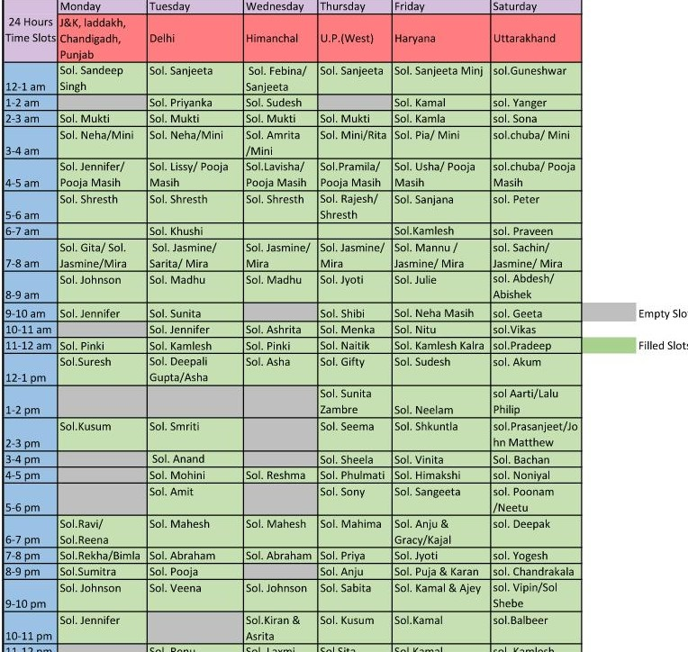
24 HOURS OFFLINE WORSHIP
(MONDAY TO SATURDAY)
Co-ordinator: Sol. Neha
States covered: 9
Date of Commencement: 20th Sept, 2021
Slots filled: U.P. West, Haryana and
Uttarakhand have 100%volunteers.
Delhi and Himanchal have 90%
and 80% volunteers respectively.
Punjab, Chandigarh and J&K have
less than 50 % volunteers.

Slide 27
24 HOURS OFFLINE WORSHIP
Testimonies
Sol. Neha: Right from the time I was first made SMLA, God showed me that 24 hours worship should start here. There was a burden in my heart. Finally after 2 months, God gave us the lead towards this and the co-ordinator of North Region asked me if I were willing to take this responsibility. I gladly accepted this task and praise God that 3 states started this in their zones.
Sol. Chuba: My first 24hrs worship experience(for UTTARAKHAND): As my turn comes @ 3 A.M. no pre-planned worship songs .As I opened my mouth to sing ,my lips straight away sang the song YOU ARE WORTHY OF IT ALL...I opened the net for the lyrics ....All the saints and angels bow before your throneAll the elders cast their crowns before the lamb of God and sing. You are worthy of it all, you are worthy of it allFor from you are all things, and to you are all things, you deserve the glory…..Day and night, night and day, let incense arise (keep repeating).Wow !!!! song based on Rev.4.
Sol. Pradeep: As I worshipped, the Lord gave me a new song with just two lines "There is power in Jesus There is power in His Blood ..Holy Spirit is Power…Holy Spirit is God's breathe. O Father you are good O Father you are beautiful. "The Lord brought back to my memory the song on Psalm 89. "I will sing of the mercies of the Lord“ Praise the Lord.

Slide 28
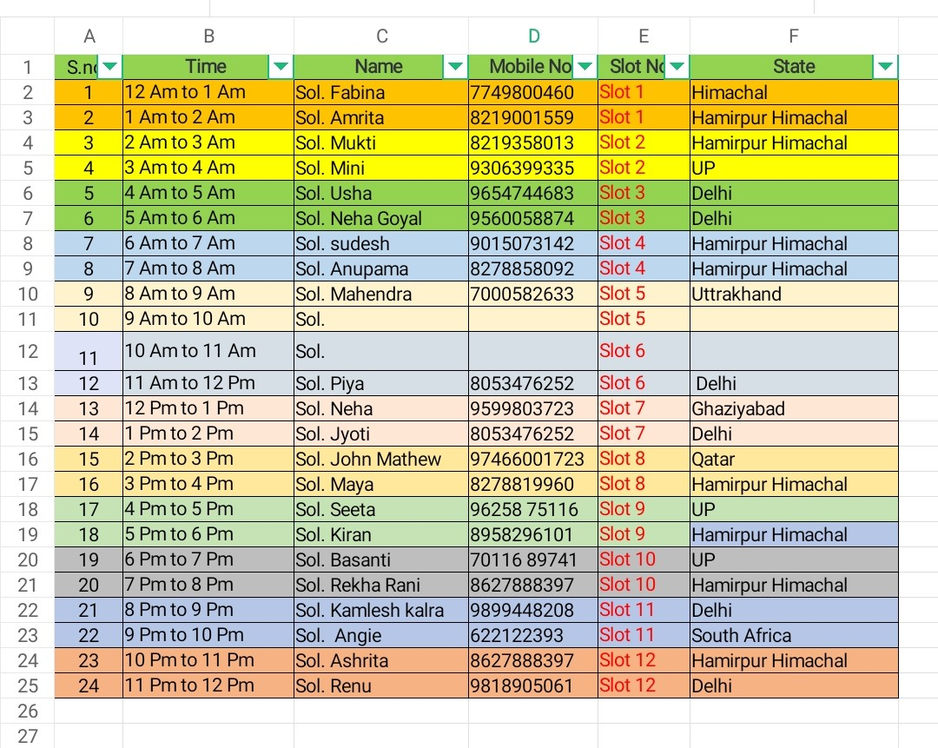
24 HOURS ONLINE WORSHIP
(EVERY SUNDAY)
Co-ordinator: Sol. Ajay
States covered: 9

Slide 29


