Slide 1

NORTH REGION
SMP & SMLA Activities
MAY - JUNE 2022

Slide 2
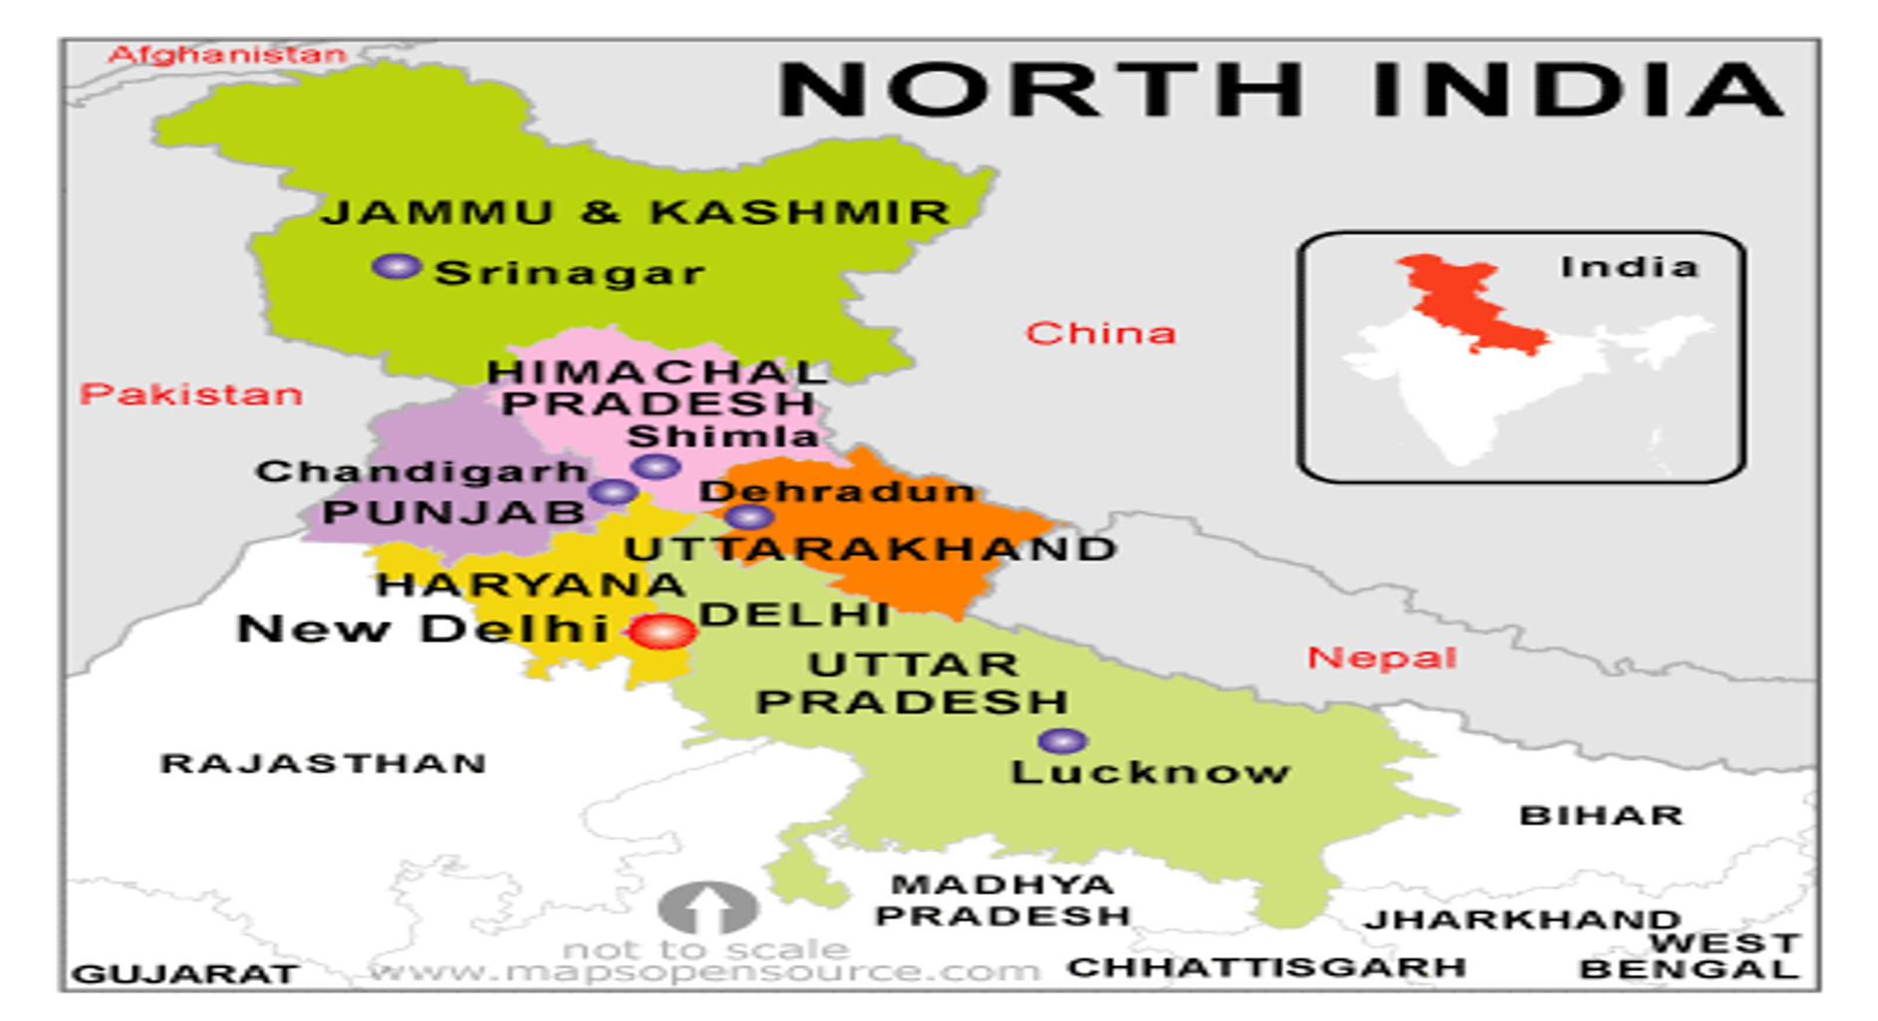

Slide 3
Activities of SMP & SMLA of North Region: May- Jun 2022
No of Shadow Parli for the North Region TOTAL 5 (DELHI (2), HARYANA (Jun), HP (May) + Combined Shadow Parli of 5 States
  Shadow Parli - DD-MMM-YYYY
    Registration Number - XXXXXX
    Topic of Shadow Parli - YYYYYY
    Category - Constituency/Zone/State
    No of Participants - 00
    Fruit of Shadow Parli - <Outcome in terms of changes in the constituency/State>
No of SLA Meetings for the state - 00 NOT UNDERTAKEN AS YET. WE WILL TRY TO ACCOMPLISH IT SOON
  SLA Meeting - DD-MMM-YYYY
    No of Participants - 00
    Fruit of SLA Meeting - <Outcome in terms of changes in the team/constituency/assembly segments>
Troop Church initiated by SMP/SMLA. 6 (FOUR)
  No of Troops - 00
  Details of each Troop
    Name of Troop - XXXX
    Registration Number - YYYY
    No of Participants - 00

Slide 4
SMP & SMLA Activities
May – June Report
NCT of Delhi

Slide 5
Activities of SMP & SMLA of Delhi - May 2022
No of Shadow Parli for the State - 01
  Shadow Parli - 31-05-2022
    Registration Number - 48/2022
    Topic of Shadow Parli - Shadow Parlie of NCT of Delhi
    Category - State
    No of Participants - 20-22
    Fruit of Shadow Parli - For benefit of ALL Believers of Delhi & Full Delhi as a whole
No of SLA Meetings for the state - NIL
  SLA Meeting - DD-MMM-YYYY
    No of Participants - 00
    Fruit of SLA Meeting - Outcome in terms of changes in the team/constituency/assembly segments
Troop Church initiated by SMP/SMLA
  No of Troops - 01
  Details of each Troop
    Name of Troop - Ebenezer Troop Church
    Registration Number - YYYY
    No of Participants - 15-18

Slide 6
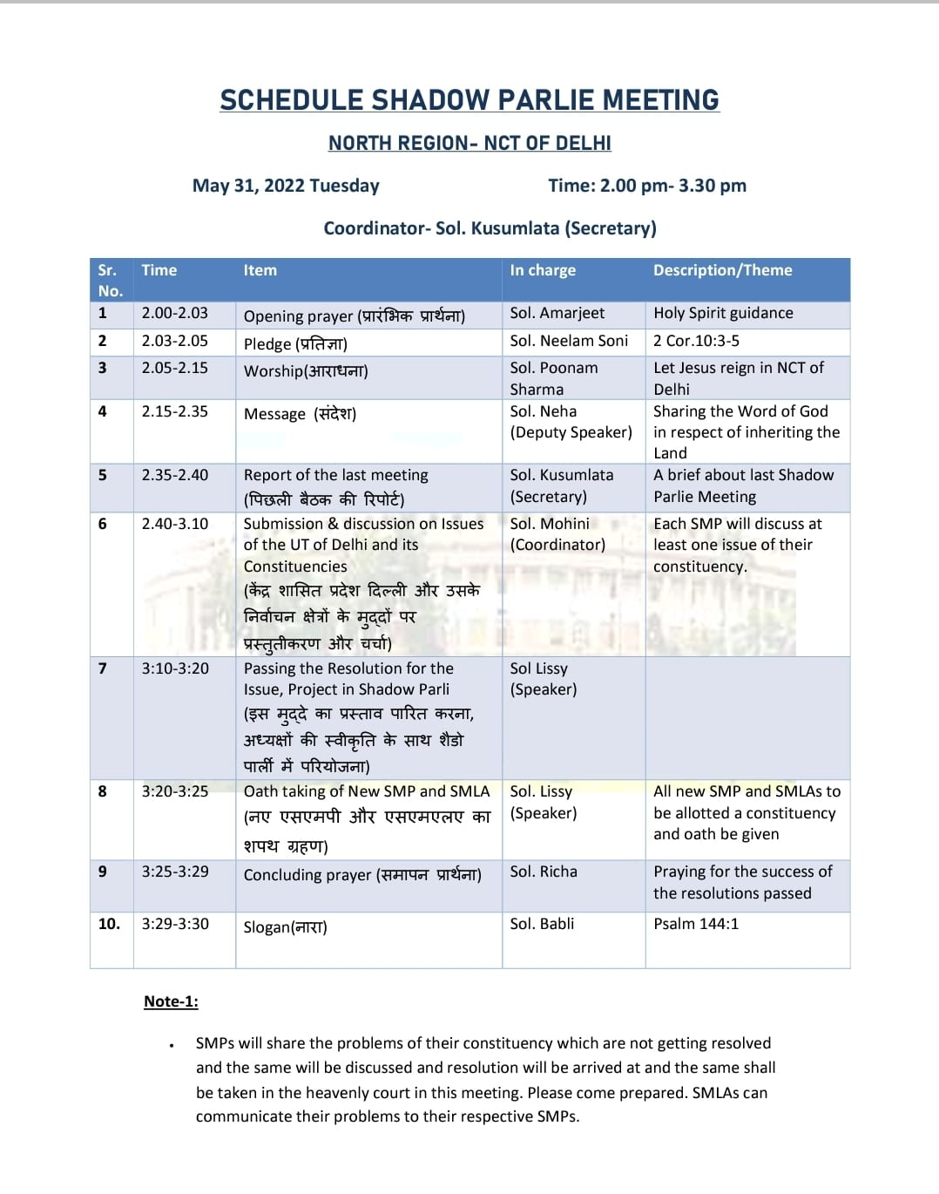
Issues Discused
East Delhi: Unemployment leading youth to criminal activities
Uttam Nagar: Addiction leading to suicides and murder
West Delhi: Against Idol Worship
South Delhi: Addiction leading to thefts
REGISTRATION NO: 48/2022

Slide 7
Activities of SMP & SMLA of Delhi: Jun 2022
No of Shadow Parli for the State - 01
  Shadow Parli - 06-06-2022
    Registration Number - ……../2022
    Topic of Shadow Parli - Shadow Parlie of NCT of Delhi
    Category - State
    No of Participants - 15- 18
    Fruit of Shadow Parli - For benefit of ALL Believers of Delhi & Full Delhi as a whole
No of SLA Meetings for the state - NIL
  SLA Meeting - DD-MMM-YYYY
    No of Participants - 00
    Fruit of SLA Meeting - Outcome in terms of changes in the team/constituency/assembly segments
Troop Church initiated by SMP/SMLA
  No of Troops - 02
  Details of each Troop.
    Name of Troop - Job Troop Church & Mariyam TC
    Registration Number - YYYY
    No of Participants - 15-18

Slide 8
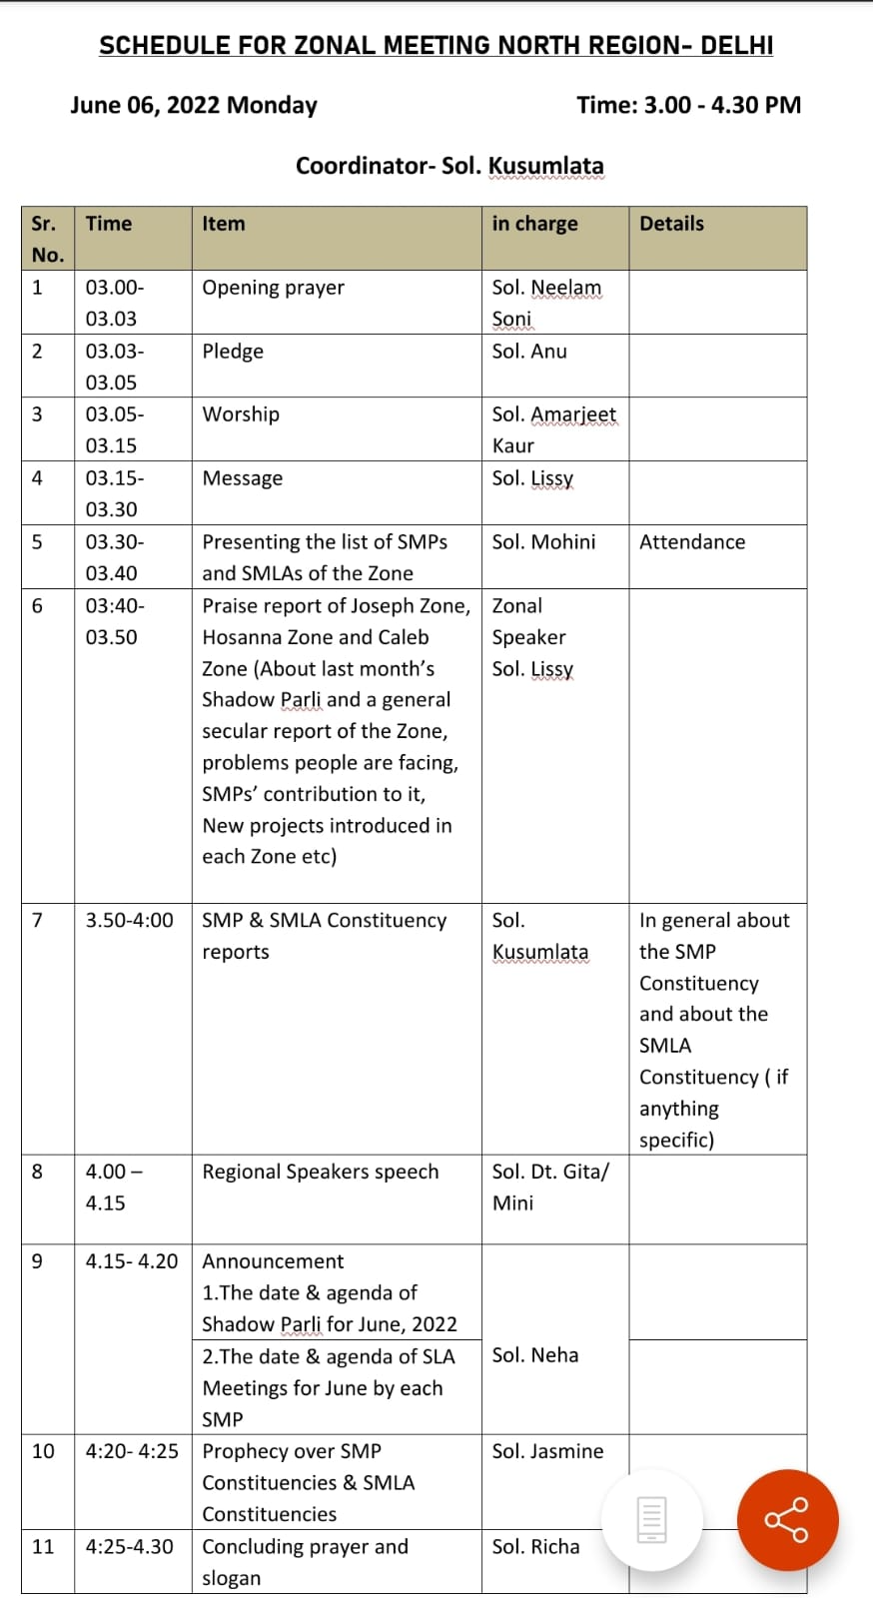
Issues Discused

Slide 9
Activities Planned by SMP & SMLA of Delhi- July 2022
No of Shadow Parli for the State - 01
  Shadow Parli - 00-7-2022 (Yet to be decided)
No of SLA Meetings for the state -00
  SLA Meeting - DD-MMM-YYYY
Troop Church initiated by SMP/SMLA
  No of Troops - 02

Slide 10
SMP & SMLA Activities
May-June Report
Haryana

Slide 11
Activities of SMP & SMLA of Haryana – Jun 2022
No of Shadow Parli for the State - 01
  Shadow Parli - 04-06-2022
    Registration Number - 52/2022
    Topic of Shadow Parli - Shadow Parlie Meeting of Haryana
    Category - State
    No of Participants - 8-10
    Fruit of Shadow Parli - For benefit of ALL Believers of Haryana & Full Sate of Haryana as a whole
No of SLA Meetings for the state - Nil
  SLA Meeting - DD-MMM-YYYY
    No of Participants - 00
    Fruit of SLA Meeting - <Outcome in terms of changes in the team/constituency/assembly segments>
Troop Church initiated by SMP/SMLA
  No of Troops - 02
  Details of each Troop
    Name of Troop - Thomas Troop Church & Elisha Troop Church
    Registration Number - YYYY
    No of Participants - 6-7

Slide 12
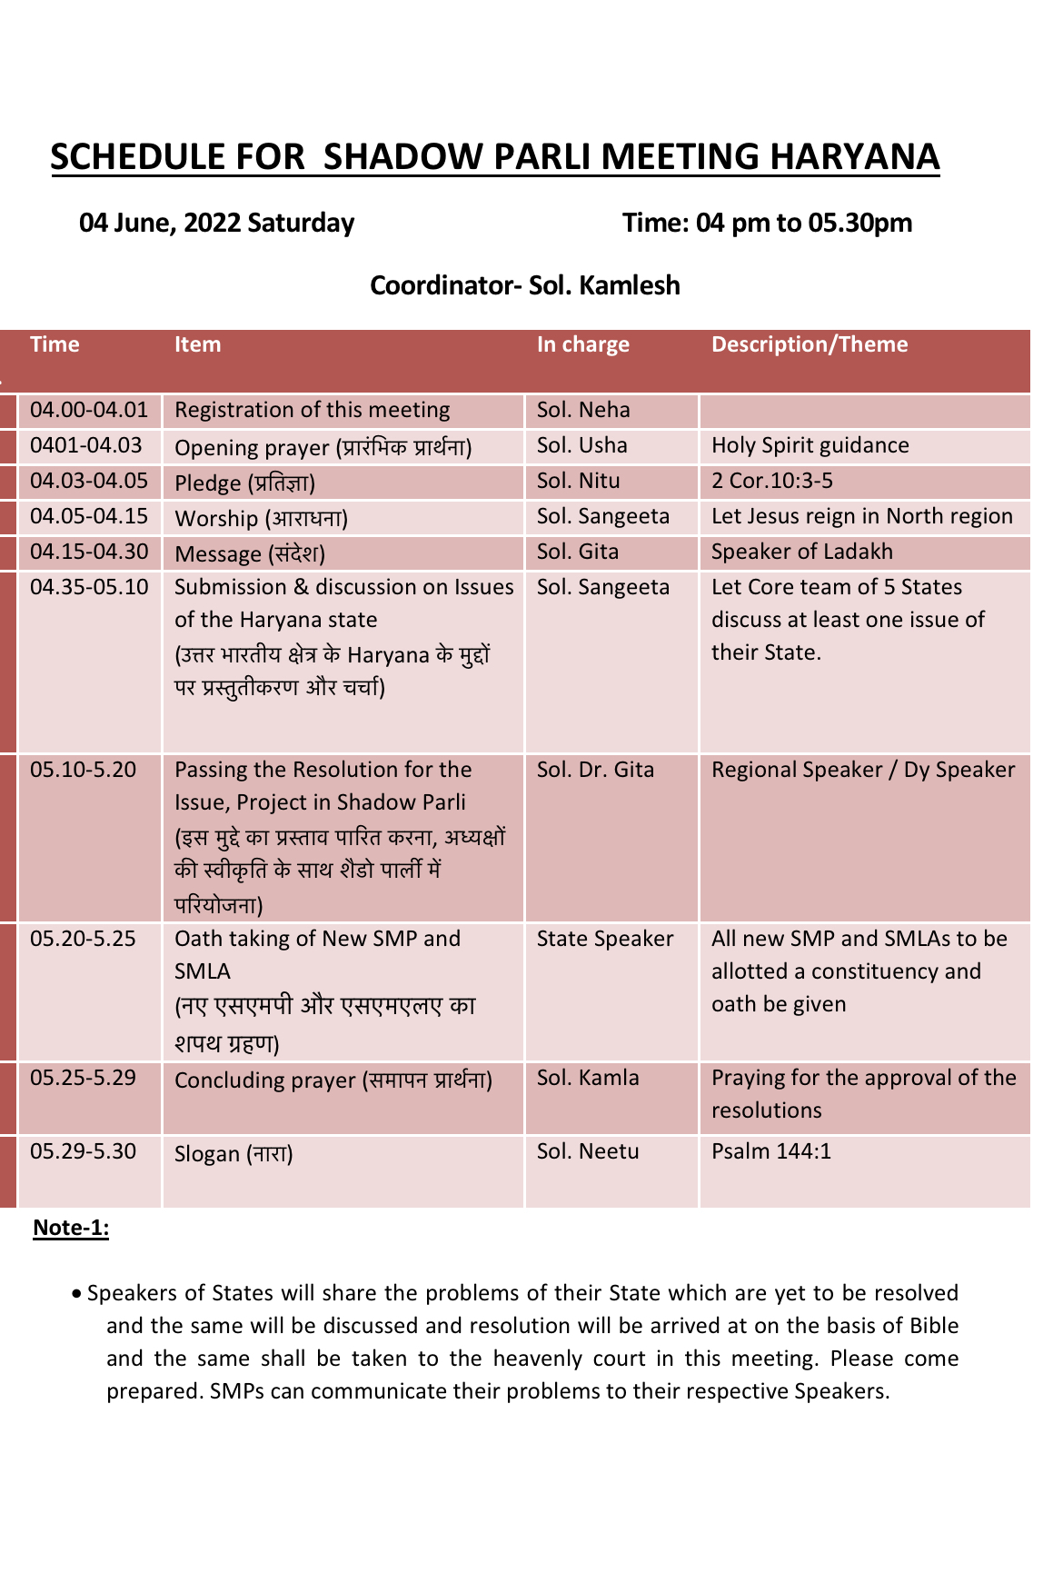
ISSUES DISCUSED
Against Intoxication among youth
2. Rights for Women
3. abolish Caste system
Follow Govt Rules instead of Panchayat
REGISTRATION NO:52/2022

Slide 13
Activities Planned by SMP & SMLA of Haryana-July 2022
No of Shadow Parli for the State - 01
  Shadow Parli - Date is yet to be decided
No of SLA Meetings for the state -00
  SLA Meeting - DD-MMM-YYYY
Troop Church initiated by SMP/SMLA
  No of Troops - 02

Slide 14
SMP & SMLA Activities
May – June Report
Himachal Pradesh

Slide 15
Activities of SMP & SMLA Himachal Pradesh: MAY- Jun 2022
No of Shadow Parli for the State - 01
  Shadow Parli - 31-05-2022
    Registration Number - 51/2022
    Topic of Shadow Parli - 1st Shadow Parlie Meeting of Himachal Pradesh
    Category - State
    No of Participants - 10
    Fruit of Shadow Parli - For benefit of ALL Believers of Himachal & Full State of Himachal as a whole.
No of SLA Meetings for the state - Nil
  SLA Meeting - DD-MMM-YYYY
    No of Participants - 00
    Fruit of SLA Meeting - <Outcome in terms of changes in the team/constituency/assembly segments>
Troop Church initiated by SMP/SMLA
  No of Troops - 00
  Details of each Troop
    Name of Troop - ……
    Registration Number - YYYY
    No of Participants - 00

Slide 16
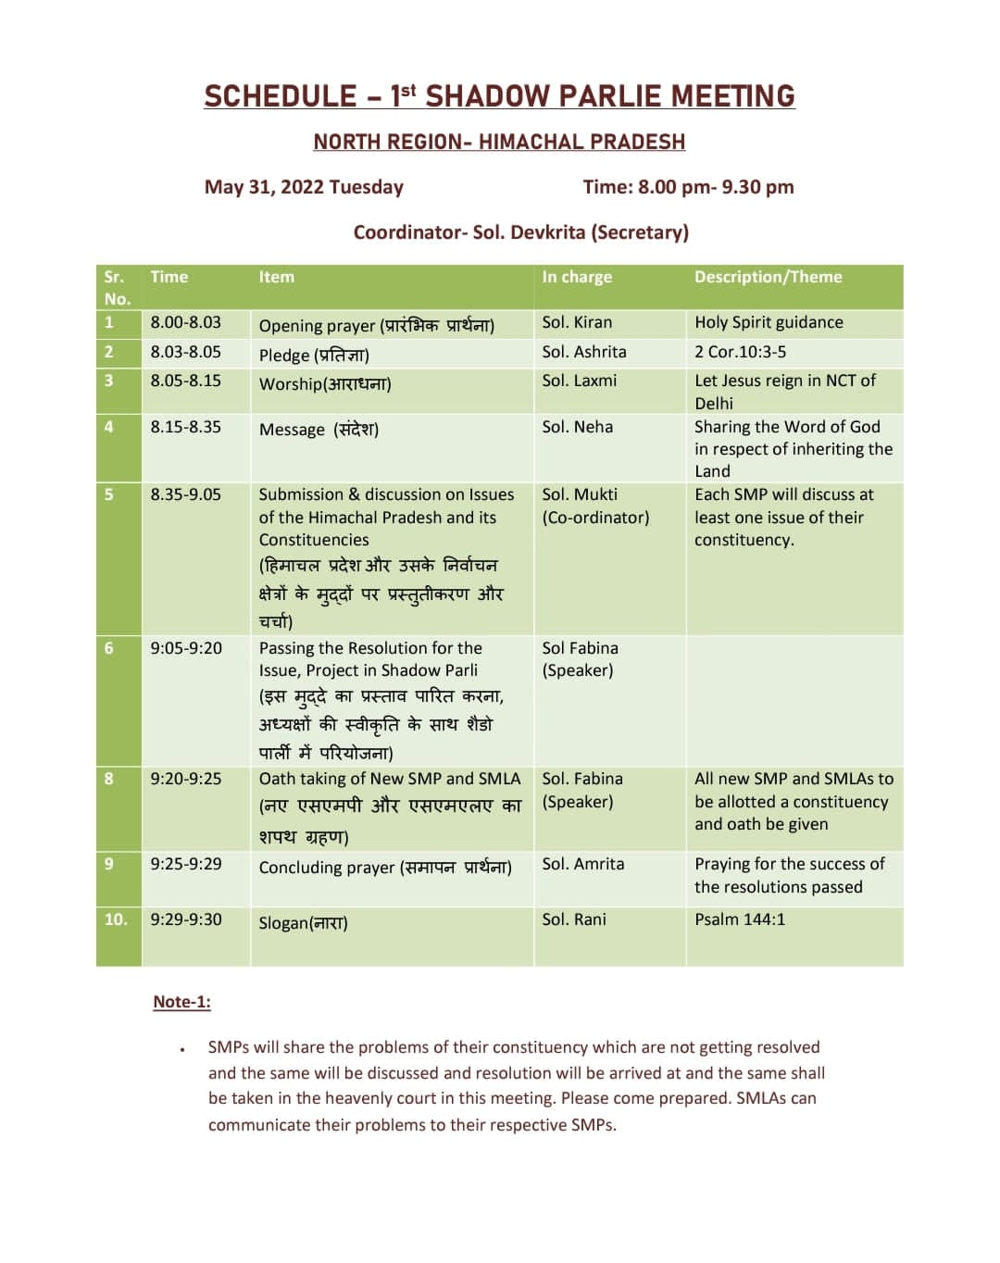
Issues Discussed
1.Discrimination between schedule caste and upper cast
2. God to change the hearts of people to know the true God
REGISTRATION NO: 51/2022

Slide 17
Activities Planned by SMP & SMLA of Himachal Pradesh – July 2022
No of Shadow Parli for the State - 01
  Shadow Parli - Date is yet to be decided
No of SLA Meetings for the state -00
  SLA Meeting - DD-MMM-YYYY
Troop Church initiated by SMP/SMLA
  No of Troops - 01

Slide 18
SMP & SMLA Activities
May – June Report
Uttarakhand, Punjab, Chandigarh, J&K
Ladakh

Slide 19
Activities of SMP & SMLA of Uttarakhand,Punjab,J&K, Chandigarh, Ladakh – Jun 2022
No of Shadow Parli for the State - 01
  Shadow Parli - 19-06-2022
    Registration Number - …/2022
    Topic of Shadow Parli - Combined Shadow Parli Meeting of 5 States & UT ie J&K, Ladakh, Punjab, Chandigarh, Uttarakhand
    Category - Region
    No of Participants - 21-22
    Fruit of Shadow Parli - For benefit of ALL Believers in the 5 States as well as Full Population of these areas.
No of SLA Meetings for the state - 00
  SLA Meeting - DD-MMM-YYYY
    No of Participants - 00
    Fruit of SLA Meeting - <Outcome in terms of changes in the team/constituency/assembly segments>
Troop Church initiated by SMP/SMLA
  No of Troops - 01
  Details of each Troop
    Name of Troop - Sharon Troop Church
    Registration Number - YYYY
    No of Participants - 8-9

Slide 20
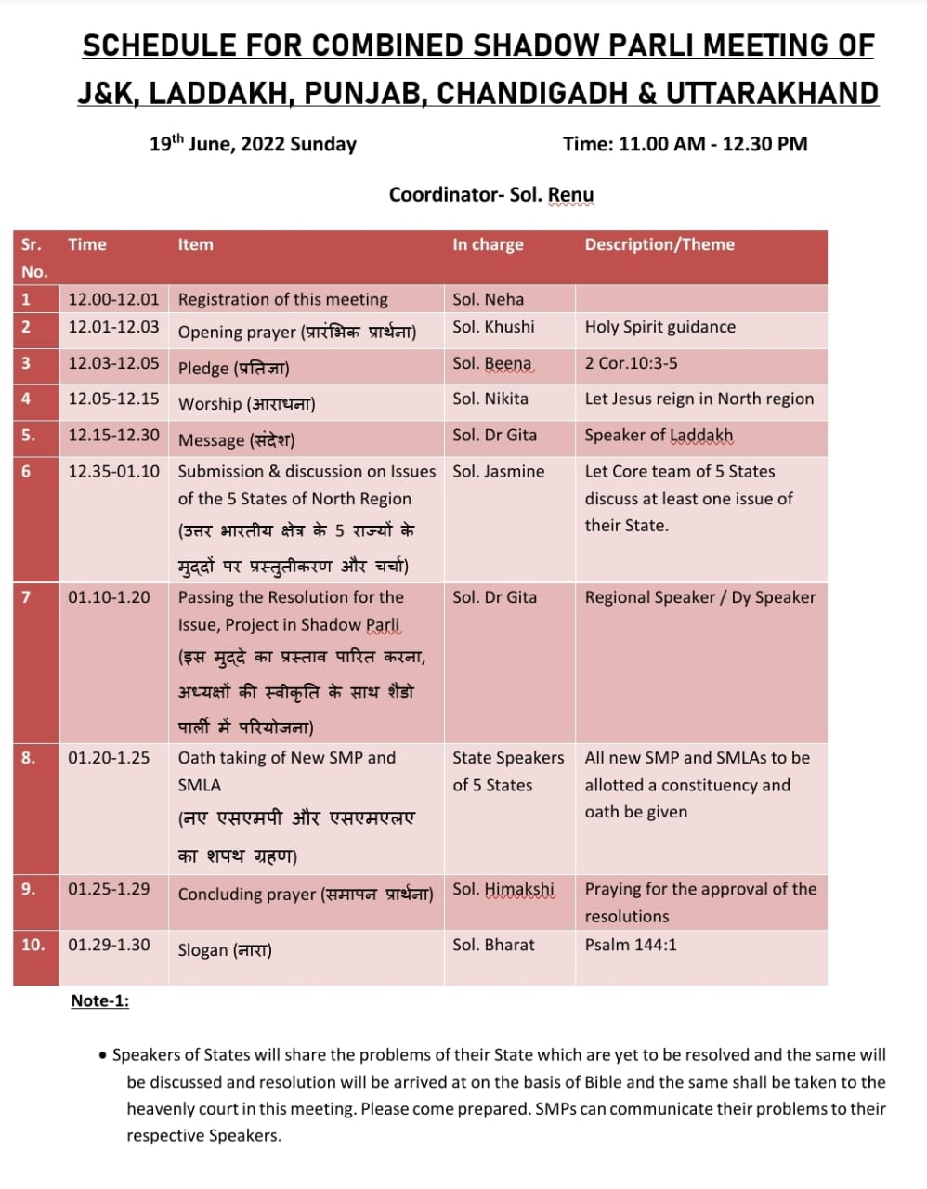
Issues Discused
1.
(Meeting yet to be held. Details will be provided later)

Slide 21
SMP & SMLA Activities
May – June Report
UTTAR PRADESH

Slide 22
Activities of SMP & SMLA of UP – May 2022
No of Shadow Parli for the State - 01. NOT YET DONE
  Shadow Parli - 00-00-2022
    Registration Number - ……./2022
    Topic of Shadow Parli - Shadow Parlie of NCT of Delhi
    Category - State
    No of Participants - 00
    Fruit of Shadow Parli - For benefit of ALL Believers of Delhi & Full Delhi as a whole
No of SLA Meetings for the state - NIL
  SLA Meeting - DD-MMM-YYYY
    No of Participants - 00
    Fruit of SLA Meeting - Outcome in terms of changes in the team/constituency/assembly segments
Troop Church initiated by SMP/SMLA
  No of Troops - 00
  Details of each Troop
    Name of Troop - Nil Troop Church
    Registration Number - YYYY
    No of Participants - 15-18

Slide 23
Activities Planned by SMP & SMLA of UP- July 2022
No of Shadow Parli for the State - 01
  Shadow Parli - 18-06-2022
No of SLA Meetings for the state -00
  SLA Meeting - DD-MMM-YYYY
Troop Church initiated by SMP/SMLA
  No of Troops - 02

Slide 24
Activities Planned by SMP & SMLA of North Region
– June 2022
No of Shadow Parli for the State - ONE PER STATE AND UT
  Shadow Parli - DD-MMM-YYYY
No of SLA Meetings for the state - WILL TRY TO UNDERTAKE
  SLA Meeting - DD-MMM-YYYY
Troop Church initiated by SMP/SMLA ONE EACH BY SMPs
  No of Troops - 00

Slide 25
Testimonies of North Region through SMP & SMLA activities:
1. Working in the Authority of our Lord Jesus Christ, we will Resolve All Problems encountered
2. We will eradicate all unbiblical practices & establish Gods Kingdom on Earth

Slide 26
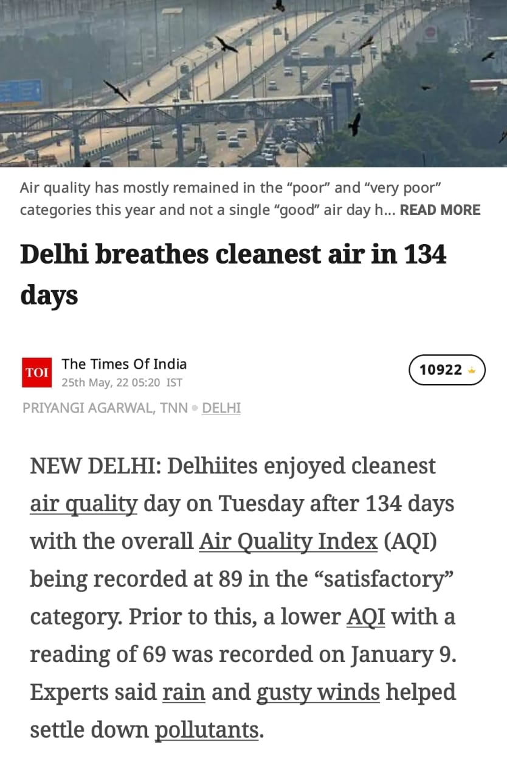
Testimonies of the State through SMP & SMLA activities
On 8th Nov, 2021 and 15th Nov, 2021, two prophecies were made for relief to Delhiites from the polluted air. On Jan 9, 2022 and now on 24th May, 2022, AQI index which was around 400 signifying unhealthy air is now in satisfactory category. We praise God for continuously answering our prayers.

Slide 27
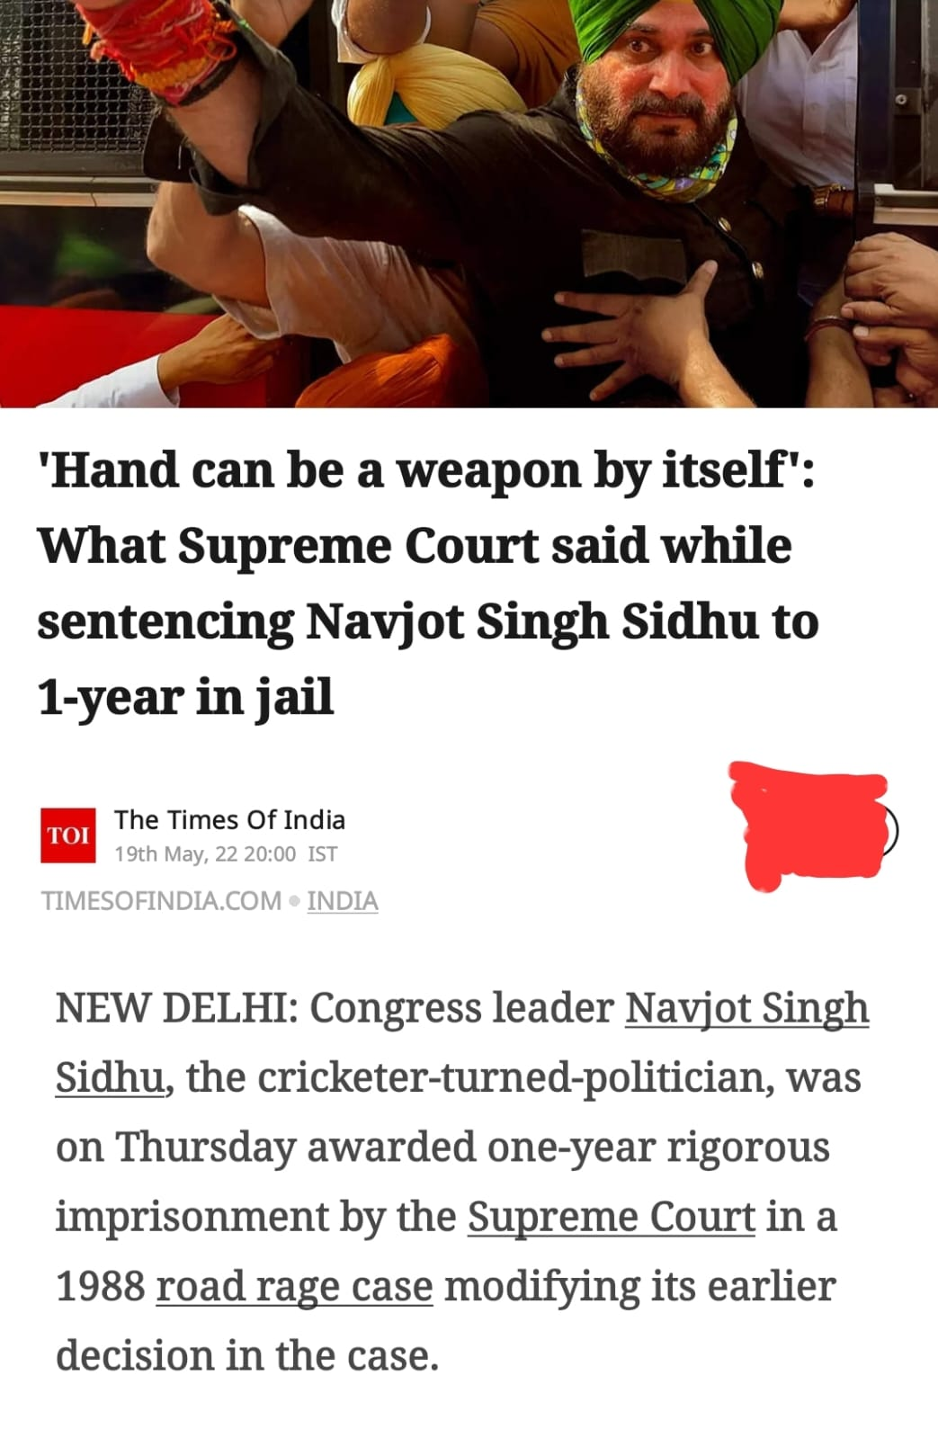
On 30th March, 2022, in the Shadow Parlie meeting of Delhi, the bill Anti-Homicidal Rage Bill (Bill No. DEL/1/3/2022) was passed and presented in the heavenly court and in that bill, the example of what Sidhu did was cited as an example of the road rage. Now we see that God’s justice is restored in the State of Punjab.

Slide 28


Slide 29


