Slide 1
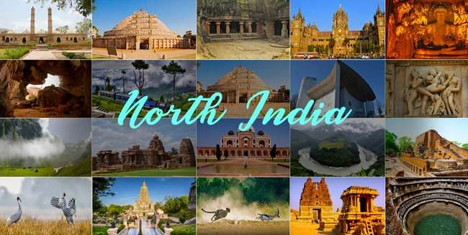
NORTH REGION PRAISES GOD FOR THE MONTH OF DRCEMBER-2024

Slide 2

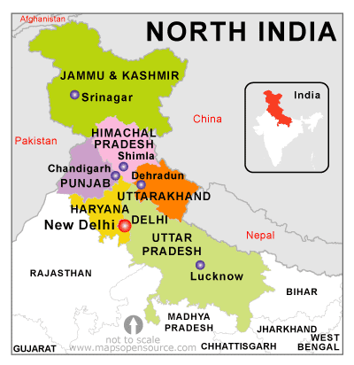
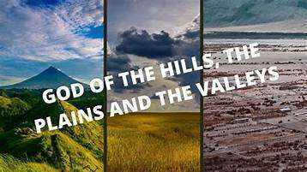
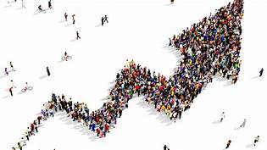
Be fruitful, multiply and fill the Earth
Genesis 1:28

Slide 3
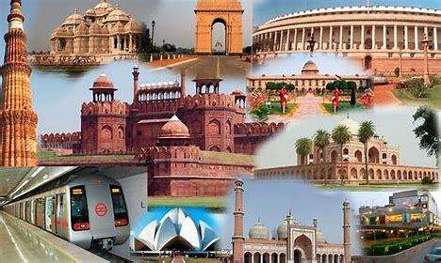
DELHI
Capital City of India

Slide 4

We Praise God for giving us this month of December, 2024

Slide 5
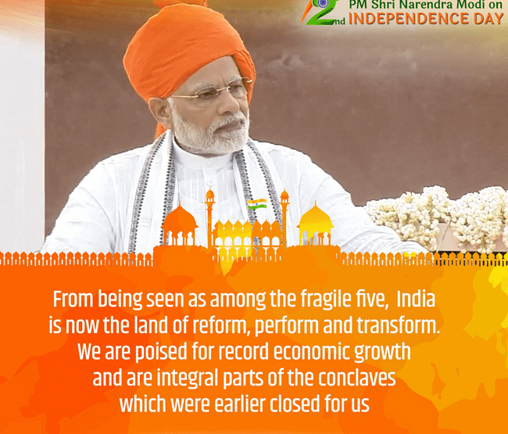
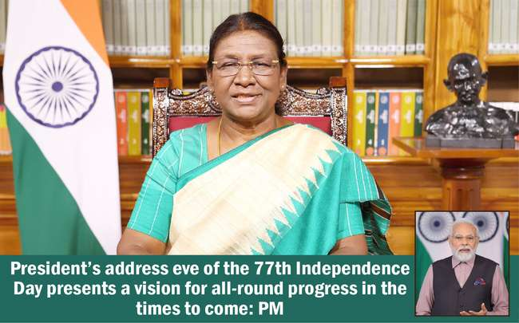
Let every person be subject to the governing authorities.……Romans 13:1

Slide 6

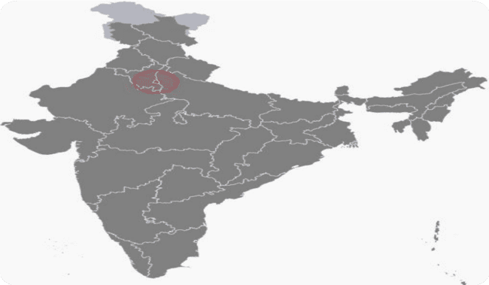


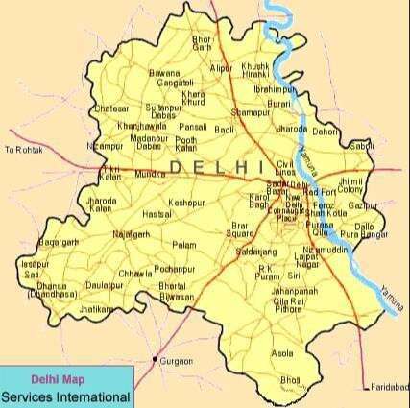
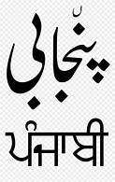

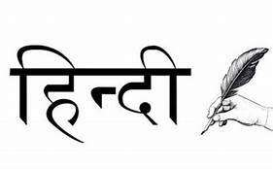
DELHI IS ON THE BANKS OF THE YAMUNA RIVER. HISTORIANS HAVE EVIDENCE THAT PEOPLE HAVE BEEN LIVING IN THIS REGION SINCE AT LEAST THE 6TH CENTURY BC. PEOPLE ALSO BELIEVE THAT THE LEGENDARY CITY OF INDRAPRASTHA WAS HERE IN THIS CITY.

Slide 7
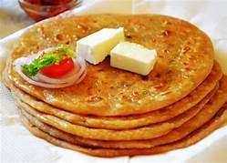
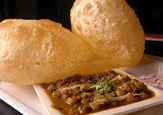
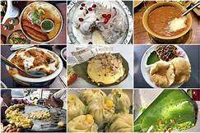
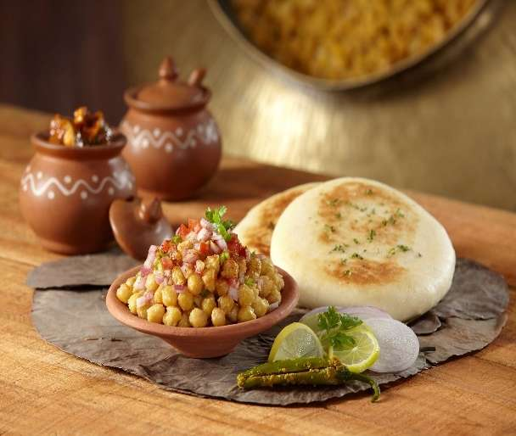
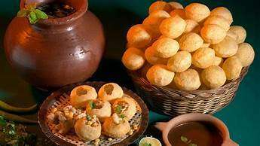
DELHI FOOD CULTURE
Food culture in Delhi is a mixture of North Indian food, Mughlai Cuisines, Punjabi food and mouth watering street food. It also includes a variety of cuisines from different parts of India.

Slide 8
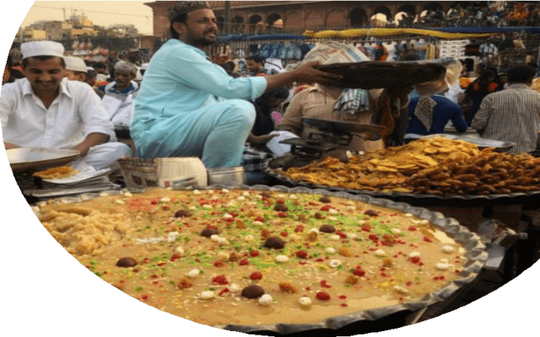
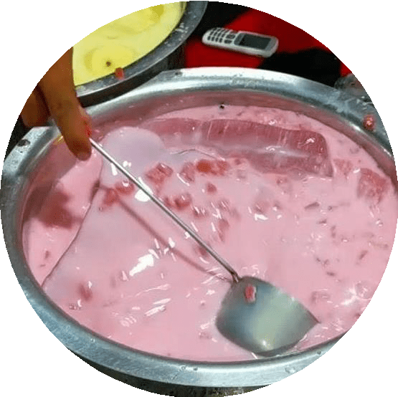
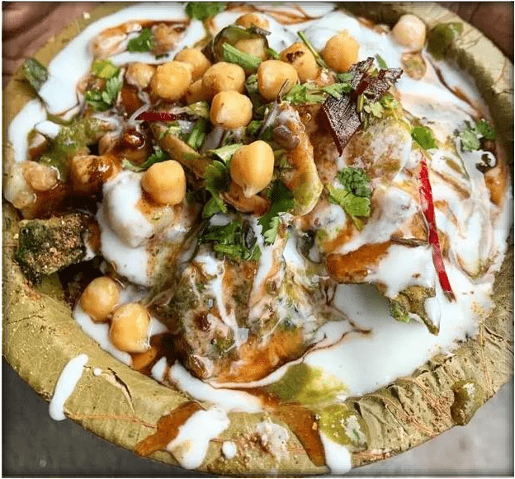
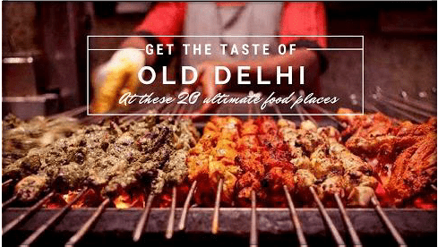
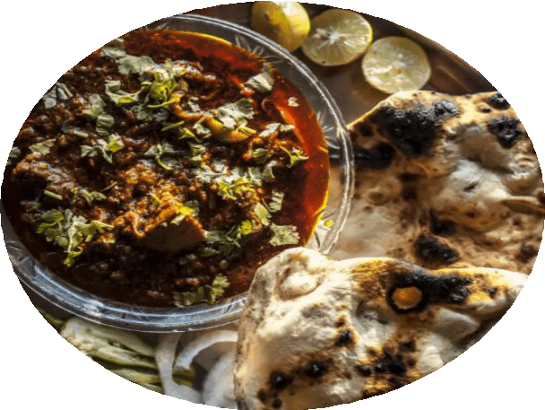

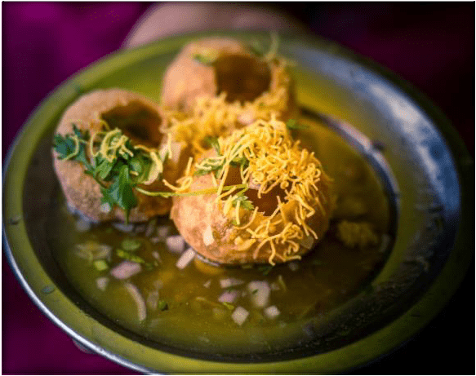
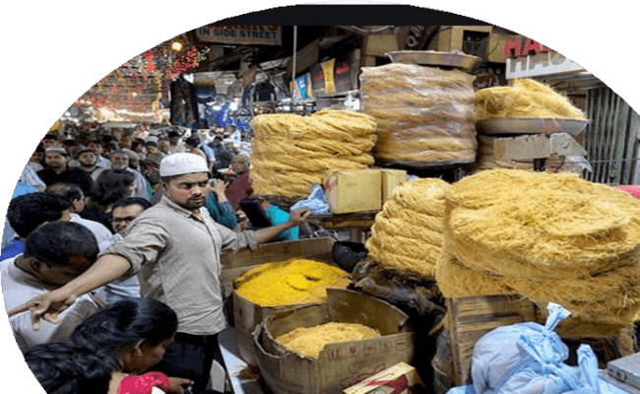

For he satisfies the thirsty
and fills the hungry with good things. Psalm 107:9

Slide 9
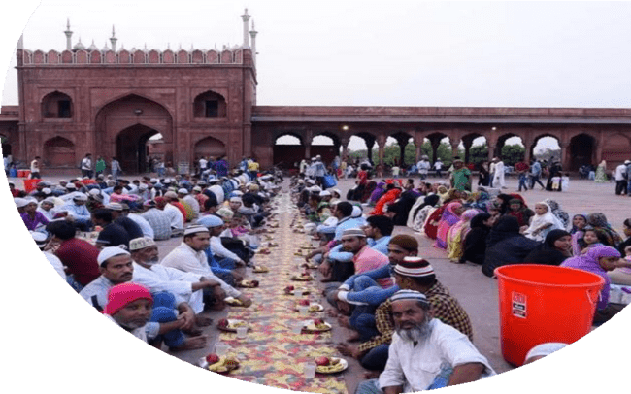
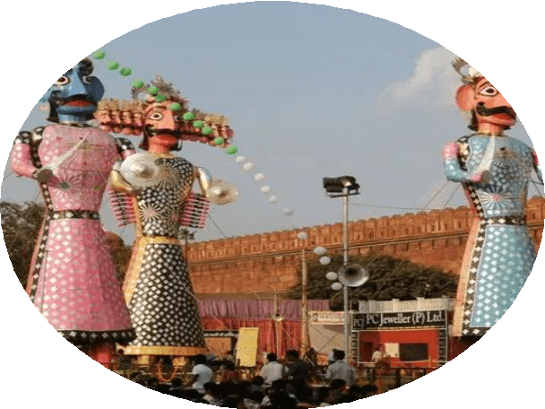

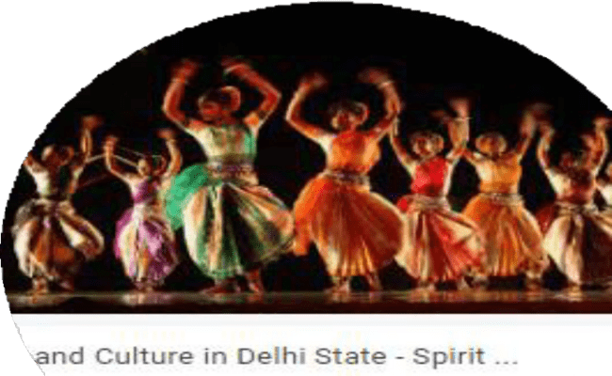
DELHI CULTURE
Delhi has communities from different regions of the country, who introduced many festivals and fairs into Delhi's culture. Today, these festivals have become the basis of Delhi's culture. Guru Purab was brought in by Sikhs, Bengalis introduced Durga Puja to Delhi and so on.
Culture of Delhi includes festivals, art, paintings, embroidery, jewelery, handicrafts, cuisine, religion and sports. Delhi, being the capital of India, is the land of festivals and celebrations.

Slide 10





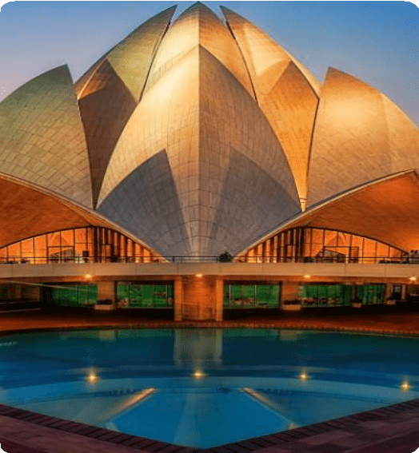
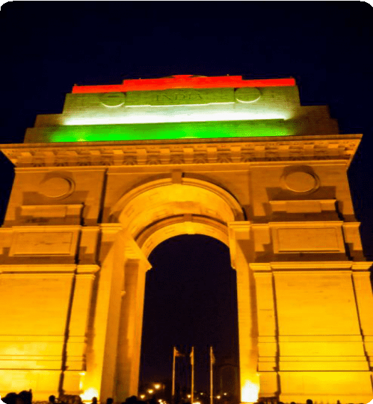
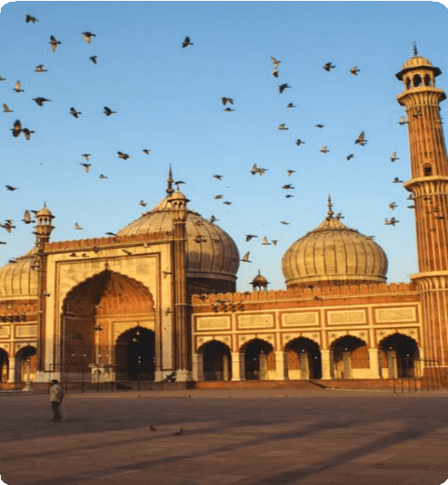
LOTUS TEMPLE
INDIA GATE
JAMA MASJID
Unless the LORD builds the house, the builders labor in vain. Unless the LORD watches over the city, the guards stand watch in vain……Psalm 127:1

Slide 11
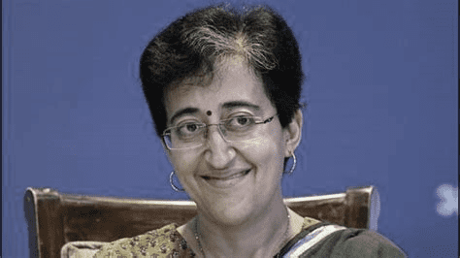
“You shall not revile God, nor curse a ruler of your people… Exodus 22:28
GOVERNMENT
Body | Government of Delhi
Lt. Governor | Anil Baijal, IAS
Chief Minister | Atishi (AAP)
Deputy Chief Minister | Manish Sisodia (AAP)
Legislature | Unicameral (70 seats)
Parliamentary Constituencies | Rajya Sabha (3 seats) Lok Sabha (7 seats)
POPULATION
Delhi's 2024 population is now estimated at 33,807,403. as per UN World Urbanization Prospects. These estimates represent the Urban agglomeration of Delhi, which typically includes Delhi's population in addition to adjacent suburban areas.

Slide 12
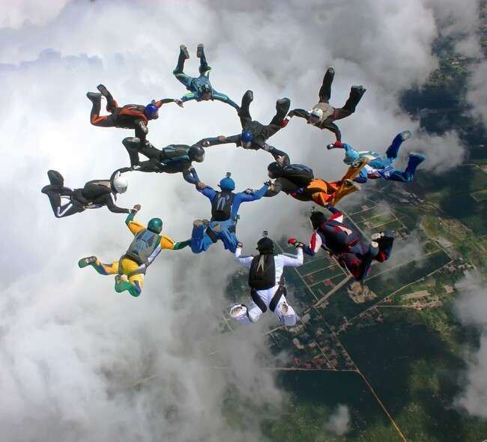
DELHI CORE TEAM
Speaker : Sol. Jasmine James
Deputy Speaker : Sol. Mahesh
Coodinator : Sol. Shobha
Secretary (S.P.)- Sol. Neha
Secretary (G.S.) – Sol. Renu

Slide 13
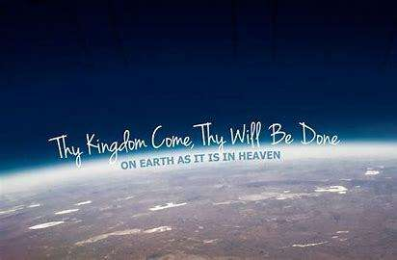

Slide 14

Shadow MPs | MPs | CONSTITUENCIES
Sol. Amarjeet | Mr. Bansuri Swaraj | New Delhi
Sol. Rajwati | Mr. Harsh Malhotra | East Delhi
Sol. Shobha | Mr. Manoj Tiwari | North East Delhi
Sol. Mahesh Tanwar | Mr. Praveen Khandelwal | Chandni Chowk
Sol. Renu Solanki | Mr. Ramvir Singh Bidhuri | South Delhi
Sol. Pooja Masih | Mrs. Kamaljeet Sehrawat | West Delhi
Sol. Vimal Tirkey | Mr. Yogendra Chandelia | North West Delhi

Slide 15
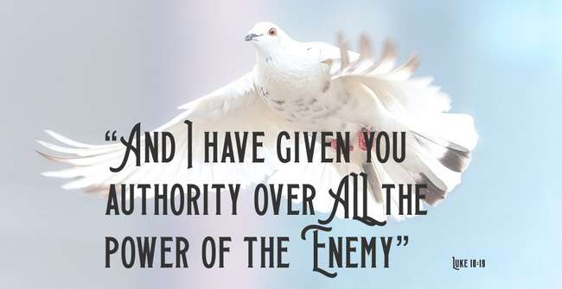
SMLA CONSTITUENCIES AND INCUMBENTS

Slide 17
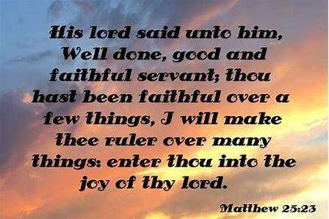
ARMY OF JESUS OPERATIONS

Slide 18

TROOP CHURCHES

Slide 19
MATTHEW TROOP CHURCH
Co-ordinator- Sol. Amarjeet
No. of Members: 12 +
Date: 27 Oct , 2024- 23 Dec, 2024 (5:30 am to 7:00 am every Sunday)

Slide 20
JACOB TROOP CHURCH
Co-ordinator- Sol. Amarjeet
No. of Members: 10 +
Date: 29 Dec , 2024- Continuing (5:30 am to 7:00 am every Saturday)

Slide 21
MARK TROOP CHURCH
Co-ordinator- Sol. Ishika
No. of Members: 8 +
Date: 18 Nov , 2024- Continuing(7:00 pm to 9 pm every Monday)

Slide 22
BETHEL TROOP CHURCH
Co-ordinator- Sol. Neha
No. of Members: 10
Date: 17 Nov , 2024- Continuing (7:00 pm to 9 pm every Sunday)

Slide 23
MORNING PRAISE AND WORSHIP
With the grace of God and towards fulfilment of vision of God, the Capital of India, Delhi started morning worship constituency wise.
Joseph Group (4 Constituencies of Delhi and Chandigarh) led by Sol. Jasmine and Sol. Amarjeet
Hosanna Group (West Delhi Constituency) led by Sol. Renu Solanki
MORNING WORSHIP CONTINUED MONDAY TO FRIDAY FROM 5:30 AM TO 7 AM IN THE MONTH OF DECEMBER, 2024

Slide 24
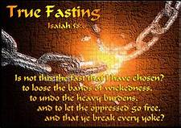
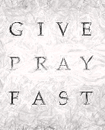
FASTING PRAYER
FASTING PRAYER CONDUCTED WITH ALL THE 9 STATES OF NORTH REGION TOGETHER ON EVERY FRIDAY OF DECEMBER, 2024 FROM 6-7 PM

Slide 25

24 HOURS ONLINE WORSHIP
(EVERY SUNDAY)
Co-ordinator: Sol. Ajay Pal
Online Worship is continuing in Delhi also alongwith all the 9 States of North Zone every Sunday.
Praise God

Slide 26
FULLNESS IN CHRIST 100 DAYS BIBLE COLLEGE
Started from 20th Nov, 2024
Delhi students –
Sol. Jasmine
Sol. Neha
Sol. Shobha
Sol. Preeti
Sol. Anandi &
Sol. Vimal

Slide 27
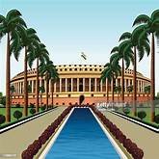
SHADOW PARLIE MEETING
December 31, 2024
7:00 pm to 8:00 pm

Slide 28



COUNTRIES ADOPTED BY DELHI
In the Enlarge my border meeting (EMB) held in Chennai in the month of November, 2021, as part of God’s plan, every State adopted one or more countries to preach the unadulterated word through Troop Churches, Morning Worship and Gift Schools. Accordingly the State of Delhi has adopted 2 countries- Poland and Saudi Arabia.
We are praying to God to open the doors to fulfill this vision.

Slide 29
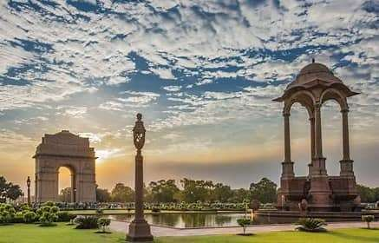
For we live by faith, not by sight.
2 Corinthians 5:7

Slide 30
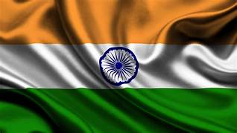
PRAISE GOD FOR HIS MIGHTY DEEDS IN THE CAPITAL OF INDIA !!!
OUR PRAYERS ARE CONTINUALLY BEING ANSWERED IN JESUS MIGHTY NAME.
aMEN !!!

