Slide 1
Praise the Lord

Slide 2
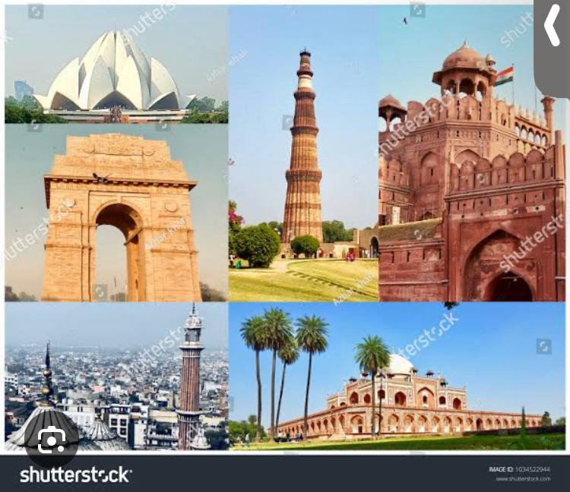
DELHI
Capital of India

Slide 3
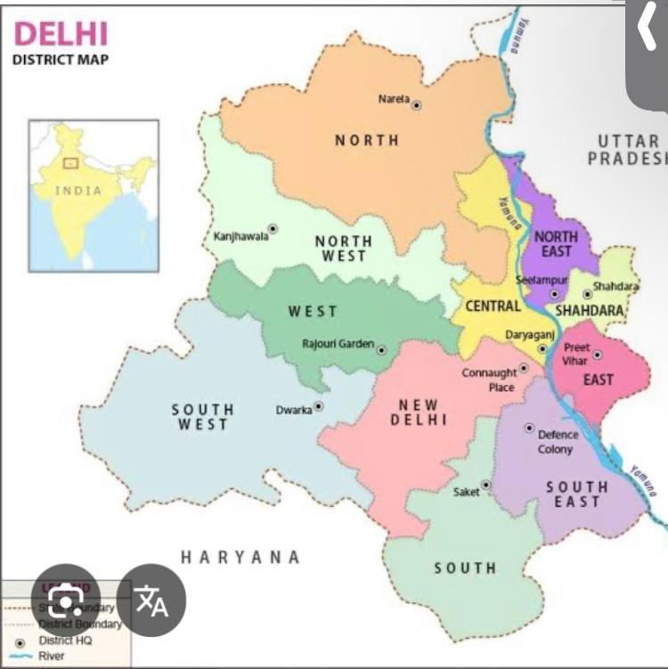

Slide 4
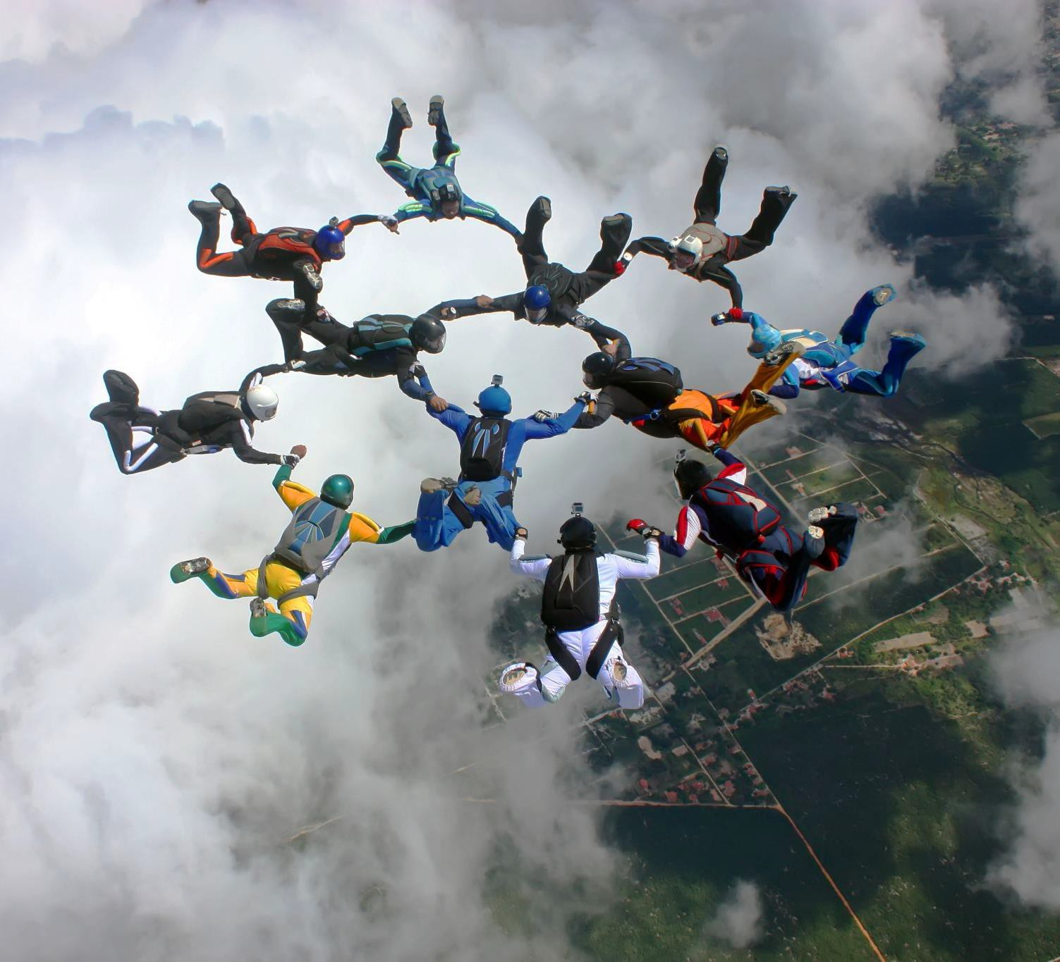
DELHI CORE TEAM
January, 2025 to June, 2025
Speaker : Sol. Jasmine James
Deputy Speaker : Sol. Amarjeet
Secretary (S.P.)- Sol. Bharat
Coodinator : Sol. Renu Solanki
Secretary (G.S.) – Shobha

Slide 5

Shadow MPs | MPs | CONSTITUENCIES
Sol. Amarjeet |  | New Delhi
Sol. Rajwati |  | East Delhi
Sol. Shobha |  | North East Delhi
Sol. Mahesh Tanwar |  | Chandni Chowk
Sol. Renu Solanki |  | South Delhi
Sol. Poonam |  | West Delhi
Sol. Vimal Tirkey |  | North West Delhi

Slide 6
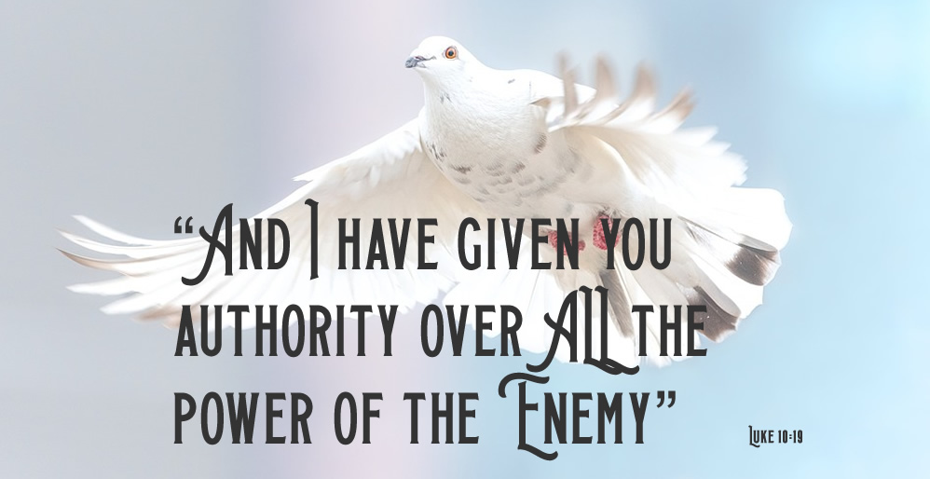
SMLA CONSTITUENCIES AND INCUMBENTS

Slide 7
S. No. | Name of SMLA | Contact No. | Constituencies Total 70
1. | Sol. Sunita Tanwar | 8130447173 | Karol Bagh
2. | Sol. Harjeet Singh |  | Patel Nagar
3. | Sol. Mahender Singh |  | Moti Nagar
4. | Sol. Sunny Mathai | 9425743585 | Delhi Cantt
5. | Sol. Renu Solanki | 9818905061 | Rajender Nagar
6. | Sol. Jasmine James | 9868335140 | New Delhi
7. | Sol. Poonam Singh |  | Kasturba Nagar
8. | Sol. |  | Malviya Nagar
9. | Sol. Kala | 9315234454 | R.K. Puram
10. | Sol. Neha | 9560058874 | Greater Kailash
11. | Sol. Nita Devi | 7982301108 | Bijwasan
12. | Sol. Sarita Winston | 8287899492 | Palam
13. | Sol. Harish Arora |  | Mehrauli
14. | So. Sam Sharma |  | Chhatarpur
15. | Sol. Satpal |  | Deoli
16. |  |  | Ambedkar Nagara
17. | Sol. Anandi |  | Sangam Vihar
S. No. | Name of SMLA | Contact No. | Constituencies Total 70
18. | Sol. P.V. John |  | Kalkaji
19. | Sol. Priti | 9811645937 | Tughalkabad
20. | Sol. Ashwini | 9811645937 | Badarpur
21. | Sol. Rajwati |  | Jangpura
22. |  |  | Okhla
23. |  |  | Trilokpuri
24. |  |  | Kondli
25. |  |  | Patparganj
26. |  |  | Laxmi Nagar
27. |  |  | Vishwas Nagar
28. |  |  | Krishna Nagar
29. |  |  | Gandhi Nagar
30. |  |  | Shahdara
31. |  |  | Adarsh Nagar
32. |  |  | Shalimar Bagh
33. | Sol. Harjeet | 7428867135 | Shakur Basti
34. |  |  | Tri Nagar

Slide 8
S. No. | Name of SMLA | Contact No. | Constituencies Total 70
35. |  |  | Wazirpur
36. |  |  | Model Town
37. | Sol. Manju |  | Sadar Bazar
38. | Sol. Mahesh Tanwar | 9873107668 | Chandni Chowk
39. |  |  | Matia Mahal
40. |  |  | Ballimaran
41. | Sol. Jai Prakash |  | Burari
42. |  |  | Timarpur
43. |  |  | Seemapuri
44. |  |  | Rohtas Nagar
45. |  |  | Seelampur
46. |  |  | Ghonda
47. |  |  | Babarpur
48. |  |  | Gokalpur
49. | Sol. Kavita | 7060131490 | Mustafabad
50. |  |  | Karawal Nagar
51. | Sol. Bharat Raikwar | 9999590338 | Narela
52. |  |  | Badli
S. No. | Name of SMLA | Contact No. | Constituencies Total 70
53. |  |  | Rithala
54. |  |  | Bawana
55. |  |  | Mundka
56. |  |  | Kirari
57. |  |  | Sultanpur Majra
58. | Sol. Deepak Kumar | 9540903575 | Nangloi
59. |  |  | Mangol Puri
60. |  |  | Rohini
61. |  |  | Madipur
62. |  |  | Rajouri Garden
63. |  |  | Hari Nagar
64. | Sol. Kusumlata | 9675119867 | Tilak Nagar
65. | Sol. Vimal | 8383093643 | Janakpuri
66. | Sol. Sushma Masih | 9582982654 | Vikaspuri
67. | Sol. Sakshi | 9319873754 | Uttam Nagar
68. | Sol. Mary |  | Dwarka
69. | Sol. Shobha | 9780866917 | Matiala
70. | Sol. Pooja Masih | 9958086534 | Najafgarh

Slide 9
MORNING PRAISE AND WORSHIP
Joseph Group
Hosanna Group
MORNING WORSHIP CONTINUES MONDAY TO FRIDAY FROM 5:30 AM TO 7 AM

Slide 10
MORNING WORSHIP TESTIMONIES
Sol. Mary has been healed from the pain in her leg pain.
Sol. Mary is growing spiritually by the grace of God. She is now able to give Morning message in Hindi Language as she was unable to read Hindi. A special thanks to Jesus.
Sol. Renu could undertake her international trip by the Grace of Jesus which was impossible for her. But Jesus shows his Glory to Jesus.

Slide 11
PRAISE THE LORD!
MORNING WORSHIP TESTIMONIES
New Soldiers have joined in the morning worship and they are actively participating in all duties.

Slide 12
PRAISE THE LORD!
MARK TROOP CHURCH
(OFFLINE) (EVERY MONDAY) Continuing since 6th December, 2024) TIME - 6:00 PM
TROOP LEADER -SOL. ISHIKAA KAUR
S. No. | Name of new Soldiers
1 | Anjali
2 | Rishu
3 | Harman
4 | Sahil
5 | Esther
6 | Lata
7 | Surjeet
8 | Harjeet Singh
9 | Rohit Balyan
TESTIMONIES
Sis Lata got healed
Lata Sisters daughter (was at home only did not accompany her mother) who was demon possessed got delivered.
Sol Ishikaa who was delaying the decision got baptised
ALL GLORY HONOUR PRAISE TO GOD! HALLELUJAH!

Slide 13
PRAISE THE LORD!
MATHEW TROOP CHURCH
(ONLINE) (EVERY SUNDAY) FROM 3 RD NOVEMBER TO 22ND DECEMBER 2024 TIME - 5.30 AM TO 7.30 AM)
TROOP LEADER -SOL AMARJEET KAUR Members - 10-12
ESTIMONIES
Preeti Sisters younger Sister Neha was distanced from her husband and had been staying in her parental home with her mother. When prayed for in the Troop her husband Sagar came back and took her back home. They got reconciled by Gods Grace.
ii) Rajwati Sisters granddaughter Nehas marriage conducted nicely and all arrangements made by Gods Grace.
ALL GLORY HONOUR PRAISE TO GOD! HALLELUJAH!

Slide 14
PRAISE THE LORD!
JACOB TROOP CHURCH
( ONLINE) ( EVERY SATURDAY) FROM 28 TH DECEMBER, 2024 TIME – 5:30 AM TO 7:30 AM
TROOP LEADER -SOL AMARJEET KAUR MEMBERS- 14-15
Ongoing by Gods Grace
ALL GLORY HONOUR & PRAISE TO GOD! HALLELUJAH!

Slide 15
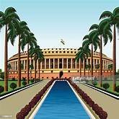
SHADOW PARLI MEETING
JANUARY 25, 2025
5:30 AM to 7:00 AM
It was a wonderful meeting with 18 SMPs/SMLAs. And 6 new SMLAs have joined Delhi AOJ Team.

Slide 16
PRAISE THE LORD
“Do you not know that those who run in a race all run, but one receives the prize? Run in such a way that you may obtain it.”‭‭I Corinthians‬ ‭9‬:‭24‬ ‭NKJV‬‬
The following six new Soldiers were administered oath today ie on 25 th January, 2025 in the Delhi State Shadow Parli meeting.
1 Sol. Mahender Singh
2 Sol. Poonam Singh
3 Sol. Harish Arora
4 Sol. Sol. PV John
5 Sol. Sam Sharma
6. Sol. Satpal
By Gods Grace all the Delhi SMPs/ SMLAs are now very active and are in the race to win ( 1 Corinthians 9:24-27) have become true fishers of men.
( Mathew 4:19&20)
Amen

Slide 17
PRAISE THE LORD! HEAVENLY APPEAL - SHADOW PARLI MEETING 25.1.2025 - Total prohibition on sale purchase and consumption of alcohol , drugs, pan, tobacco, cigarettes/ beedis and gutka. All the SMPs and SMLAs of Delhi AOJ confessed & repented for allowing easy access to young and old alike to such intoxicating addictive substances in Delhi.

Slide 18
Family Building School classes will be conducted after FC-3 classes for strengthening family bonds.
Friday Night Prayer will be Re-started.

Slide 19
DELHI CIVIL ADMINISTRATION DEVELOPMENT UPDATES IN JANUARY 2025

Slide 20
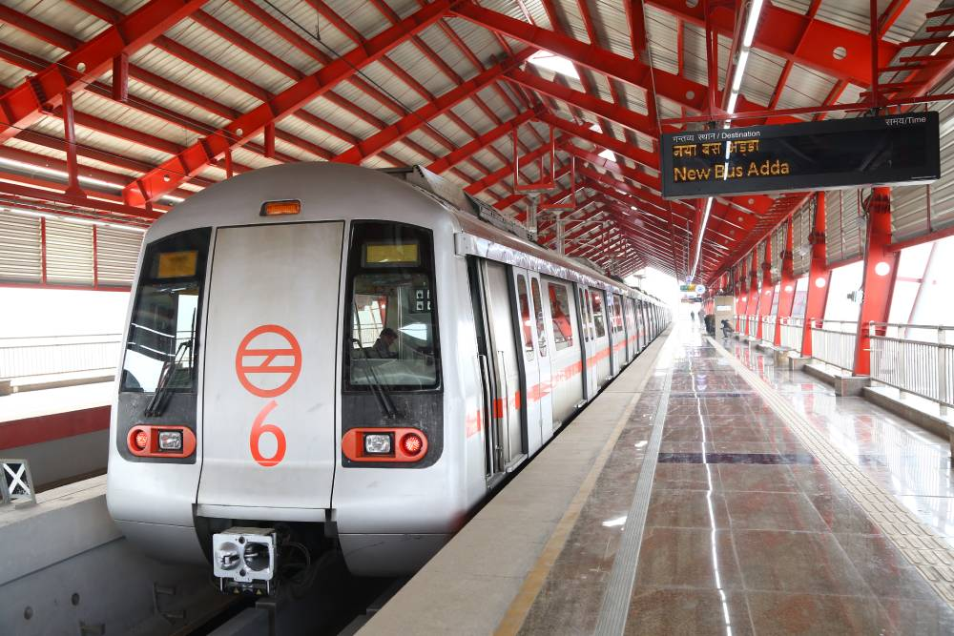
WHEEL WING MEETING GENERAL
PRAISE REPORT 05.02.2025
रिठाला-कुंडली मेट्रो कॉरिडोर पकड़ेगा रफ्तार, नरेला का होगा विकास; 20 साल से था इंतजार
Testimony of Sol. Bharat Raikwar SMLA Narela constituency

Slide 21
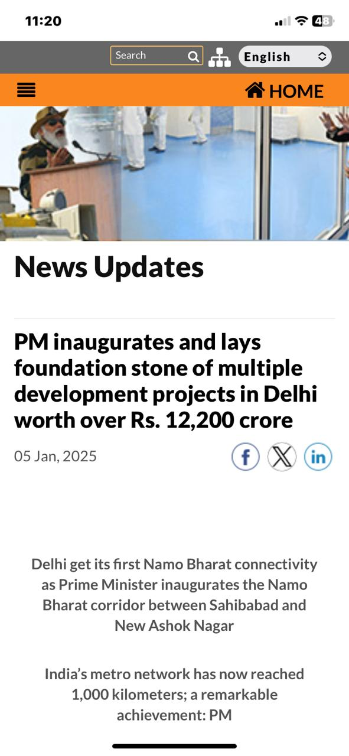

Slide 22
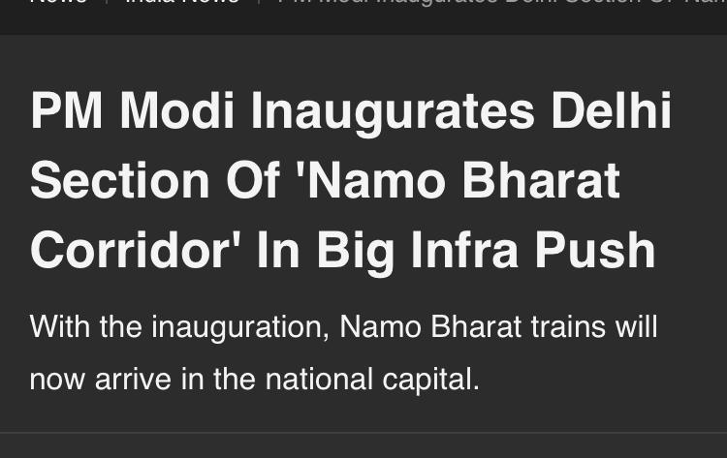
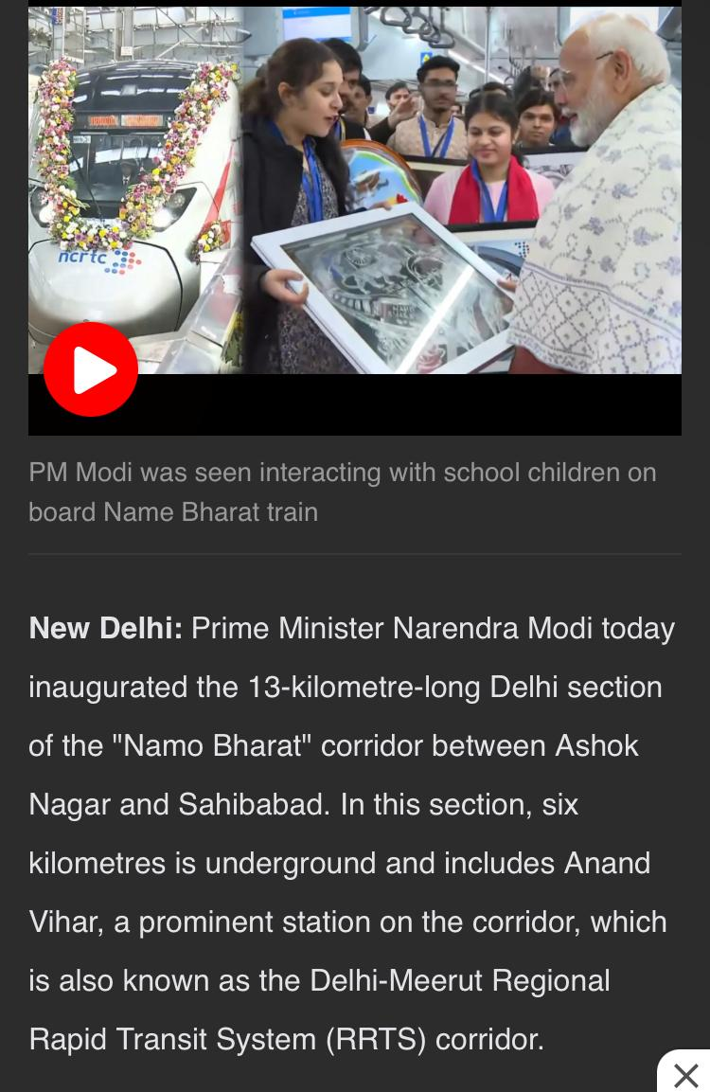
Prime Minister Narendra modi inaugurates the Namo Bharat corridor between Sahibabad and New Ashok Nagar

Slide 23
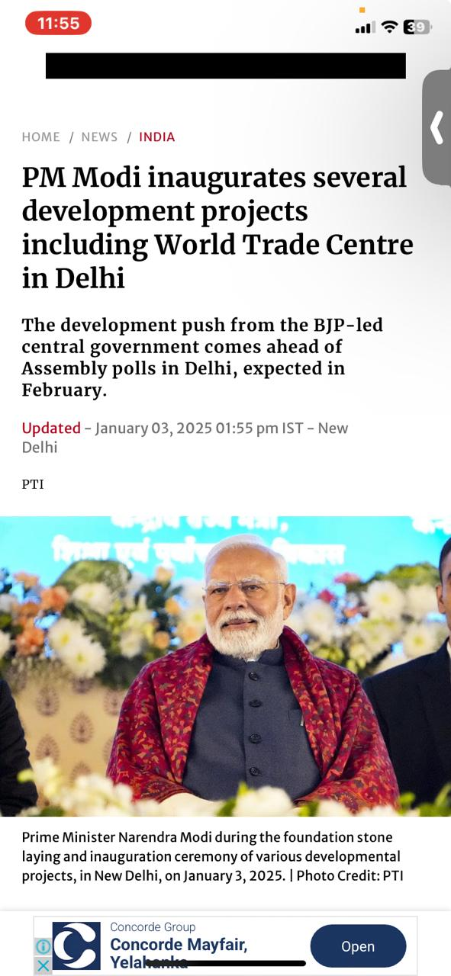

Slide 24
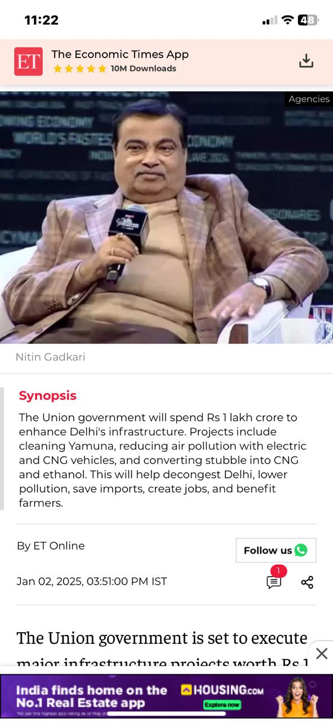

Slide 25
Praise the Lord! God answered our prayers for Delhi’s suffocating air pollution.

Slide 26
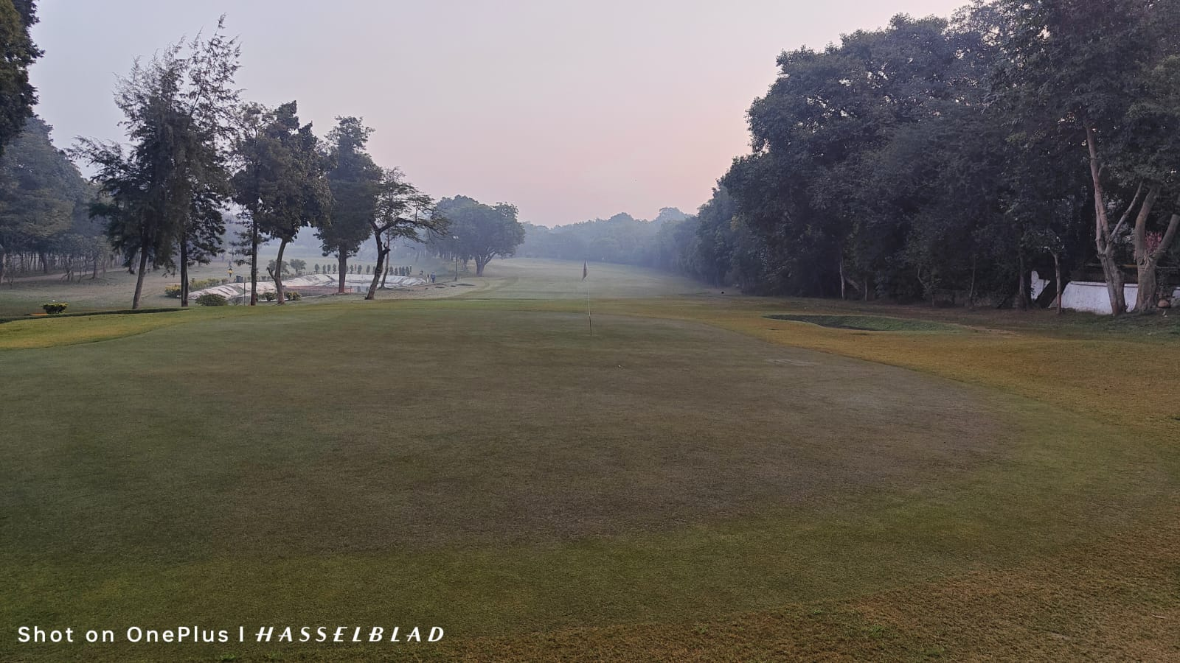
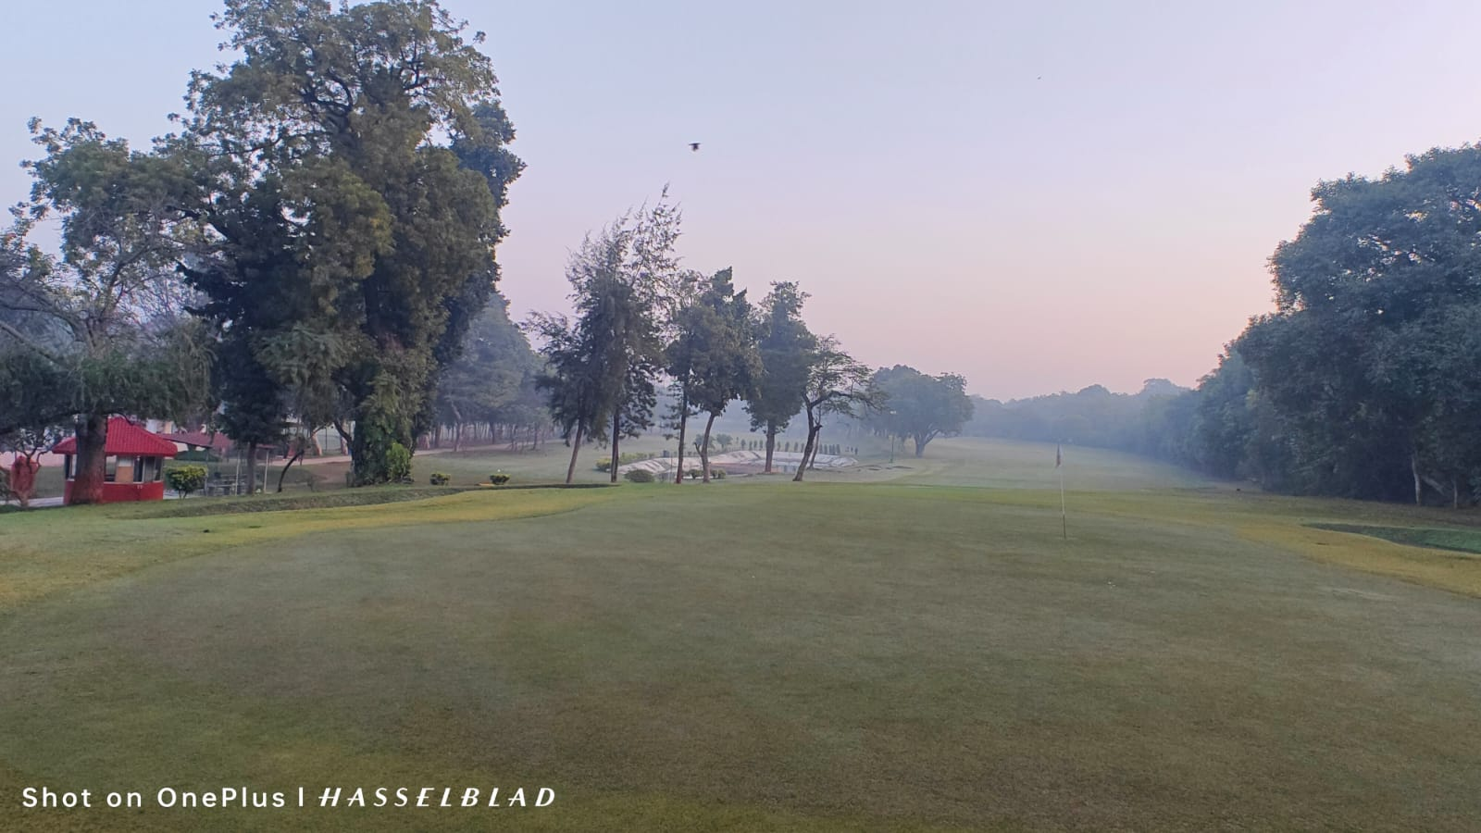
God is shining on Delhi. No fog smog. Report from one real Army Colonel Rajeev Avid golfer.

Slide 27
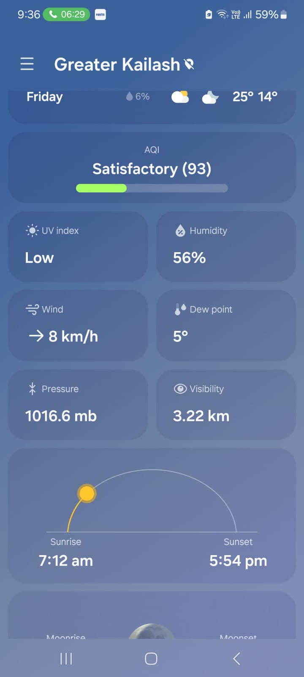
Praise the Lord! God answered our prayers for clearing Delhi’s suffocating air pollution.

Slide 28

PRAISE GOD FOR HIS MIGHTY DEEDS IN THE CAPITAL OF INDIA !!!
OUR PRAYERS ARE CONTINUALLY BEING ANSWERED IN JESUS MIGHTY NAME.
aMEN !!!

